Slide 1

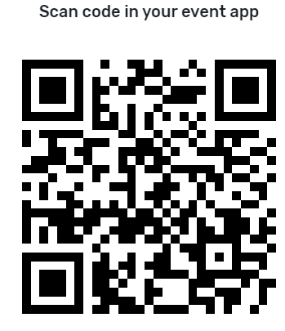

Pink 3.1
Empowering Extension with AI: The ExtensionBot Project
ojQlsfD8

Slide 2


Empowering Extension with AI
The ExtensionBot Project
Notes:
Intro myself and my background

Slide 3

Notes:
A member-based nonprofit established by Extension Directors and Administrators nationwide that is an integral part of the Cooperative Extension System.
The Foundation helps Cooperative Extension professionals make a more measurable and visible impact on local issues.

Slide 4

Poll
Have you used any of the major LLM chatbots for an important task recently?
Tried ExtensionBot in the last 30 days?
Notes:
Please give me a show of hands for frequently? How about occasionally?

Slide 5
Extension Bot FAQs
Who’s behind it? | The Extension Foundation working with Eduworks and LGU partners. Funded by the NTAE grant from USDA-NIFA.
Governance? | An AI Advisory Board from member institutions and the Extension Foundation
Audience? | Extension Educators, volunteers and the public in all areas of Extension
Topical areas? | Any Extension relevant question
Project Status | Beta release is working well and available
Cost to Use ExtensionBot | Free to any Extension Service
Participating Extension Services | Twenty-two thus far, another three in the queue
Notes:
ExtensionBot is an AI chatbot using an LLM, is also a data gathering services, AI Advisory Committee currently composed of first 5 extension services – Oregon, Oklahoma, Florida, Georgia, Kentucky

Slide 6
In the beginning…
2,000,000,000
8
112
50,000
500,000
Google searches daily (US)
Hours average daily screen time
Extension services
Ask Extension questions annually
Ask Extension questions in database
Notes:
SERP screens are inundated with commercial oriented links. Emerging AI search “answers” rely on content from many sources, not necessarily fact-based, 112 Extension Services – all publishing content
Extension content often hard to find, even on Extension sites
We assembled a committee from 11 Extension Services

Slide 7
Trustworthy Answers,
On Demand
AI chatbot
Shared data
Localized and deployed locally
Notes:
People are online and want immediate and trustworthy answers

Slide 8

Guiding Principles
Serve as a way to connect into Extension
Localized and configurable
Respect privacy of users
Cite sources
Respect provenance, ownership, and attribution of resources
Content/data should be updated frequently
Reporting for participants
Leverage open-source tools (where feasible)
Accurate (limited hallucinations)
Notes:
A committee with representation from eleven Extension Services defined requirements and guidelines

Slide 9
Use cases
Augmenting Extension Educators and volunteers
Answering questions from the public
Supporting Ag Producers with complex questions*
Notes:
We thought about what problems and audiences a chatbot could help with, in order of difficulty. Ag producers questions will need deterministic capabilities as well as probabilistic, also need image recognition and integration with other data sources such as market data

Slide 10
Benefits
Immediate answers 24/7/365
Scalable for crises/hot topics
Offload basic question-answering
Surfacing “hidden” Extension content
Data gathering and insights
Notes:
This will be expected by the public soon, people will go elsewhere if we don’t meet this need. AI has fastest adoption of a technology ever, more than search

Slide 11
Ethical Considerations and Risks for Extension
Biased training data and/or biased algorithms could lead to biased outputs
Ethical considerations such as transparency, accountability and social responsibility
What happens to those whose jobs are displaced
Source: Hill, P. A., & Narine, L. K. (2023). Ensuring Responsible and Transparent Use of Generative AI in Extension.

Slide 12
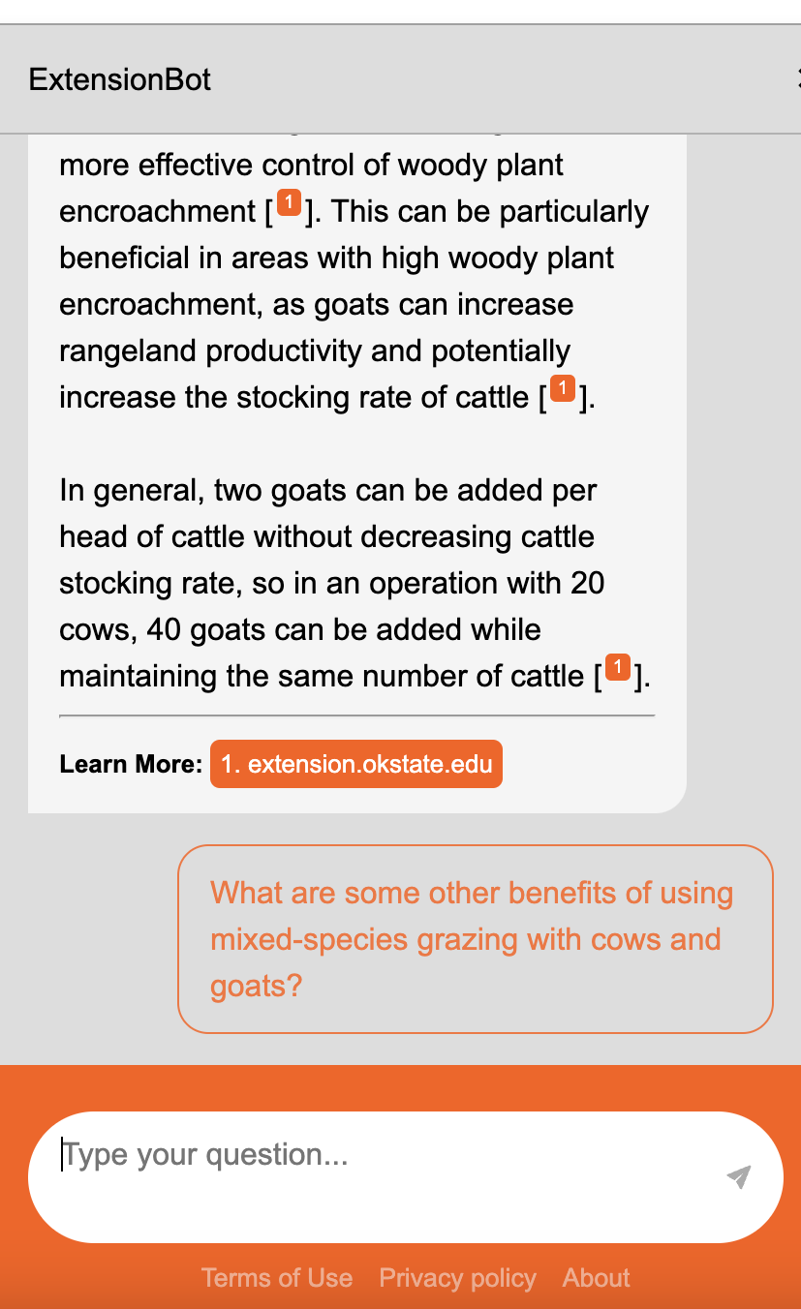
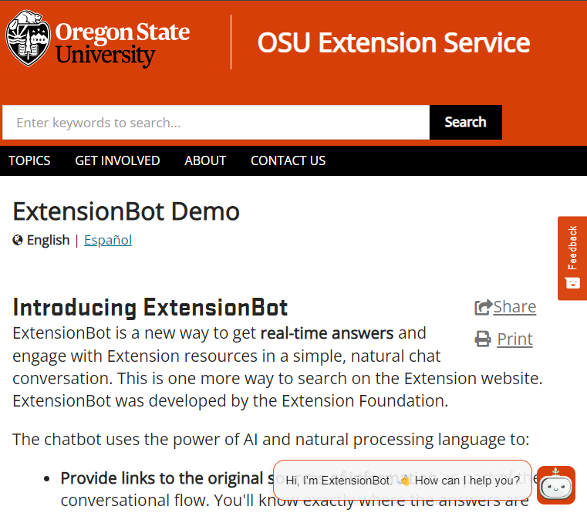
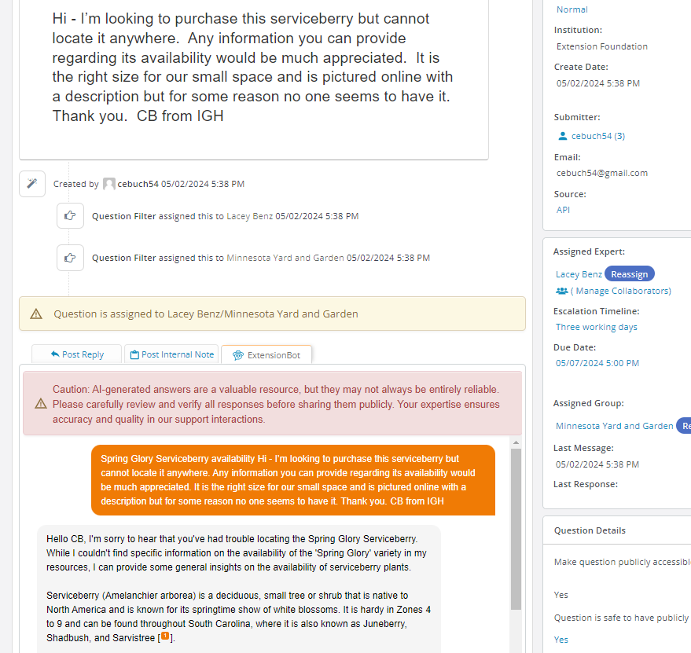
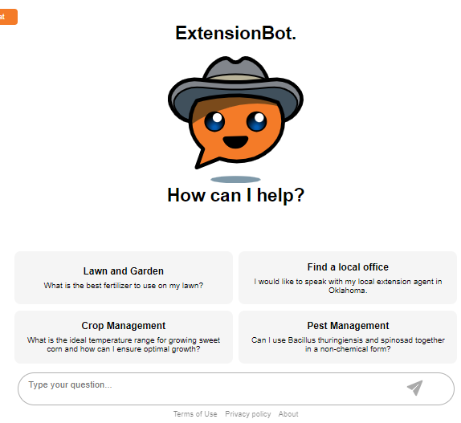
ExtensionBot Interfaces
Notes:
Full page, widget, inside Ask Extension to aid experts, working on a Facebook Messenger version, all configurable for branding purposes, others such as SMS, mobile SDK and other social platforms possible in the future

Slide 13
Front-end implementation
Two versions – full screen and slide-out widget
Embedded JS code
Configuration options – ability to downweight sources and resources
  "client": "general",
  "search_size": 100,
  "list_of_states": [],
  "state_downweight": 0.99,
  "source_downweight": 0.99,
  "cut_off": 0.8,
  "max_return_amount": 10
See example at https://askhelp.extension.org/
More details at https://extension.org/extbot/

Slide 14
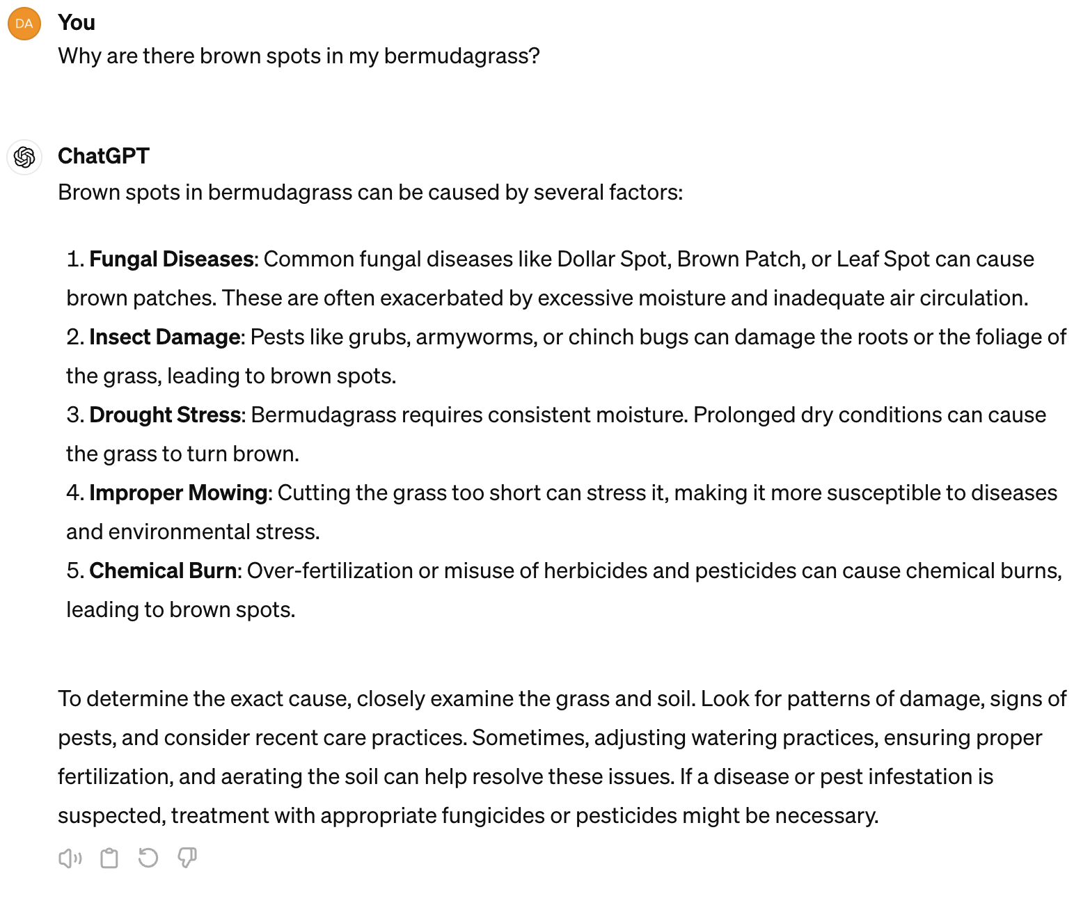
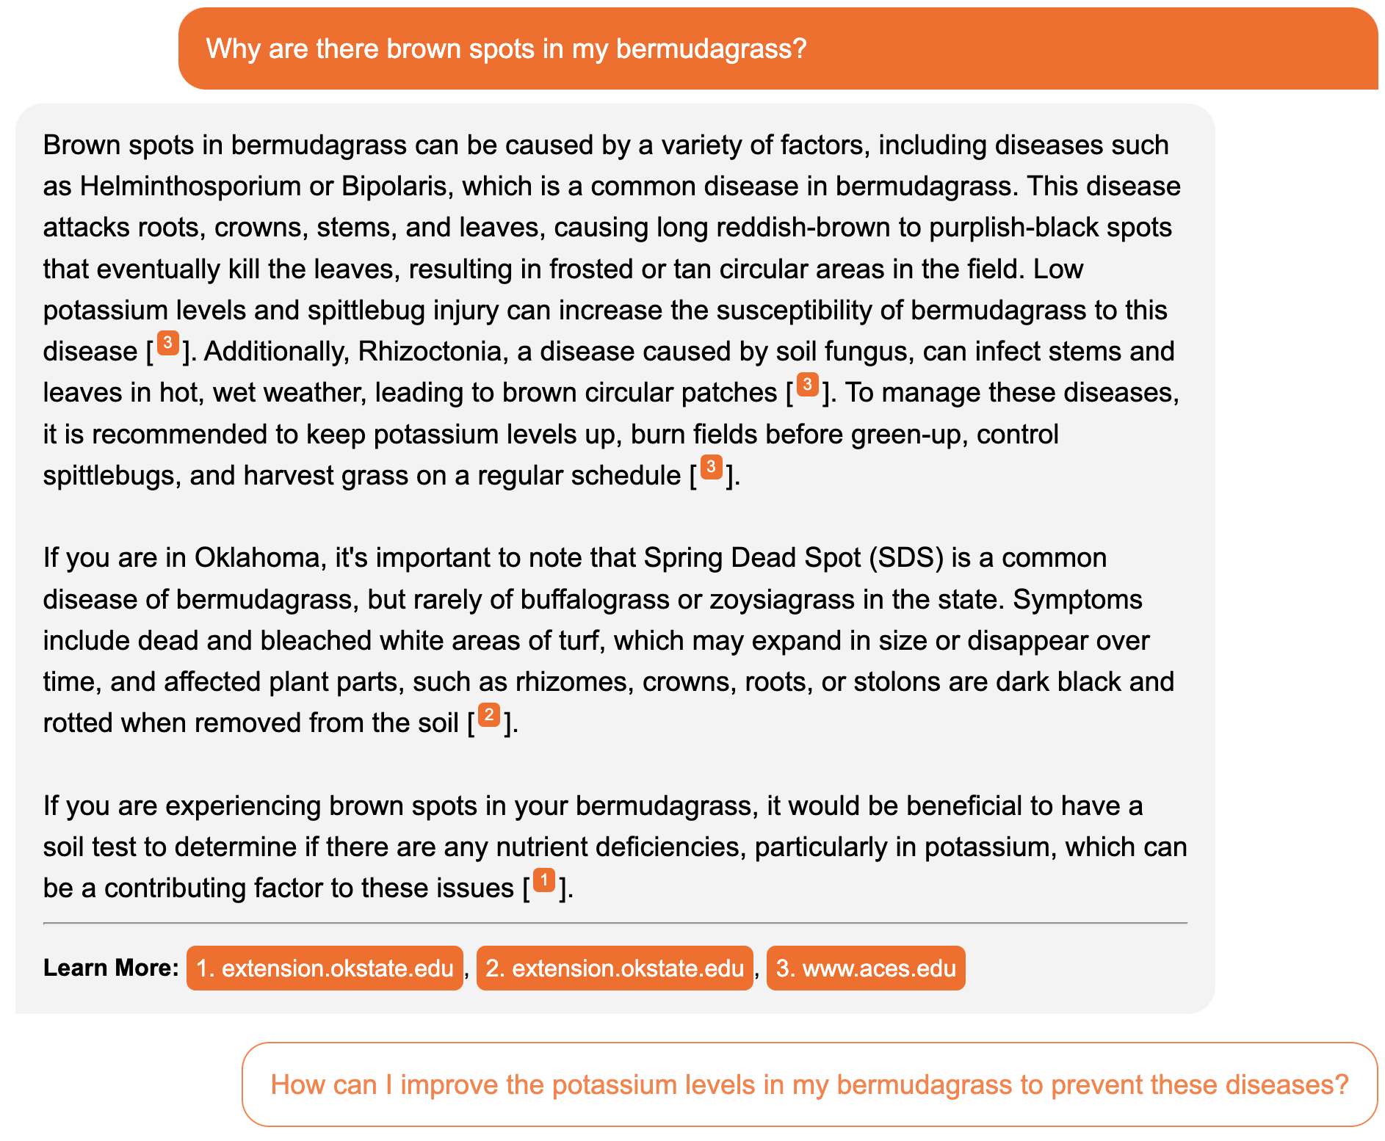
ChatGPT 4
ExtensionBot
References
Localization
Answer reflects Extension
Reference links
Follow up question
Notes:
Take a look at these two answers, what do you think? I’ll give you a little time. ChatGPT uses more basic language and is good at breaking its answers up into bullets. ExtensionBot uses more complex terms and in this case provides an ag oriented answer (also works for lawn) reflecting it’s source material. Two key metrics for machine learning quality are precision (accuracy/correctness) and recall (comprehensiveness). The arrows point out differences in Extensionbot. GPT4 also takes WAY more processing power than Mistral

Slide 15
ExtensionBot - Data Ingestion
Data Inputs
Divides large texts into chunks small enough for max context length of both models
Vectorizes each text chunk using “mean pooling” approach.
HTML
PDF
Qdrant
(Vector DB)
Reformatting
Doc-based Chunking
Embedding Model
JSON
Credit: Jeff Yarbro
Notes:
Brace yourself – 2 technical slides coming. In simpler terms, it's about transforming pieces of text into numbers by averaging the numbers representing individual words, making it easier for the AI to process and understand the text.

Slide 16
ExtensionBot Architecture
Based on a Retrieval-Augmented Generation (RAG) approach to provide citable references and avoid hallucinations.
RAG Pipeline
Qdrant
(Vector DB)
Embedding Model
Vector
Dashboard
API
Logging DB
Query
Similarity Search Results
Chat Logs
Query Transformation
Query
Query
OS Rasa
Query
Front End UI/UX
Reranking
LLM
Answer
Answer
Results
Credit: Jeff Yarbro

Slide 17
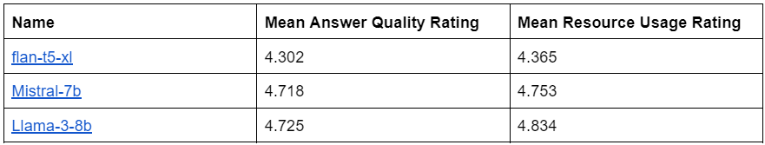
ExtensionBot LLM Performance Metrics
Notes:
Our architecture allows us to swap out LLMs easily.
We use GPT-4-turbo to evaluate fine-tuned models.
Mean resource usage – higher means more GPU, CPU, power, memory, etc

Slide 18

What have we learned?
More data = better results
Fact-based approach minimizes hallucinations
Obtaining data is hard
Localization is vital
AI technology is changing very rapidly
GPU’s are expensive

Slide 19

Roadmap
New LLM
Grow participation
Automate data gathering
More content types
Handling deterministic questions
Image recognition
Other interfaces
More connection between chatbot and Extension personnel
Funding
Image credit: DALL-E 3

Slide 20
Questions?
Notes:
Pause for questions

Slide 21
Links
ExtensionBot
https://extension.org/chat/
https://extension.org/extensionbot-v2
https://extension.org/tools/extbot/
https://extension.okstate.edu/extensionbot/
https://extension.okstate.edu/fact-sheets/blackleg-of-canola.html
Commercial LLMs
Claude https://claude.ai/chats
ChatGPT https://chat.openai.com/
Google Gemini https://gemini.google.com/app
Microsoft Copilot https://copilot.microsoft.com/
Perplexity https://www.perplexity.ai/

Slide 22
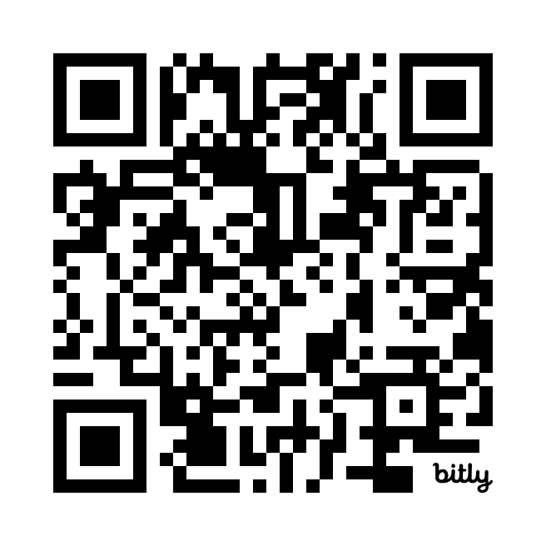
Thank you!
Contacts
marklocklear@extension.org
davidwarren@extension.org

Slide 23
Bonus slides past here

Slide 24
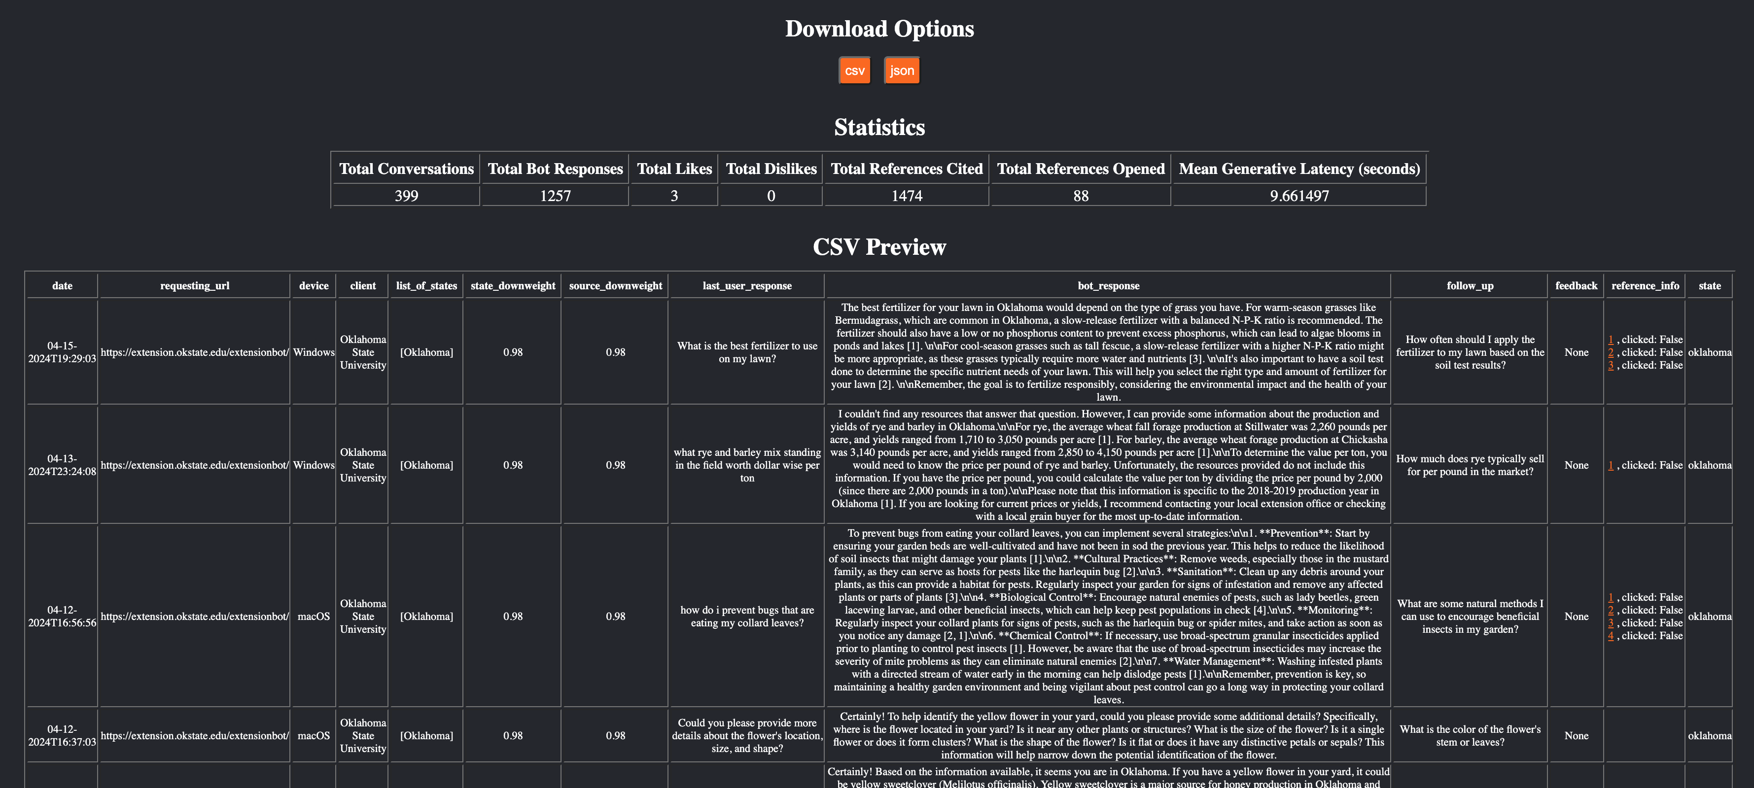
Reporting Dashboard

Slide 25
Implications of Generative AI on Extension
Increased efficiency
Job displacement
Improved education via AI augmentation of teaching
Ethical considerations, transparency and risk management
Funding to invest in AI (personnel, technology, education) to remain relevant
Existential threat to the Extension Service? Probably not, but AI will force change
Source: Hill, P. A., & Narine, L. K. (2023). Ensuring Responsible and Transparent Use of Generative AI in Extension.
Notes:
Repetitive and basic administrative tasks that don’t require substantial judgement will be automated

Slide 26

Extension Bot - Trustworthy by Design
A fact-based network to minimize hallucinations
Only content from Extension Services
More Extension Services = better answers
Notes:
Training - Training a model simply means learning (determining) good values from from labeled examples.

Slide 27

Recommended Reading
Emeritus Institute of Management (2023). The Ultimate Reading List of the 10 Best Books on AI.
https://emeritus.org/blog/best-books-on-ai/
Ferrer, Josep. How Transformers Work: A Detailed Exploration of Transformer Architecture. https://www.datacamp.com/tutorial/how-transformers-work
Hill, P. A., & Narine, L. K. (2023). Ensuring Responsible and Transparent Use of Generative AI in Extension. The Journal of Extension, 61(2), Article 13. https://doi.org/10.34068/joe.61.02.13
World Economic Forum & Accenture (2023). Jobs of Tomorrow: Large Language Models and Jobs WHITE PAPER SEPTEMBER 2023. https://www3.weforum.org/docs/WEF_Jobs_of_Tomorrow_Generative_AI_2023.pdf
McKinsey and Company (2024). What is generative AI? https://www.mckinsey.com/featured-insights/mckinsey-explainers/what-is-generative-ai
MIT Open Learning (2023). What will the future of education look like in a world with generative AI?. https://openlearning.mit.edu/news/what-will-future-education-look-world-generative-ai
Glasswing Ventures (2024). The History of Artificial Intelligence. https://glasswing.vc/blog/thinking-corner/the-history-of-artificial-intelligence/
Stanford Human-Centered Artificial Intelligence Index Report 2024. https://hai.stanford.edu/research/ai-index-report
Scientific American, Lauren Leffer, April 5, 2024. AI Chatbots Will Never Stop Hallucinating. https://www.scientificamerican.com/article/chatbot-hallucinations-inevitable/
U.S. Government Services Administration Center of Excellence for IT Modernization. AI Guide for Government: A Living and Evolving Guide to the Application of Artificial Intelligence for the U.S. Federal Government https://coe.gsa.gov/coe/ai-guide-for-government/what-is-ai-key-terminology/

Slide 28
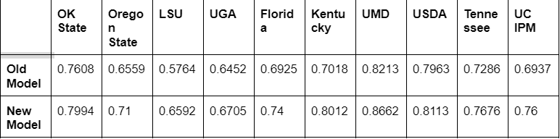
ExtensionBot Embedding Model Performance Metrics
The embedding model is trained on all chunks within the vector database.
For each chunk, we use an LLM (mixtral and GPT-4) to generate a natural question that the chunk answers. These questions are generated in different ways to increase variability.
We then measure top-5 accuracy for each question in a separate test set.

Slide 29
ExtensionBot Configuration Options
Institutions can choose where and how to make the chatbot available within their website.
  Insertion code has parameters to control the behavior and UI look
  Institutions can customize by:
    Updating theme colors and avatar/window attributes in the UI/UX
    Designating a home state & weighting
    Designating a list of other acceptable states with weighting
    Providing state office contact URL
All chatbot UIs are connected to the same chatbot backend
Credit: Deb Brown

Slide 30

About ExtensionBot
An Extension Foundation initiative
Partnering with LGU Extension Services
USDA-NIFA NTAE grant funding
Eduworks is development partner
A data gathering and integration service
An AI chatbot
This Photo by Unknown Author is licensed under CC BY-SA

Slide 31
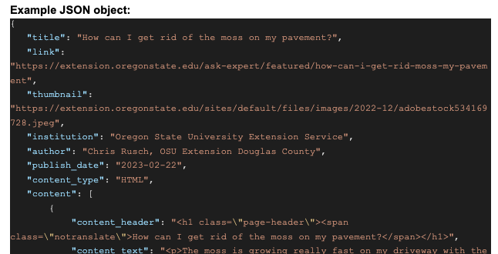

Slide 32
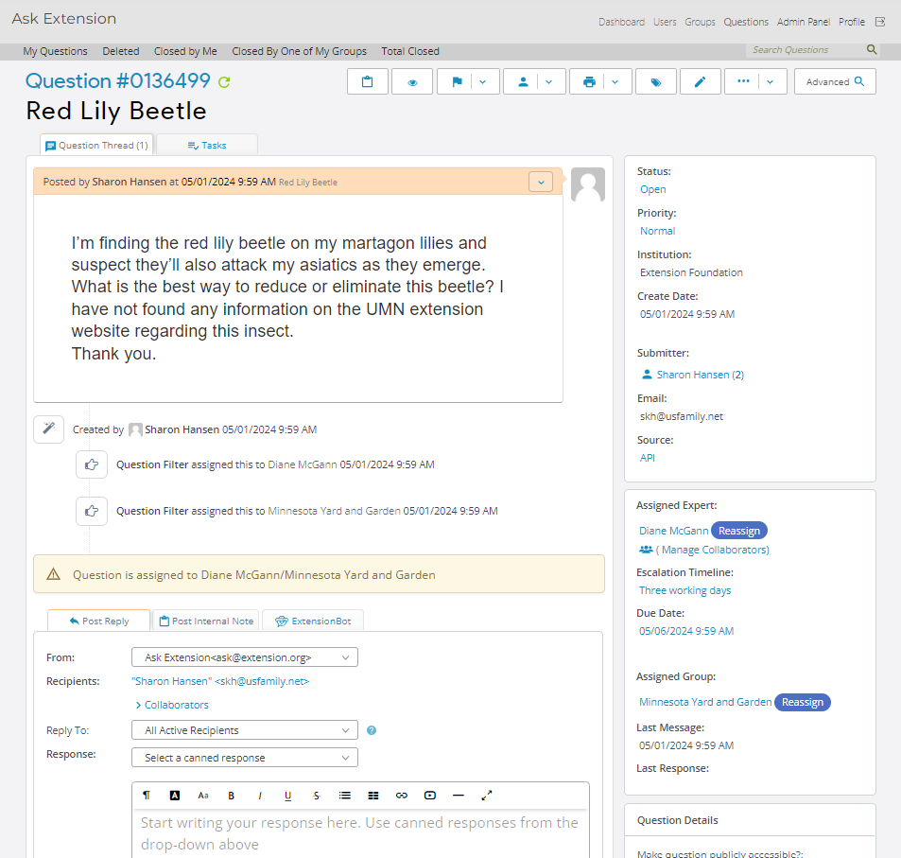
Ask Extension Application
Subject Matter Expert question answering system based on osTicket, customized for Extension Foundation
  Public Question-asking
  Institution-based SME answering
  Communications via web site and emails
  ask2.extension.org
  714,378 total questions answered
  by 30,942 SMEs
  in 1,147 groups, 83 institutions

Slide 33

About Me
David Warren is AI Program Leader at the Extension Foundation as well as Senior Director of Digital Strategies for the Oklahoma State University Division of Agriculture. He has two decades of global experience in both the public and private sectors.
David holds an MBA from Oklahoma State University and is an Adjunct Professor in the Business Analytics Program in the OSU Spears School of Business.
Notes:
Rules based systems are non-ML AI examples including NLP

Slide 34
How to start using ExtensionBot
Do you have a curated set of content?
Identify relevant data sources
Give us data via JSON format files that conforms to our specification
Should be publicly available content
Plan to update file regularly to avoid stale data
Alternatively – we are assisting some Extension Services via “scraping” their selected content

