Slide 1
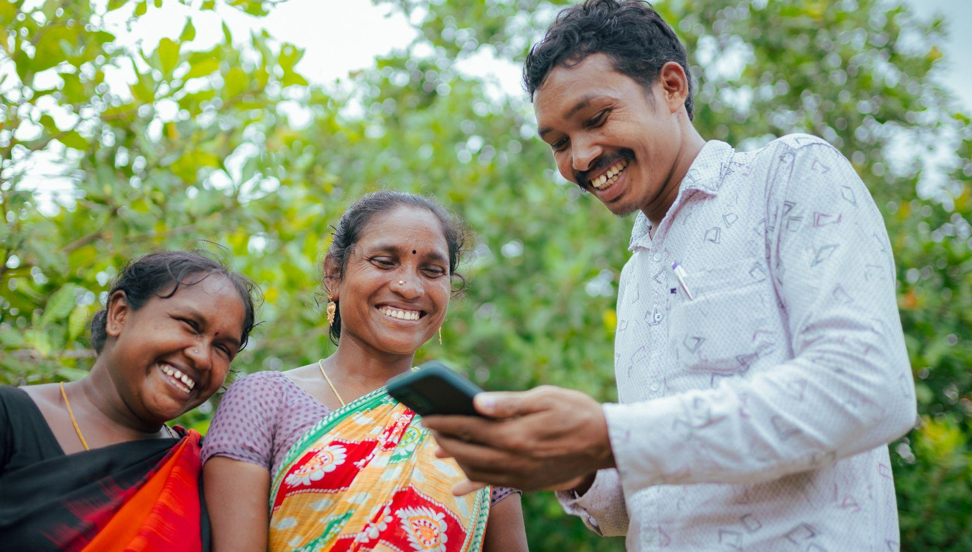

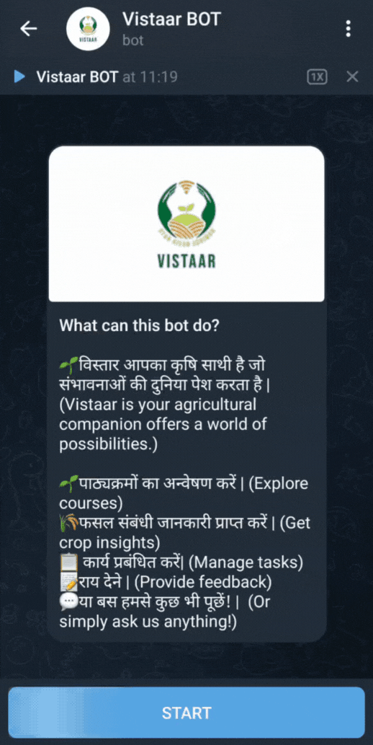
Leveraging AI for Transformative Agricultural Extension

Slide 2

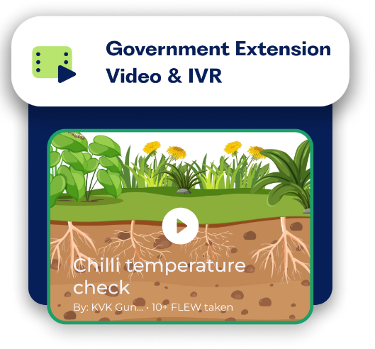
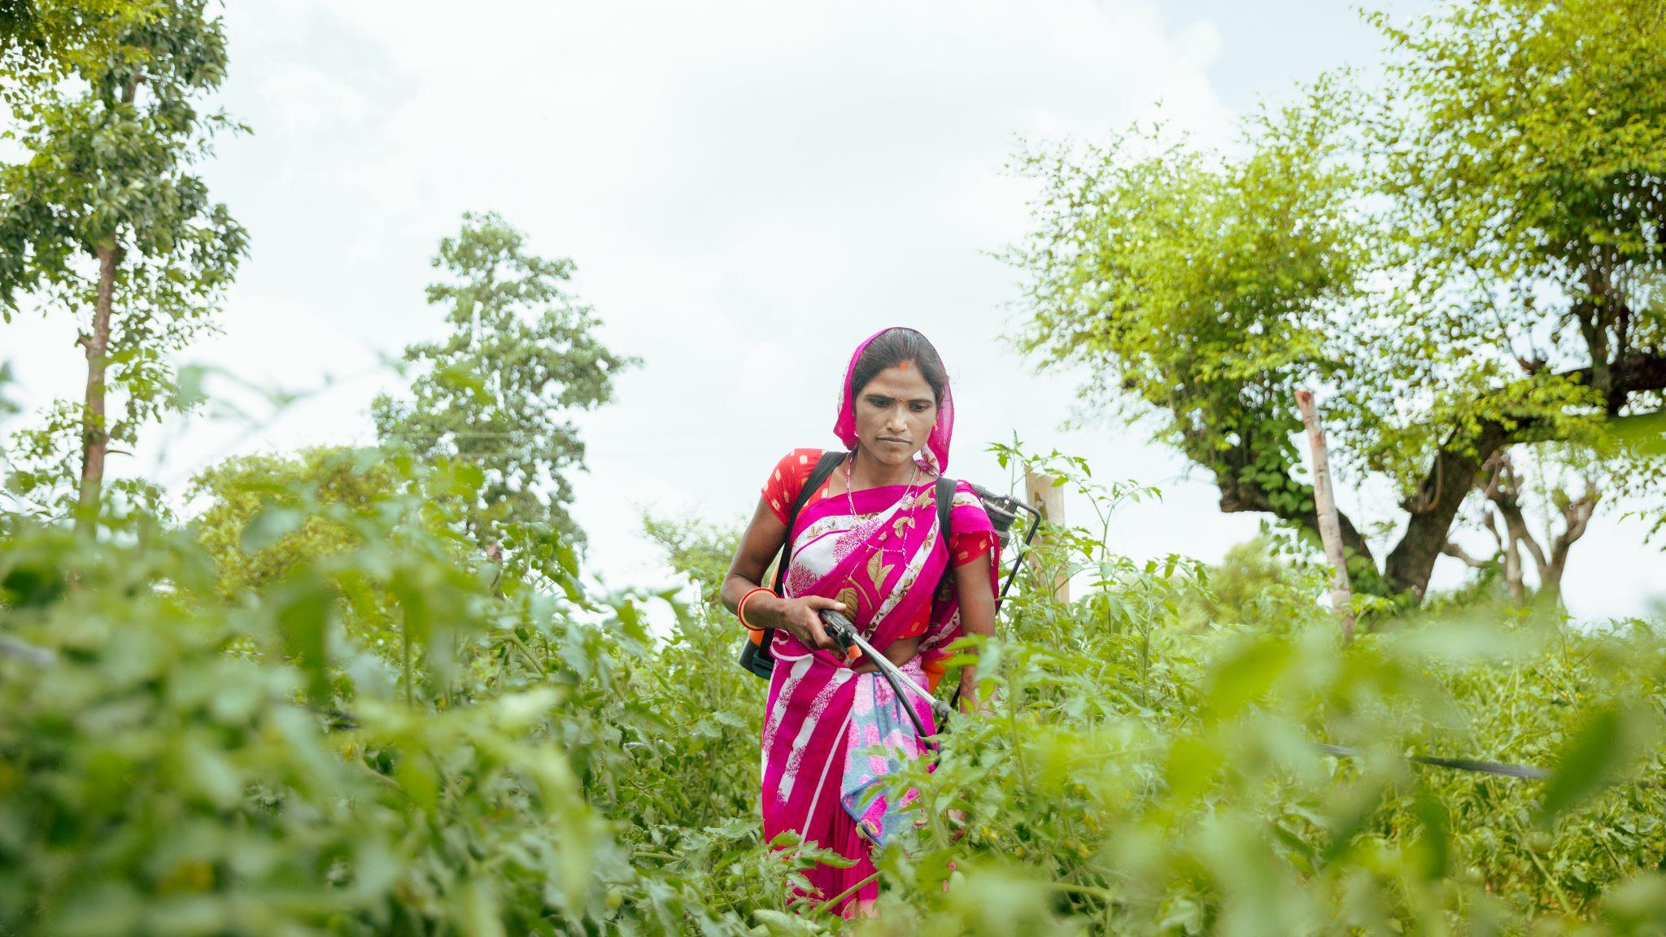
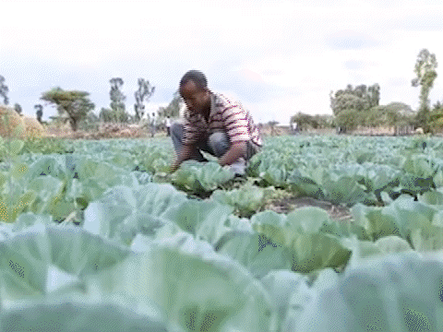

15 years of success digitizing extension delivery
Digital Green has trained over 54,000 government extension agents to create and share local farmer videos, to augment the model of existing government extension systems.
Through this network of extension agents, over 5.2 million smallholder farmers (70% women) have received improved extension advisory services
Our approach has proven impact:
Brings the average cost per adoption reduced from $35 to $3.50/farmer/practice.¹
Increases farmer income by up to 24%²
GOVERNMENT
EXTENSION
AGENTS
Mediated video
screenings
Feedback & adoption data
FARMER
1: Baul, Tushi, Dean Karlan, Kentaro Toyama, and Kathryn Vasilaky. “Improving Smallholder Agriculture via Video-Based Group Extension.” Global Poverty Research Lab, n.d. https://doi.org/10.2139/ssrn.4307353
2: Abate, Gashaw T., Tanguy Bernard, Simrin Makhija, and David J. Spielman. “Accelerating Technical Change through ICT: Evidence from a Video-Mediated Extension Experiment in Ethiopia.” World Development 161 (January 1, 2023): 106089. https://doi.org/10.1016/j.worlddev.2022.106089
HOW

Slide 3


How can we increase the
speed and effectiveness
of extension systems?

Slide 4
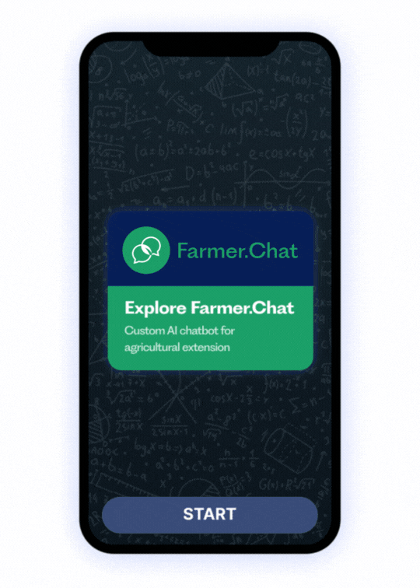
An AI Assistant for Extension Agents
Personalized, on-demand, localized advisory to Extension Agents with push & pull content
Multimedia interface with text, voice, video and image messages.
Building farmer and Extension Agent profiles & data
To better reach women, low-literacy, low digital skill, and off-line farmers

Slide 5
Core Functionality of Farmer.Chat
Tailored Advisory: The system leverages a variety of data sources to tailor advisory to best suit user needs.
User Profiles: Digitizing user names, locations, gender, contact information, and farm level data
Crop Calendar: Leverage approved crop calendar to create tailored advisory based on seasonality and best practices
Soil & Weather: Location data informs the system in referencing soil and weather data to customize advisory
Text and Voice Queries: Users can ask queries via text messages and voice messages in a variety of languages
Multimedia Responses: Users receive both text, audio and link out to video responses relevant to their queries
Image Analysis: Photos submitted by users can be analyzed to identify crop and livestock pests, diseases, and other problems

Slide 6
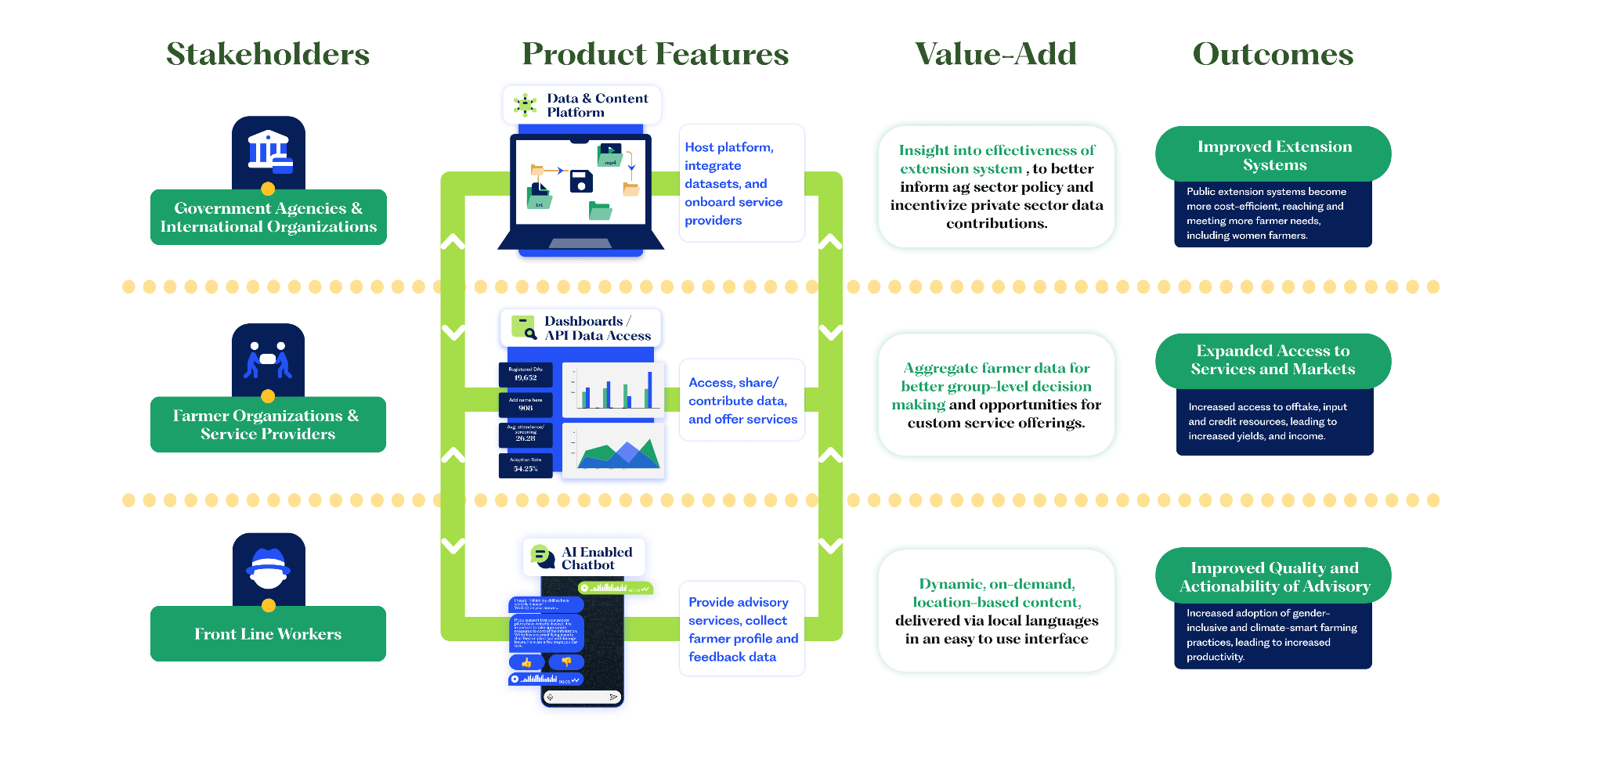
A Digital Extension Platform

Slide 7
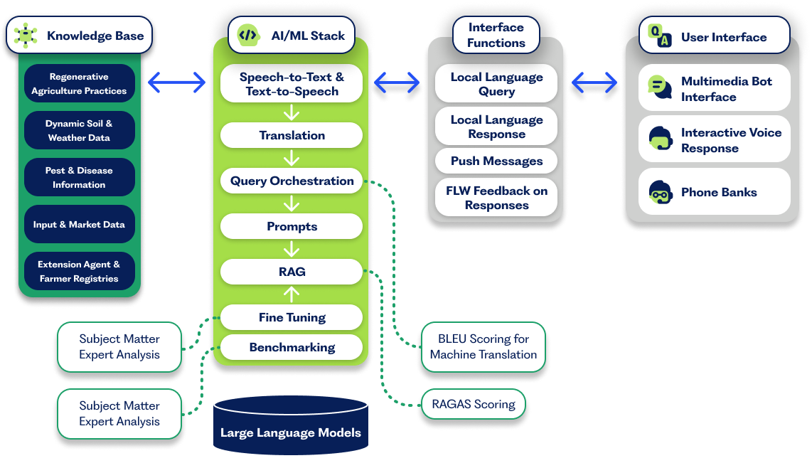
Network tech stack
In recent tests using GPT4-Turbo reranking, we reduced responses with hallucinations from 23% to 0% and responses with irrelevant information from 37% to 3%; responses were 65% faster but cost 6x more.
Goal: Establish benchmark and achieve 90%+ performance scores

Slide 8
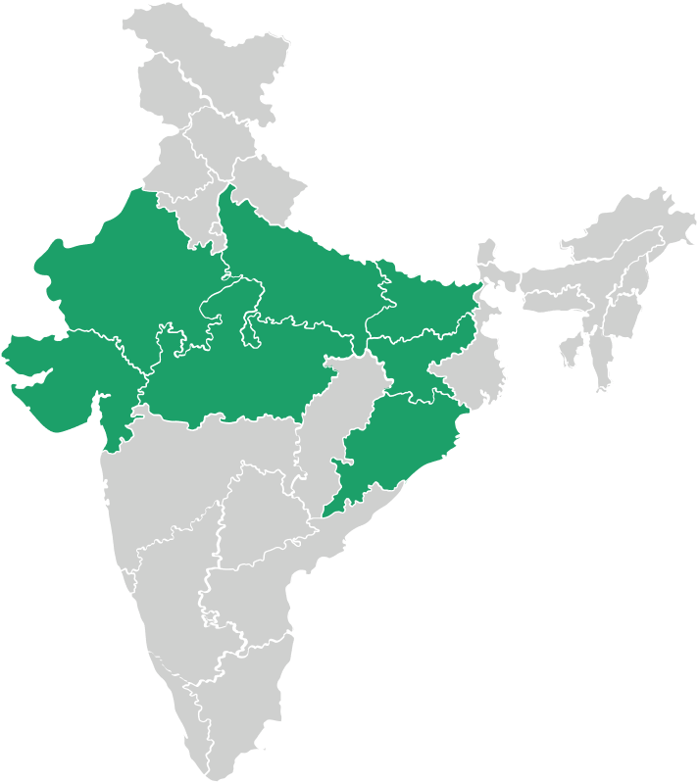
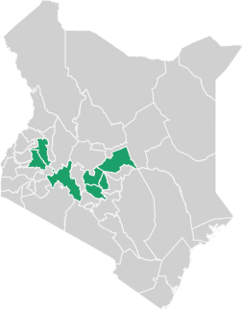
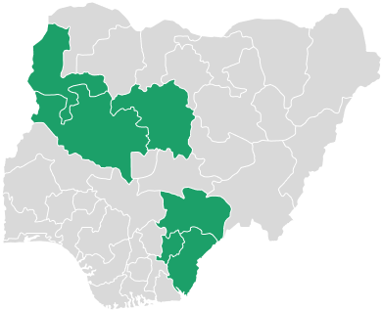
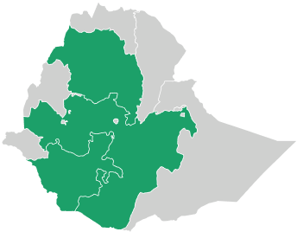
Current Farmer.Chat user base
India
Kenya
Nigeria
Ethiopia
Bihar, Uttar Pradesh, Orissa
Madhya Pradesh, Rajasthan, Jharkhand
Kirinyaga, Meru, Murang’a, Nakuru, Nandi, Nyeri, Uasin Gishu
Niger, Kaduna, Cross River, Benue, Kebbi, Ebonyi
Amhara, Oromia, Sidama, Central Ethiopia, South and SW Ethiopia
~5000 EA users
20 commodities
~5000 EA users
8 commodities
220 MSMEs
450 K farmers
~400 EA users
Goal: $35→$0.35 per farmer adoption
100x more cost effective
Notes:
Coffee
Dairy
Potato
Avocado
Chicken
Banana
Cabbage
Mango

Slide 9
Join Us in the Success of Farmer.Chat
Successful AI interventions require support from well-intentioned, competent people or organizations.
We are looking for collaboration with:
Technology Partners: Contribute to the development and training of the AI language model which powers Farmer.Chat
Subject Experts: Leverage your expertise to contribute to the accuracy and validity of the advisory Farmer.Chat delivers
Contribute Content: Contribute data such as soil, weather and market data
Voice Sampling: Enrich the datasets used to train AI in language learning with audio recordings of diverse speakers, languages, and dialects
Notes:
The so-called developed and developing world divide can’t be closed by technology alone. Things like physical infrastructure, human capital, political institutions, and finance are necessary foundations to the gains that technology can provide. Technology is really only good at magnifying human intent and capability. We’ve found success only comes through partnerships with government, NGO, and private sector agencies that already work with farmers and where technology can improve their efficiency and broaden the participation of the communities that they work with. That’s when video, for instance, can spark the curiosity of farmers to take their “one small step” toward improving their lives and those around them.

Slide 10
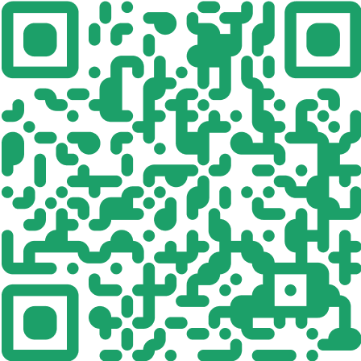
Explore Farmer.Chat
Follow up with us:
Learn more about the AI Commons and working group we're forming
Learn how to customize and deploy Farmer.Chat for local solutions
Scan me to start
https://b.link/farmerchatdemo
Archana Karanam
archana@digitalgreen.org

Slide 11
