Slide 1


Critical AI Literacy
Julika von Stackelberg, Ph.D. Candidate
NETC 2024, May 15

Slide 2


Slide 3


Slide 4
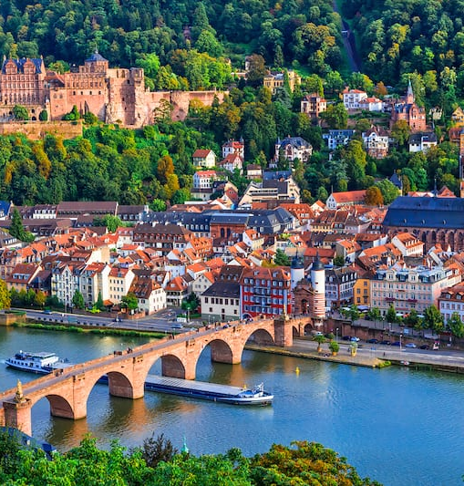
My Story
Born and raised in Heidelberg
Driven by justice/fairness
Always sought community

Slide 5
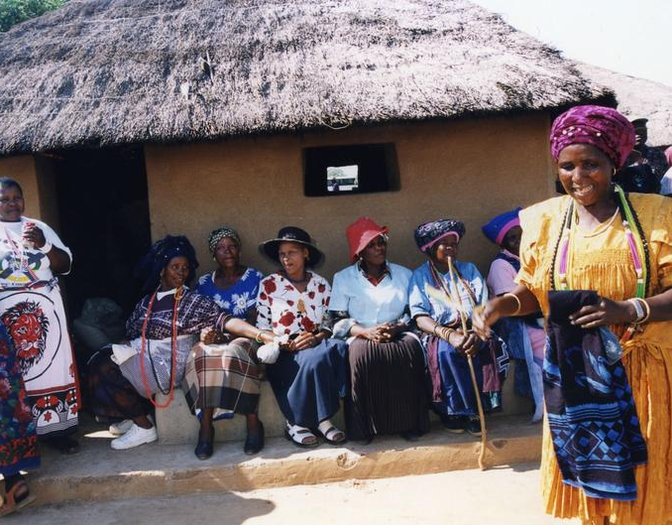
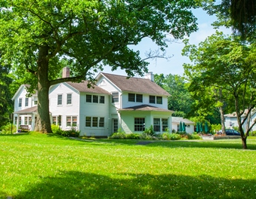
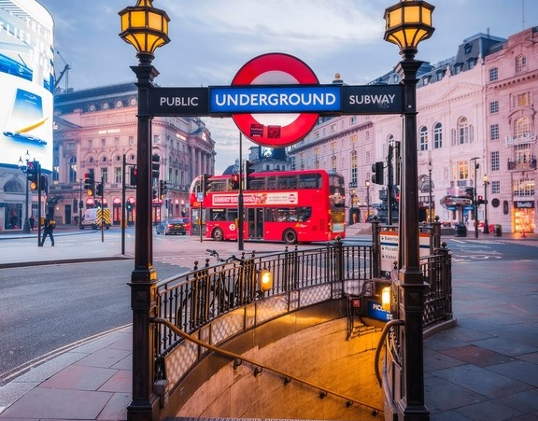
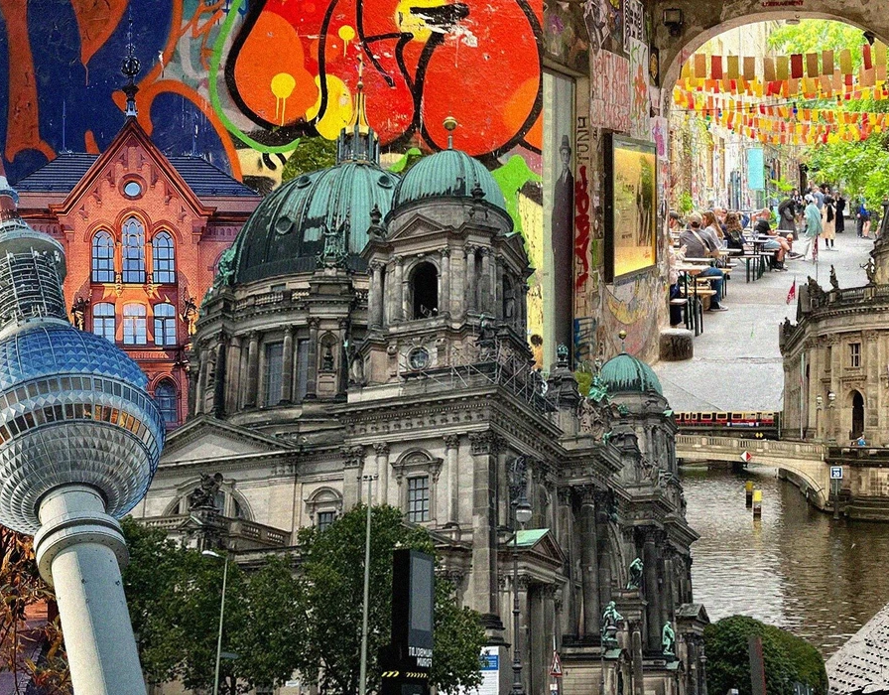
World Citizenship & Belonging Education & Knowledge Time & Emergent

Slide 6
Objectives
Provide an overview of the impact of the data that inform LLMs and ML
Discuss the risks of reproducing past and current inequities due to biased data
Learn to apply a critical lens when working with AI-based tools to ensure the well-being of all

Slide 7
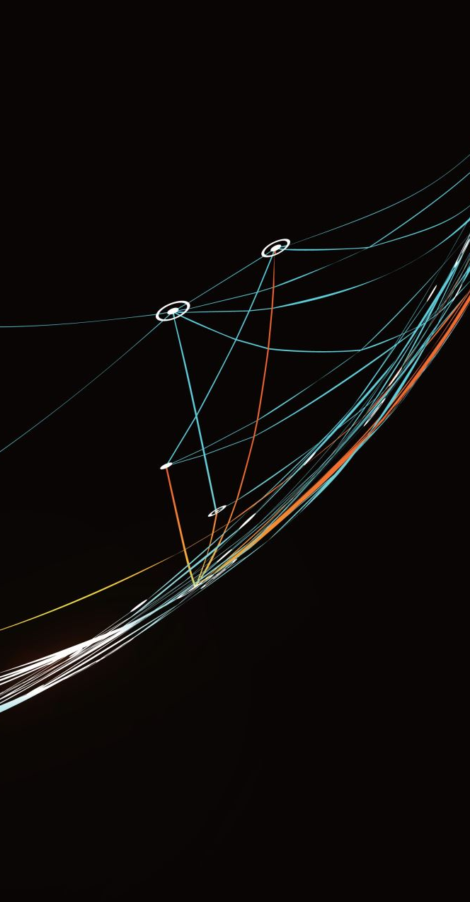
AI DIET: LLMs & ML

Slide 8

Pirated Ingredients
Training data
Data labor

Slide 9
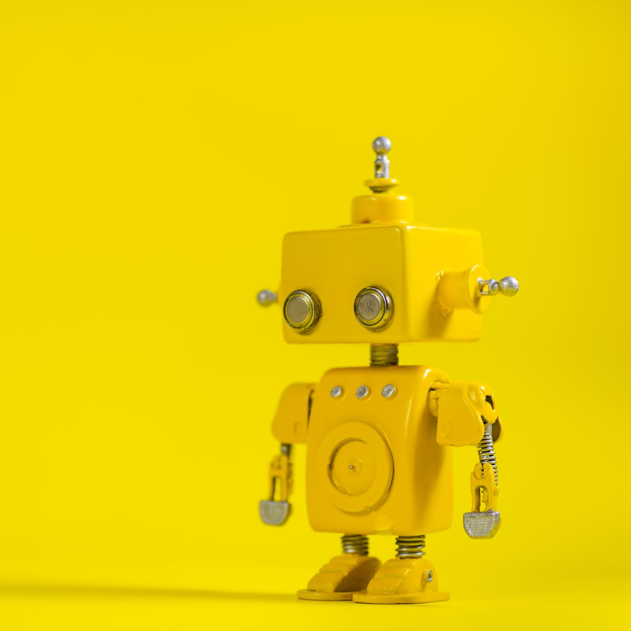
AI Origin and Definition
The term “Artificial Intelligence” was created by a number of researchers in 1955.
Machines performing the most advanced human thought activities (McCarthy, et al., 1955).
Notes:
How many of the researchers were women? How many people of color were there? This shows that the sciences, technology, and society are woven together in a way that creates more complexity than what may be visible on the surface. Hence, looking at this triad when we want to understand the role of AI may help…

Slide 10

Science, Technology & Society

Slide 11
Science & Objectivity
The world we live in was advanced by sciences that are rooted in specific philosophies that placed value on
- Development
- Globalization
- Technology
Lineage to eugenics
Social thickness & complexity
Notes:
This points out… as Sheila Jasanoff calls this the social thickness and complexity of the interplay between science, technology, and society.

Slide 12

Role of Technology
Address and solve complex problems like changes in our climate, depletion of resources, etc.
→ requires an infrastructure

Slide 13
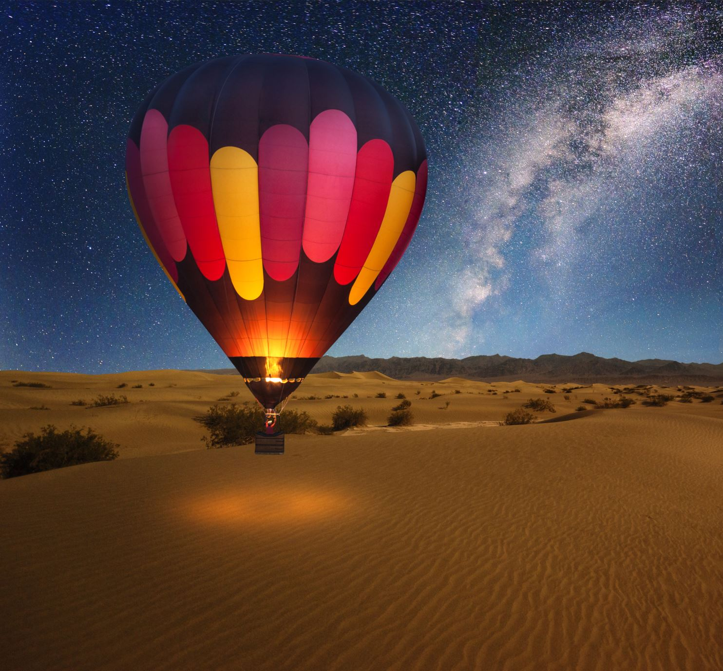
Summarizes into a Sociotechnical Imaginary
→ Society

Slide 14
What is a Social Imaginary?
Philosopher and cultural theorist Charles Taylor developed the concept and described social imaginaries as shared beliefs, symbols, and practices that shaped a society’s understanding of itself (Taylor, 2003).
→ Points to the plans, vision, and perspectives the Master used to build his house…

Slide 15
Sociotechnical Imaginaries
Sociotechnical imaginaries emerged as a concept to understand the connection between science and technology and how each was shaped by the forms and values of a society (Tidwell & Tidwell, 2017).

Slide 16

Are We Reproducing the Past?
Example: Gender Shades Project
Notes:
If AI is trained on data that represents the ideologies that have led to the inequities in our world, are we at risk of reproducing the past?

Slide 17
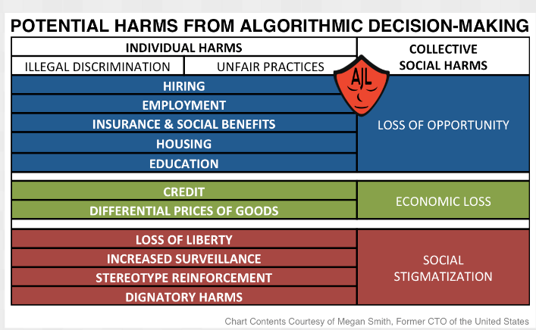

Slide 18
Extension Supported Future
WHERE ARE WE GOING?

Slide 19
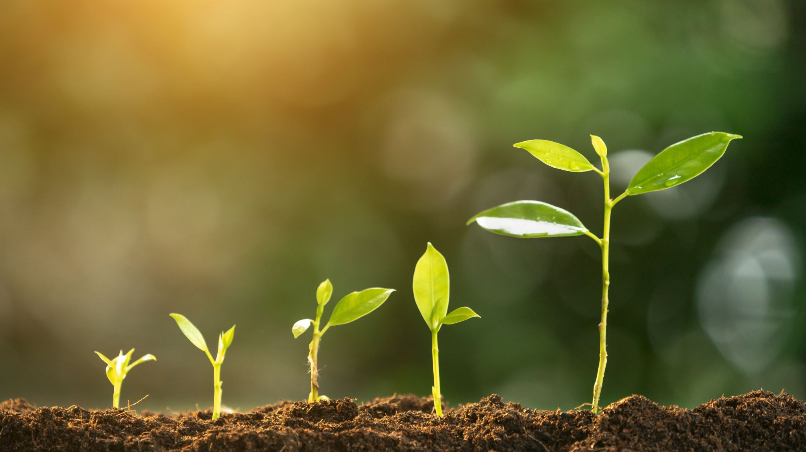

STABILITY
GROWTH
DECAY
REORGANIZATION
RENEWAL
RESILIENCE

Slide 20

Community Resilience Sustainability Technology
Technology continues to shape our lives and our world in profound ways

Slide 21
CRITICAL LENS Frameworks & Ethics

Slide 22
Resilience
Resilience has been used as a concept to identify strategies to enhance protective factors and stability in socioecological contexts that describe the interconnection between individual and social realms in society and ecological contexts that focus on sustainability development (Nüchtern, 2021).
How is that woven into the present dominant social imaginary? How can we apply our understanding of this to a framework that supports well-being?

Slide 23
Frameworks and Ethics
How do we transition from extraction-oriented practices and frameworks towards regenerative well-being?
1. Centering the well-being of all human and planetary life
2. Community awareness and engagement
3. Develop indicators for well-being that are rooted in “knowing ourselves”

Slide 24
Critical Frameworks
Gebru & Torres (2024) argued that the TESCREAL movement (Transhumanism and Extropianism, Singulartarianism, Cosmism, Rationalism, Effective Altruism, and Longtermism) represented a second wave of eugenics, as this bundle of ideologies promises utopia through AGI.
Need well-defined, well-scoped systems that prioritize people’s safety (Gebru & Torres, p. 21, 2024).
Notes:
This is where I am going back to the Master Community Builder Program, which operates with a pedagogical framework that centers the well-being of all life, human and planetary.
Research title…

Slide 25
Role of Extensions: Collaboratively developed Healing-informed Sociotechnical Imaginary as a Critical Framework for Community Building
That understands the long-term impact of trauma
That understands the mechanisms that facilitate healing and well-being
Prioritizes human and planetary life
Recognizes agency

Slide 26
What’s Your Next Step?

Slide 27
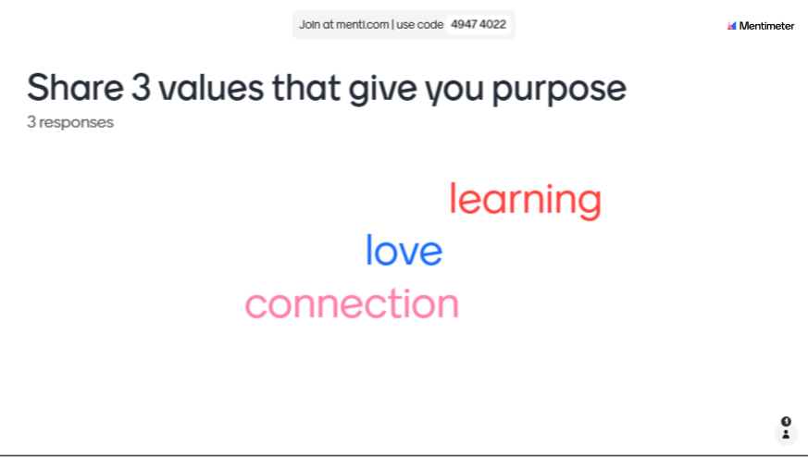
HOW MIGHT YOUR VALUES INFORM A FRAMEWORK FOR WORKING WITH AI?

Slide 28
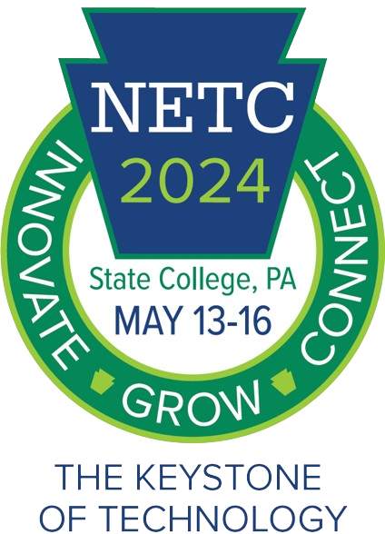


Pink 3.5
Critical AI Literacy
WzRTzOv9

