Slide 1
EFNEP
Bridge Access Program
January 8, 2024
Notes:
Karl (2 Minutes) - Welcome!
Our Tech Host is Melanie…we’re using the Q&A function today…(intro Melanie to explain)

Slide 2
EXCITE is funded through an Interagency Agreement with the USDA National Institute of Food and Agriculture (NIFA) and the Centers for Disease Control and Prevention (CDC). Funding for CDC Bridge activities is contingent upon the availability of CDC funds and an official award from NIFA to the Extension Foundation (EXCITE Team).

Slide 3
Agenda
Welcome & Introductions of Leadership - Michelle Rodgers
Bridge Access Intro - Jackie Wilkins
How to Integrate Bridge and Resources-Diane Oliver
How to Locate your Priority Population - CDC Data Informed Tech Assistance
WizeHive, RFA and Budget-Brenna Kotar
Timeline
Discussion and Q&A-use Q&A
Notes:
Karl - review agenda; introduce Michelle
Here’s how we’re going to spend our time together today…(review agenda)
To get us started please welcome the EXCITE program director…Michelle Rodgers!

Slide 4
CES Immunization Education since 2021
Partnership with CDC - $16 Million
Over 18 Million Reached
COVID Immunization Education
Adult Immunization Education
Notes:
Intro Michelle…

Slide 5
Bridge Funding Opportunity!
Purpose-Bridge the Gap (Equity)
Increase awareness of eligibility for COVID-19 vaccine
Increase awareness of when and how to get a free updated COVID-19 vaccine through Bridge Access for those 18 + uninsured and underinsured
Notes:
https://www.census.gov/programs-surveys/sahie.html
Thank you, Michelle!
And welcome to all of you who are joining us today. I am thrilled that you are interested in learning more about this exciting BRIDGE funding opportunity. The purpose of the funding is to bridge the access gap and improve equity for COVID-19 vaccines in two main ways–

Slide 6
3 Prong Approach:
EXCITE Implementation Phase Projects
$25,000 amendment
Integrated into existing program, funding & reporting
Can redraft budget to refocus efforts
EFNEP Institutions
76 Institutions $50-70,000 RFA
Trusted messengers already working with priority population
Integration with existing program support EFNEP sustainability
NIFA support
1994 Institutions
Menu of Options supported by Ruth Hursman
Notes:
We are taking a 3-pronged approach to bridging access through this program:
The first is through our existing EXCITE Implementation Phase Project partners who can receive an amendment to their current contract that enables them to receive an additional $25,000 to join BRIDGE Access. This will be integrated into their existing program, funding and reporting efforts. They will be able to redraft their budget to refocus their efforts.
The second prong potentially involves all of you through our EFNEP Institutions– up to 76 institutions with funding anticipated to range between $50-$70K via an RFA. You are already trusted messengers working with the population we are prioritizing. The program can be easily integrated into your existing program and will enhance EFNEP sustainability through these additional dollars. Our federal partner (NIFA) is supporting this innovative programming through EFNEP.
The final prong is through our 1994 Institutions and will have a menu of options available to them with support from our 1994 lead, Ruth Hursman.
Is anyone providing information about BRIDGE funding now?

Slide 7
Increase awareness of eligibility for free updated COVID-19 vaccines among uninsured adults and adults whose insurance doesn’t cover COVID-19 vaccines in-network.
Project Goal Drive uptake of free updated COVID-19 vaccines through the Bridge Access Program
Increase awareness of where and how to get a free updated COVID-19 vaccine through the Bridge Access Program.
Notes:
Our project goal is to drive uptake of free updated COVID-19 vaccines through the Bridge Access Program…
We have two required outcomes: ***
We Drive uptake of free updated COVID-19 vaccines through the Bridge Access Program

Slide 8
The Bridge Access Program is a temporary program to close a gap in access to COVID-19 vaccines
On April 18, HHS announced the
The Bridge Program is intended for…
Bridge Access Program For COVID-19 Vaccines, to maintain broad access to updated COVID-19 vaccines for millions of Americans that would not have coverage through their health insurance.
The Bridge Access Program launched in September and is a temporary program to cover updated COVID-19 vaccinations post-commercialization.
CDC is committed to ensuring broad access to updated COVID- 19 vaccines and to continued progress toward vaccine equity.
Adults (18+) with health insurance that does not cover COVID-19 vaccines from in-network providers for free
Adults (18+) without health insurance
to access free COVID-19 vaccines through…
Long-standing partnerships with health departments, their enrolled providers, and local health centers
Select retail pharmacies: CVS, Walgreens, and additional pharmacies contracted under eTrueNorth
3
Notes:
This program is temporary…

Slide 9
Cost & Inequitable Access = key barriers to vaccination
13% of adults ages 18 to 64 were estimated to be uninsured in the third quarter of 2022.
_{46%} of adults impacted by high
costs never get vaccinated
Adults in racial and ethnic minority groups are also less likely than White adults, on average, to have health insurance
Adults 19-64 years old with Health Insurance, by Race and Ethnicity, 2021
Adults who have to pay
_{58%} $30 out of pocket for their
flu shot are 58% less likely
to get vaccinated
75%
77%
57%
60%
53%
42%
In 2018, adults with health insurance were 2-3 times more likely to receive a flu vaccine than those without insurance
2-3x
White
Black
Hispanic
Asian
AIAN
NHOPI
Sources: Health Insurance Coverage: Early Release of Estimates From the National Health Interview Survey, July 2021–September 2022 | Source: Commonwealth Fund Biennial Health Insurance Survey, 2022 | Sou₅rce: Health Coverage by Race and Ethnicity
Notes:
We know that barriers remain to vaccination for all, with key barriers being cost and inequitable access…

Slide 10
COVID-19 commercialization meant many would lose access
When COVID-19 vaccines and treatments were moved to the commercial market in Fall 2023,
25-30 million uninsured adults would have lost access to affordable vaccines.
Adult Population by Coverage Status (millions)¹
24.8
Uninsured
7.1
COVID-19 vaccines were free regardless of insurance status during the public health emergency (PHE) through the federal program to purchase and distribute COVID-19 vaccines.
After the end of the PHE, COVID- 19 vaccines transitioned to the commercial market without federal purchasing and distribution that guaranteed access for everyone.
Underinsured*
23.0
Medicaid Enrolled (19-64)
121.7
Medicare Enrolled
51.0
Privately Insured (19-64)
*Underinsured is defined here as related to vaccination coverage and is a pre-Inflation Reduction Act estimate, so may be larger than the current underinsured population. 1/ Data are internal CDC estimates.
6
Notes:
[Start at blue box]
[Move to title box]
[F/up with notes, if needed]
COVID-19 vaccines are still covered at no cost for most people living in the U.S. through their private health insurance, Medicare and Medicaid plans. However, there are 25-30 million adults without insurance and additional adults whose insurance does not provide no-cost COVID-19 vaccines after these products move onto the commercial market.
CDC’s Bridge Access Program is a public-private partnership to help maintain access to no-cost COVID-19 vaccines for adults who are underinsured or uninsured through their local pharmacies, the existing public health infrastructure, and their local health centers.

Slide 11
A communications toolkit was developed to help partners promote the Bridge Access Program.
All communication assets are downloadable and adaptable should partners want to disseminate them directly through their offices, websites and social media channels.
Communications Toolkit for Bridge Access Program
key messages
sample newsletter
program resources
18
Notes:
I hope you will choose to join us in this effort– and when you do, wou will have a number of excellent resources to aid in your promotion of BRIDGE access …

Slide 12
Program Resources & Promotional Materials
Use these program resources and promotional materials from the toolkit to help promote COVID-19 vaccination and the Bridge Access Program.
FAQ
One-pager
Social media
Additional materials may be added over time.

Slide 13
How can I find out about Bridge Access Program sites?
Contact your State/jurisdictional immunization program to learn more about opportunities to coordinate with public health sites: https://www.immunize.org/states/
Vaccine.gov Enter zip code and select only show Bridge access sites
Notes:
https://www.immunize.org/states/
In order to understand where your current BRIDGE Access program sites are, you can…

Slide 14
EXCITE Resources
Website: EXCITE.Extension.org
EXCITE EFNEP BRIDGE PROGRAM RESOURCES–
https://excite.extension.org/excite-efnep-bridge-project-resources/
Notes:
https://excite.extension.org/
We also have a fabulous site available for understanding the entire EXCITE initiative, as well as specific resources related to the EFNEP BRIDGE Access Program.

Slide 15
EXCITE.Extension.org
Notes:
Now I’ll turn it over to Diane Oliver, our Curriculum Specialist for the EXCITE EFNEP Bridge Program— Diane…
Thanks Jackie!
Intro Dr. Helen Chipman…

Slide 16
How to Integrate into EFNEP
Diane Oliver
Curriculum Specialist EXCITE EFNEP Bridge
Notes:
Karl intro Diane Oliver, EFNEP Coord from University of Delaware, Curriculum Specialist for EXCITE Bridge program

Slide 17
How can EFNEP promote BRIDGE?
•Flyers to promote both programs
•Displays to promote both programs
•Emails to current and new partners
•Post on Social Media EFNEP accounts
•Articles for website
•Talking points at the start or end of a lesson

Slide 18
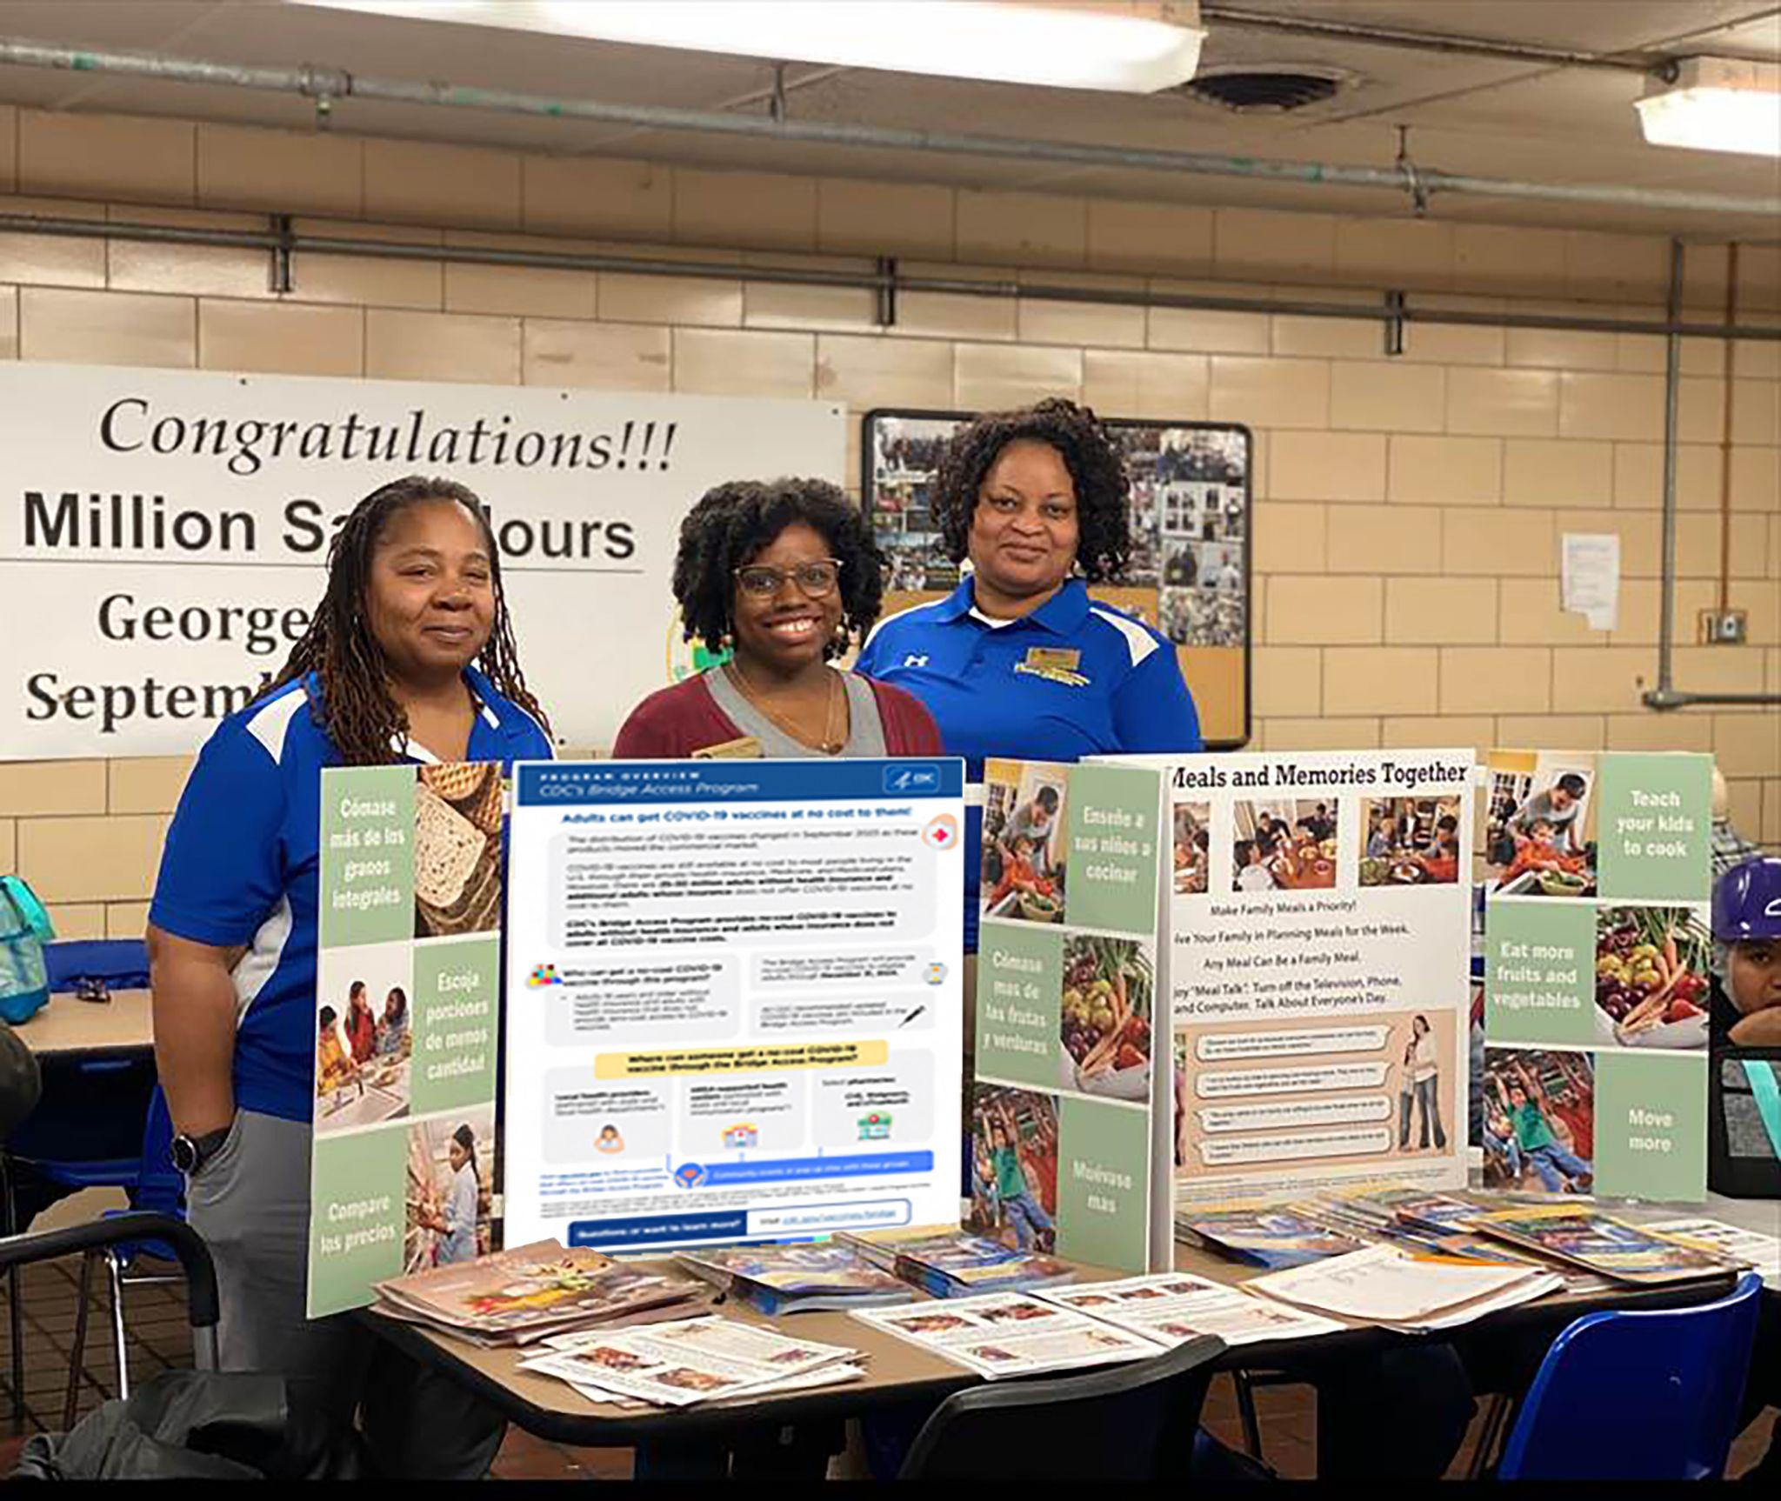

Slide 19
EFNEP BRIDGE
Talking Points for EFNEP Adult Lessons

Slide 20
Physical Activity
•People are hesitant to go to gym because of Covid-19.
•People have a fear of going out in public.
•People don’t want to wear a mask to exercise.
•Long Covid makes it more difficult to breathe.
•Long Covid decreases the ability for people to be physically active and more sedentary which could lead to weight gain.
•Getting sick could set you back with any physical activity goals or schedules - especially if you have a bad case of an illness
•Recent studies show that individuals who are physically active may have a lower risk of severe COVID outcomes (https://www.who.int/europe/activities/considering-physical-activity-and-covid-19)

Slide 21
Food Safety
●Importance of hand washing not only to prevent foodborne illness but also to prevent other illnesses caused by bacteria and viruses like COVID-19 and the flu.
●Avoiding coughing on food to prevent the spread of germs.
●Cleaning surfaces often decreases bacteria and viruses from growing.

Slide 22
Fruit and Vegetable Intake
●Vitamin C helps with a strong immune system.
●Antioxidants and Phytochemicals in plant foods help make your immune system function to the best of its ability.
●Eating more plant-based foods help people fight off diseases.
●A diet high in fruits and vegetables could help with weight loss.
●Recent studies show that high fruit and vegetable intake may be linked to less severe COVID-19 outcomes (https://www.ncbi.nlm.nih.gov/pmc/articles/PMC9557193/)

Slide 23
Meal Planning
Just like you plan meals, plan to get up to date on doctor visits and your vaccinations like the Covid-19 booster. Getting it any time of the year is better than not getting it at all.

Slide 24
Shopping for Less
Just like we want to get the best price on foods we eat, it’s also a good idea to shop around for your health. For those without insurance or for insurance that doesn’t cover the COVID-19, there is the BRIDGE program where you can get the vaccine for free. Go to vaccines.gov (have on slide or write on board) to find a place near you.
Free Covid-19 Vaccine
For those with no insurance or who have to pay for it
coupon
coupon

Slide 25
What is BRIDGE?
●The Bridge Access Program is a temporary program to close a gap in access to COVID-19 vaccines.
●It allows individuals who don’t have health insurance and who are underinsured to receive the COVID-19 vaccine free of charge.
●Medicaid and Medicare already cover the COVID-19 vaccine

Slide 26
Where can I go to get the COVID-19 vaccine?
Walgreens
CVS
Federally funded health care facilities
Local pharmacies – vaccines.gov

Slide 27
Identifying your Priority Populations:CDC Data Informed Technical Assistance
Eve Lee and Javona Brown, CDC Data Consultants
Notes:
Eve Lee and Javona Brown
Demo…

Slide 28
RFA for EXCITE Bridge for EFNEP
Brenna Kotar
EXCITE Project Manager
Notes:
Karl intro Brenna

Slide 29
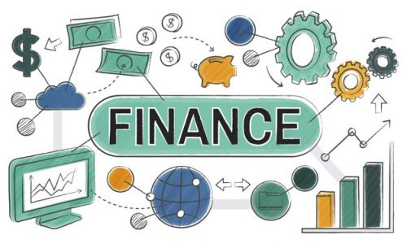
RFA & Application
Extension Foundation Finance Team
Arielle Smith, CPA - Comptroller
Brenna Kotar - Contracts Management
Kim Santoro & Cece Manoochehri - Grants Specialists
Barbara Adams, Senior Accountant
Contact us! sponsoredprograms@extension.org
RFA & Application Guide
RFA walk through
WizeHive - Grants Management
EXCITE is funded through an Interagency Agreement with the USDA NIFA and the CDC.
This is federal funding - must adhere to USDA NIFA guidelines!
Notes:
Brenna
Insert RFA

Slide 30
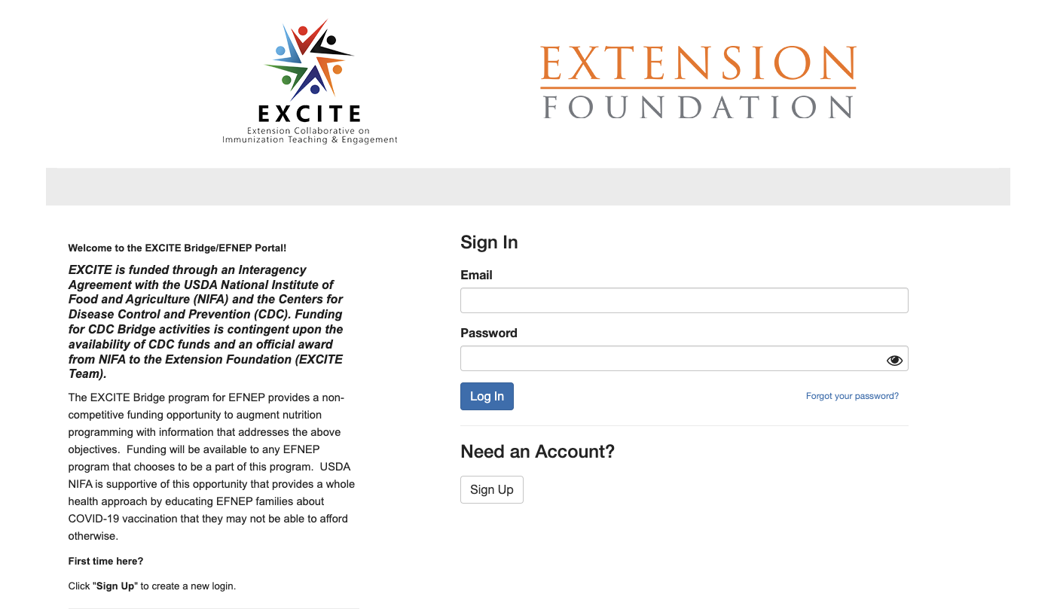
EFNEP Bridge Application Walkthrough
Non competitive funding opportunity!
$70,000 - Cost Reimbursement
Simple, short application through WizeHive, 5 questions!
Work with your Grants & Contracts or Sponsored Programs Office.
Not doing so will cause significant delays.
Application Walkthrough Video - Coming Soon!

Slide 31
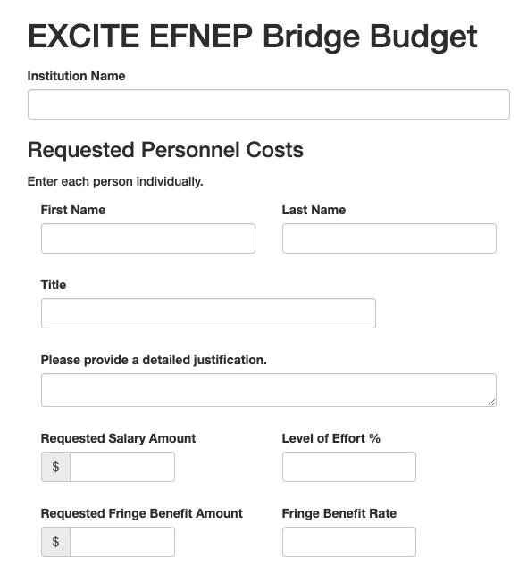
EFNEP Bridge Application - Budget Walkthrough
WizeHive
Budget Categories
Personnel Costs
Capital Equipment
unit cost of $5,000 or more
Travel for personnel
Participant Support Costs -
Student stipends/gift cards paid to educational/training participants or to individuals that support an educational/training program.
Other Direct Costs
Materials & supplies, publication costs, consultant services, honoraria, contractual costs and subawards.

Slide 32
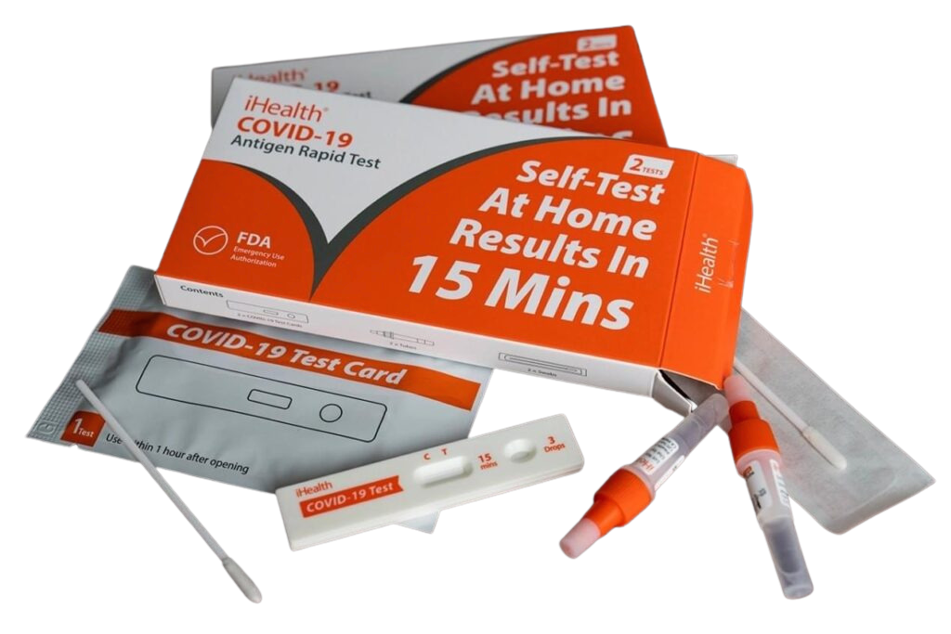
Common Non Allowable Costs
Vaccines
Provider time to administer vaccines
Covid Test Kits (for EXCITE)
Promotional Items
Food & Alcohol
Entertainment
Certain travel costs- first class travel
Fund-raising
Lobbying costs
Fines and penalties

Slide 33
Timeline
January 8th: EFNEP EXCITE Bridge info session
January: Rolling application period begins as soon as contract assigned
February or 4 weeks minimum from start of application: Final application due
February Annual Conference: Required session to cover implementation and reporting
March/April Contract executed- Begin implementation
April & beyond: Monthly spotlight sessions (hold second Thursdays at 3pm EST beginning April)
December 2024: Federal Bridge program of free vaccination ends
March 2025: End of funding
Notes:
Back to Jackie…
We are awaiting some final steps from our federal partners related to contract assignment and then we can initiate the application period. We anticipate this to occur at some point before the end of January but will update you all as it becomes available.
Once released, you will have 4 weeks minimum from the start of the applications before the final application is due. This will be a rolling application process.

Slide 34
What remaining questions do you have?
Notes:
Questions?

Slide 35
First Point of Contact:
If you have additional programmatic questions or would like to discuss the application process further, please reach out to:
Jackie Wilkins, Ph.D.
Associate Director, EXCITE Bridge Access Program
Email: jackiewilkins@extension.org
If you have contract or budget issues, please contact: sponsoredprograms@extension.org

Slide 36
EXCITE is funded through an Interagency Agreement with the USDA National Institute of Food and Agriculture (NIFA) and the Centers for Disease Control and Prevention (CDC). Funding for CDC Bridge activities is contingent upon the availability of CDC funds and an official award from NIFA to the Extension Foundation (EXCITE Team).

