Slide 1



GETTING TO THE HEART AND MIND OF THE MATTER:
A Toolkit to Build Confidence as a
Trusted Messenger of Health Information

Slide 2



Toolkit Workshops & Learning Modules
What is motivational interviewing
Motivational intervewing strategies
Motivational interviewing in group settings
What is science media literacy and why it matters
The science behind science media literacy
Applying the science media literacy infographic to real-world scenarios
Introduction to neuromarketing: A tool for effective health communication
Applied neuromarketing: Understanding the human brain
Applied neuromarketing: Producing brain-friendly health communication
Motivational Interviewing
Science
Media
Literacy
Neuro-
marketing

Slide 3
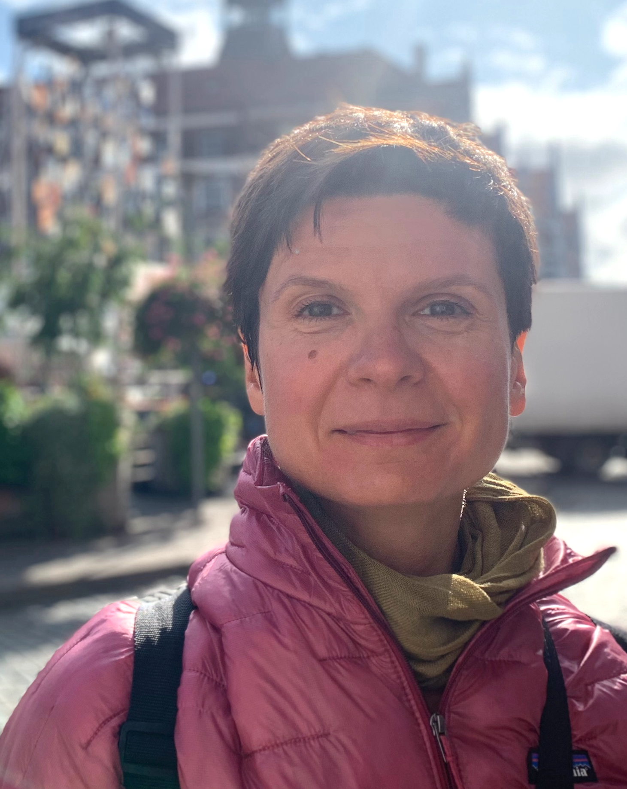
Motivational interviewing toolkit author:
Anya Sheftel, PhD
Research Assistant Professor of Special Education
College of Education

Slide 4
Module 3:
Motivational Interviewing in Group Settings

Slide 5

Agenda
MI Spirit and Processes
Change Talk
Technical Skills
MI in Group Settings

Slide 6
Partnership
Compassion
MI Spirit
(p. 20)
Acceptance
Evocation
Miller & Rollnick, 2013

Slide 7

Processes of MI (p. 22)
Engaging:
Get to know the person
Planning:
If appropriate, develop a plan
Focusing: Identify a collaborative focus for the conversation
Evoking:
Evoke and reinforce statements about change
Miller & Rollnick, 2013

Slide 8

Change Talk (p. 23)
Desire: I want to change
Ability: I can change
Reasons: These are my reasons for changing
Need: I need to change
Commitment: I will start engaging in a new behavior
Activation: I am considering change
Taking Steps: I will/have started to take steps towards change
Miller & Rollnick, 2013

Slide 9
MI Technical Skills
(p. 25-33)
Avoid the Righting Reflex
  Dance, don’t wrestle
  Reduce interpersonal discord
Reflections
  Reflect what the person said to you in the form of a statement
  Simple reflection = simple restatement
  Complex reflection = additional content (reflect meaning or feeling)
Open-ended questions
  Show curiosity
Affirmations
  Affirm strengths, values, goals
Miller & Rollnick, 2013

Slide 10
MI in Group Settings
(p. 44)
Have a plan
Start of group:
  Focus on the positive
  Stay in the moment
  Explore perspectives
Build up to:
  Look towards the future
  Reflect and explore change talk
End the group on a positive note
Throughout:
  Support self-efficacy
  Reduce interpersonal discord
Wagner & Ingersoll, 2012

Slide 11
What Did We Cover?
MI Spirit and Processes
Change Talk
Technical Skills
MI in Group Settings

Slide 12


