Slide 1



GETTING TO THE HEART AND MIND OF THE MATTER:
A Toolkit to Build Confidence as a
Trusted Messenger of Health Information
Notes:
Hello, my name is ___________________ with the Washington State University team working in collaboration with the Extension Collaborative on Immunization Teaching and Engagement, or EXCITE. This is one of 3 [Motivational Interviewing/Science Media Literacy/Neuromarketing] modules as part of the “Getting to the Heart and Mind of the Matter” toolkit.

Slide 2



Toolkit Workshops & Learning Modules
What is motivational interviewing
Motivational intervewing strategies
Motivational interviewing in group settings
What is science media literacy and why it matters
The science behind science media literacy
Applying the science media literacy infographic to real-world scenarios
Introduction to neuromarketing: A tool for effective health communication
Applied neuromarketing: Understanding the human brain
Applied neuromarketing: Producing brain-friendly health communication
Motivational Interviewing
Science
Media
Literacy
Neuro-
marketing
Notes:
There are many other modules for you to use to help you learn from the toolkit. You can watch any of our other videos about Motivational Interviewing, Science Media Literacy, or Neuromarketing by clicking the link to each of the modules in the description.

Slide 3
Neuromarketing Part 2
Applied Neuromarketing:
Understanding the
Human Brain

Slide 4

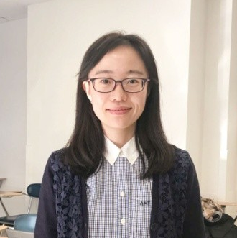
Neuromarketing toolkit authors:
Paul Bolls, PhD
Co-Director,
Murrow Media Mind Lab
Di Mu
Doctoral Candidate,
Research Associate,
Murrow Media Mind Lab
Notes:
Erica accidentally cut in this updated slide but left it in just in case it's useful for others to see or provide peer review suggestions.

Slide 5
This module will help you to:
01.
Gain an understanding of the human brain, the MIND
02.
Understand brain “truths” about how the mind works
03.
Understand basic practical implications of “brain truths” for brain friendly Communication Content

Slide 6
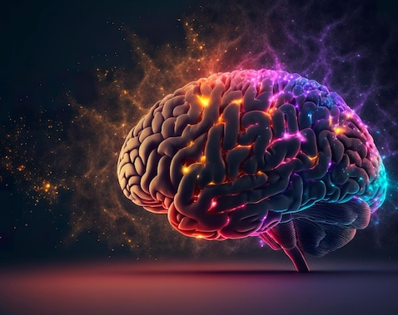
Understanding the Brain! Brain Truths for Brain Friendly Communication Content
“Brain Truths” can be used to help guide creative choices concerning communication content
The practical value of these “Brain Truths” comes from the fact that they are fundamental truths about the human brain.
What about “Neurodiversity,” aren’t human brains individually different?

Slide 7
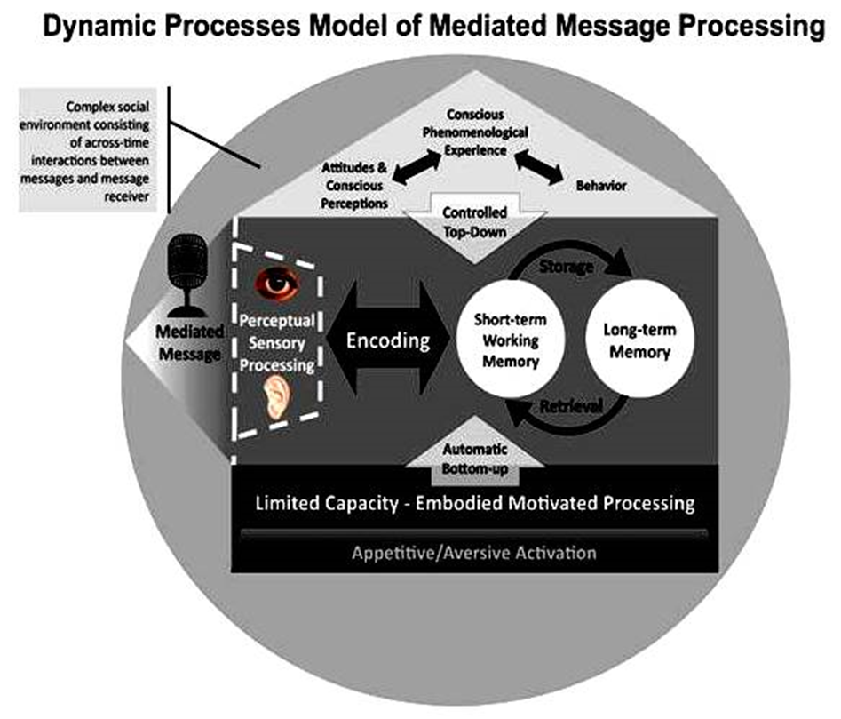

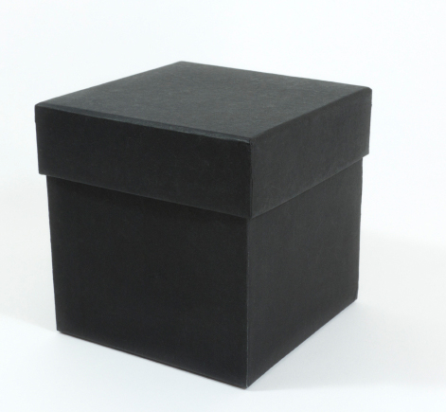
Communication efforts can fail through “ignorance” of how the human mind processes AND responds to content
The human mind does a lot of work processing communication content… most of the work is unconscious/automatic
Brain/mind treated as
black box whose
activity cannot be validly
observed
X
RESPONSE

Slide 8
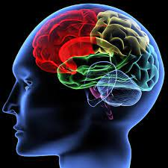
BRAIN TRUTH 1:
The brain is a limited capacity processor
The overall amounts as well as number of distinct “bits” of information in communication content can overload cognitive capacity of the targeted audience causing memory for the content to suffer

Slide 9
The brain is a limited capacity processor
The practical implication of this brain truth is that Communication professionals must focus on:
  Developing content that highlights one central message with a maximum of two or three supporting messages communicated in a clear, uncluttered manner
  Designing content to be delivered in a concise manner with as few “bits” of distinct information as possible
  Delivering content in a way that makes it as easy as possible for audience members to cognitively process (pay attention and learn) the central, most valuable information in the communication content

Slide 10
BRAIN TRUTH 2:
The brain is a contextual/cultural processor
Cultural “cues” in communication content increase the motivational relevance of the content and the context in which content is delivered determines attention and memory

Slide 11
The brain is a contextual/cultural processor
The practical implication of this brain truth is that Communication professionals must focus on:
  Developing content that is informed by expert understanding of the cultural background, emotional triggers, values, and pre-existing attitudes of the intended audience
  Designing content with sensory elements (e.g., visuals, words, colors) that resonate with the cultural background of the intended audience and in a form (layout) that focuses attention on relevant cultural cues
  Delivering content over channels/technology platforms that are culturally relevant to the intended audience and are as uncluttered as possible.

Slide 12
BRAIN TRUTH 3:
The brain is a motivated/emotional processor
Raw motivations related to approach/avoid in combination with emotional responses determine how individuals will process and respond to communication content
  These emotional processes determine how the brain will process and respond to communication content within milliseconds of exposure to the content
  Brain friendly communication content that is intended to educate community members MUST resonate with them at an emotional/motivational level

Slide 13
The brain is a motivated/emotional processor
The practical implication of this brain truth is that Communication professionals must focus on:
  Developing content that strategically includes sensory elements that explicitly connect with current emotional triggers the intended audience feels toward the subject of the content
  Designing content that strikes the best mixture of positive and negative emotional tone based on the emotional context surrounding the topic
  Delivering content over channels/technology platforms that evoke a positive user experience using sources/spokespeople that have strong, positive emotional affiliations with the intended audience

Slide 14
Brain “Truths” guide applied to Neuromarketing Science leading to Brain Friendly communication content!

Slide 15
Applied Neuromarketing Science Case Study
Di Mu
Doctoral Candidate
Research Associate at Murrow Media Mind Lab

Slide 16

Notes:
Script: "Thank you for watching and learning with us today. Again, we'd like to thank the EXCITE Foundation, through its Interagency Agreement with the USDA National Institute of Food and Agriculture, and the Centers for Disease Control and Prevention, for funding this project. We hope this toolkit is helpful to you and your communities."

