Slide 1



GETTING TO THE HEART AND MIND OF THE MATTER:
A Toolkit to Build Confidence as a
Trusted Messenger of Health Information
Notes:
Hello, my name is ___________________ with the Washington State University team working in collaboration with the Extension Collaborative on Immunization Teaching and Engagement, or EXCITE. This is one of 3 [Motivational Interviewing/Science Media Literacy/Neuromarketing] modules as part of the “Getting to the Heart and Mind of the Matter” toolkit.

Slide 2



Toolkit Workshops & Learning Modules
What is motivational interviewing
Motivational intervewing strategies
Motivational interviewing in group settings
What is science media literacy and why it matters
The science behind science media literacy
Applying the science media literacy infographic to real-world scenarios
Introduction to neuromarketing: A tool for effective health communication
Applied neuromarketing: Understanding the human brain
Applied neuromarketing: Producing brain-friendly health communication
Motivational Interviewing
Science
Media
Literacy
Neuro-
marketing
Notes:
There are many other modules for you to use to help you learn from the toolkit. You can watch any of our other videos about Motivational Interviewing, Science Media Literacy, or Neuromarketing by clicking the link to each of the modules in the description.

Slide 3

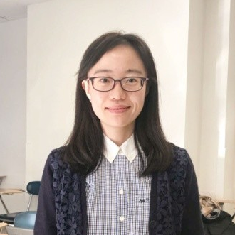
Neuromarketing toolkit authors:
Paul Bolls, PhD
Co-Director,
Murrow Media Mind Lab
Di Mu
Doctoral Candidate,
Research Associate,
Murrow Media Mind Lab
Notes:
Erica accidentally cut in this updated slide but left it in just in case it's useful for others to see or provide peer review suggestions.

Slide 4
Neuromarketing Part 3
Applied Neuromarketing:
Producing Brain Friendly Health Communication

Slide 5
This module has ONE objective:
Gain a practical understanding of how to apply an
understanding of Neuromarketing Science to developing,
designing, and delivering BRAIN FRIENDLY, EFFECTIVE,
health communication content!
LET’S DO IT!

Slide 6
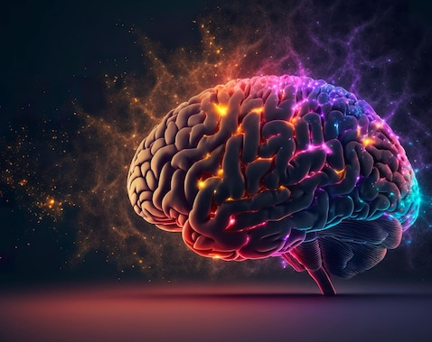
Neuromarketing Science: A tool for brain friendly health communication content
Effective” “brain friendly” health communication content will engage, educate, and empower individuals to make evidence-based health decisions!

Slide 7
Neuromarketing Science & Health Communication Content
Neuromarketing Science has a valuable role to play in producing and delivering effective health science content by:
  Guiding production of “brain friendly” content
  Providing new “data based” actionable insights

Slide 8
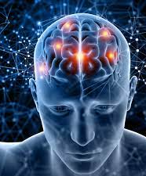
Communication professionals MUST remember that human brain characteristics ALWAYS impact how community members mentally process and respond to all information.
Emotional and potentially politicized communication contexts that surround health science in general, makes a scientific approach to health communication through Neuromarketing Science even more crucial to the process of developing, designing, and delivering effective health communication content.

Slide 9
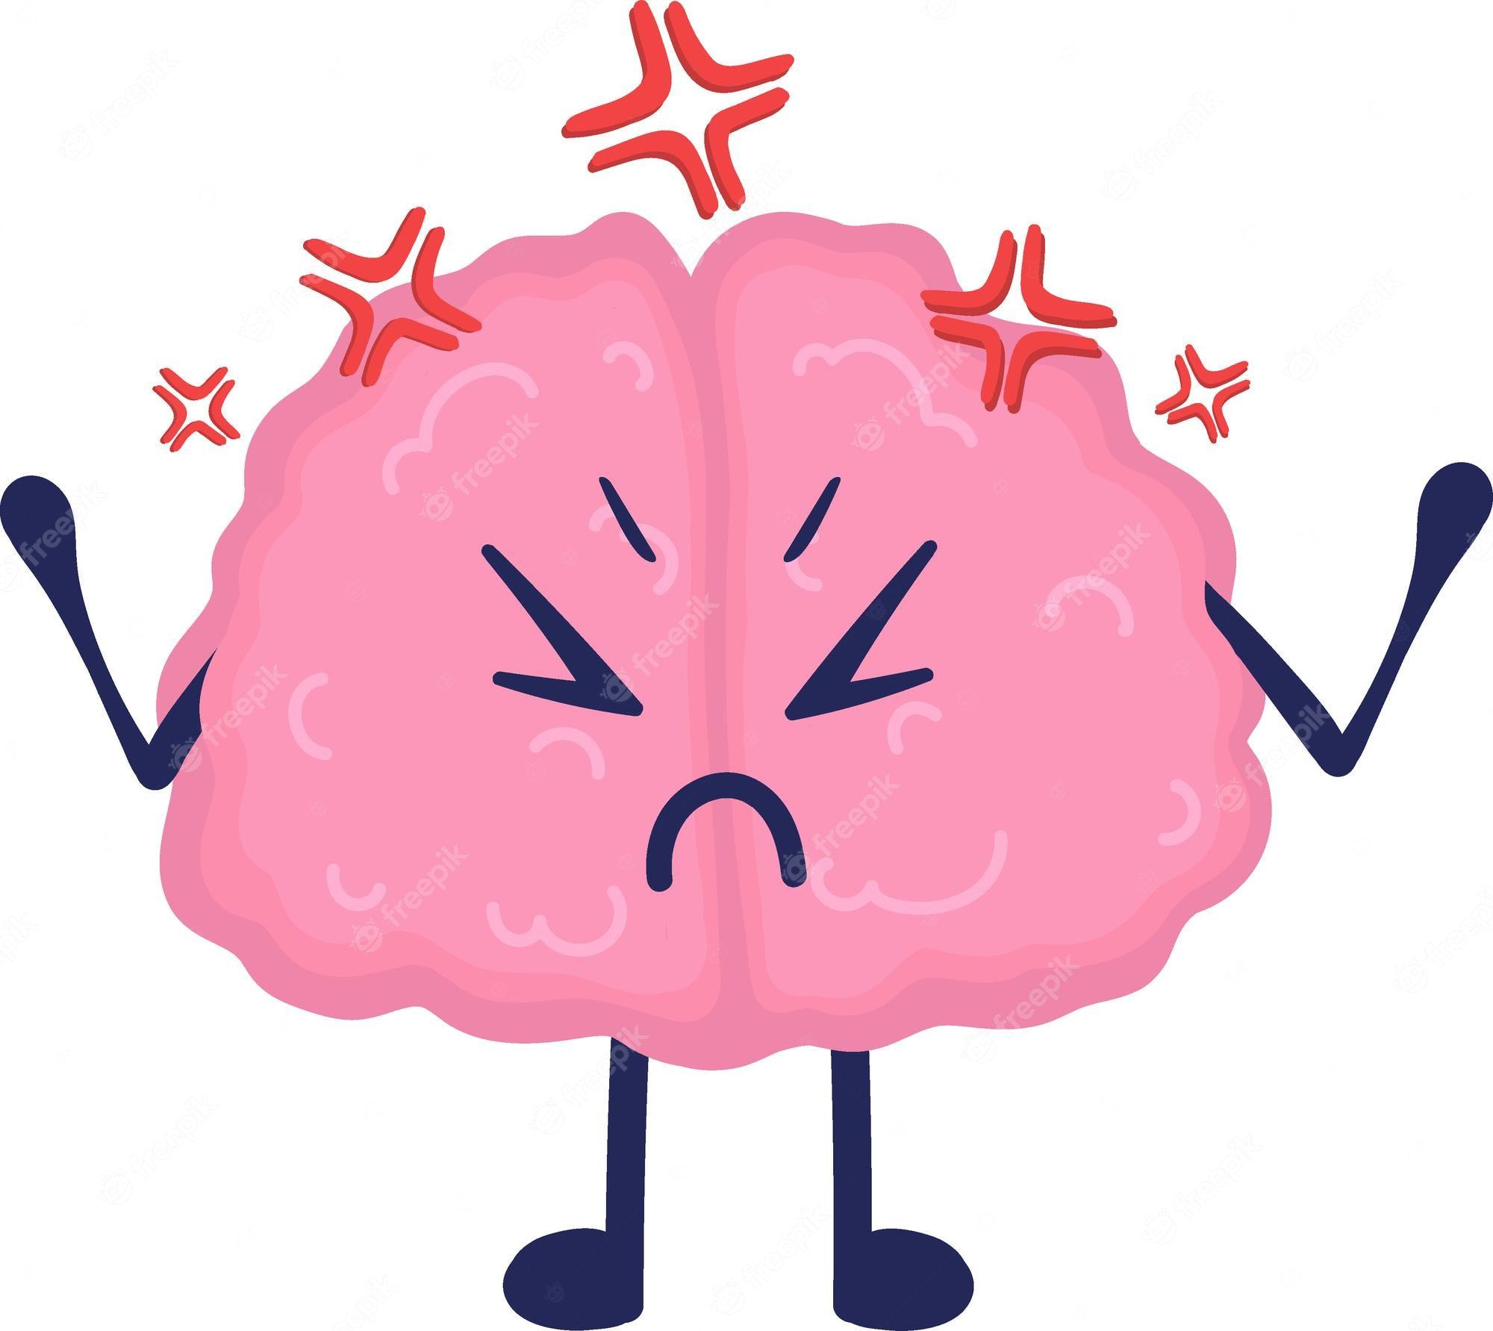
“Three brain truths” in “overdrive”
The Brain is a Motivational Emotional processor
  Health Science information/misinformation is extremely emotional/political, priming “aversive/defensive” responses
The Brain is a Limited Capacity processor
  Health Science contains a lot of “bits” of changing information tied to the evolving science
The Brain is a Cultural/Contextual processor
  Cultural background and experiences creating disparities and distrust shape the communication context and filter how Health Science is interpreted and responded to

Slide 10
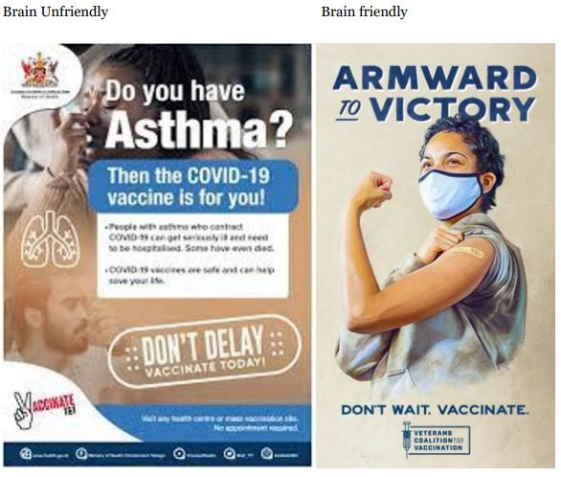
The Solution: Respect the “Three brain truths”
The Brain is a Motivational Emotional processor

Slide 11
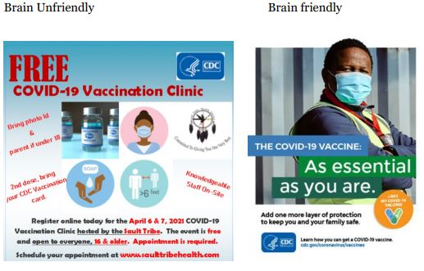
The Solution: Respect the “Three brain truths”
The Brain is a Limited Capacity processor

Slide 12
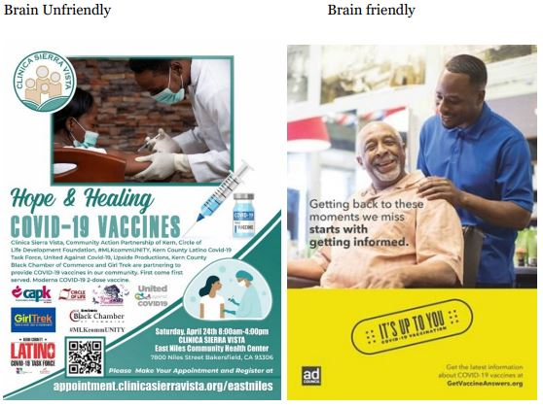
The Solution: Respect the “Three brain truths”
The Brain is a Cultural/Contextual processor

Slide 13
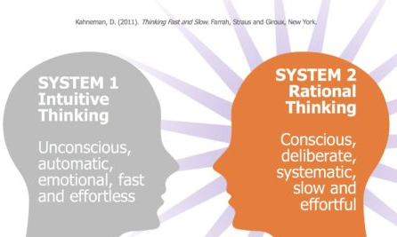
Developing “Brain Friendly” Health Science Content
Brain Friendly health education content will include content that engages BOTH “Intuitive” AND “Rational” thinking
Use production features to engage System 1
  Camera angle and shot length
  Color Schemes
  Font size
  Production pacing and “effects”
Use copy/content to engage System 2
  Write copy/content to highlight key points
  Write copy/content to empower
  Write copy/content to evoke feelings

Slide 14
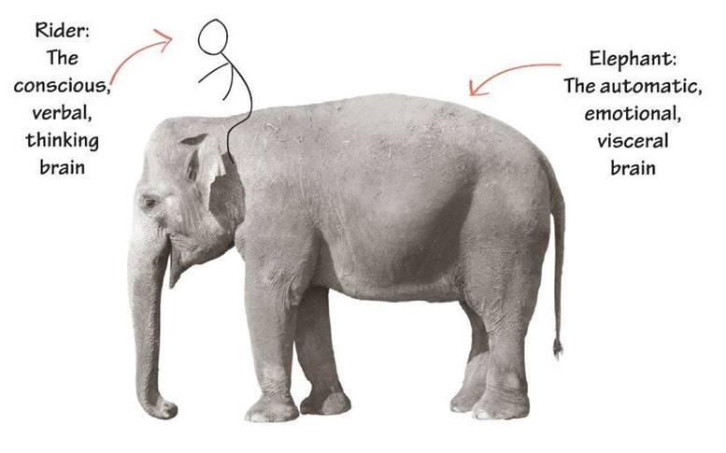
Developing “Brain Friendly” Vaccine Science Content
Brain Friendly health education content for communities MUST reduce defensiveness and emotionally resonate to motivate individuals to consider and act on information
Brain Friendly health science content
needs to “tame the Elephant”
Feature “relatable” real humans
Feature positive emotional content (hope)
Acknowledge risks (negative affect)
Use calming color schemes
Use inclusive language “we”
Avoid highlighting extremely aversive cues
Avoid unintended political cues
Avoid “red” or similar color schemes
Avoid “directive” or “loss-frame” content

Slide 15
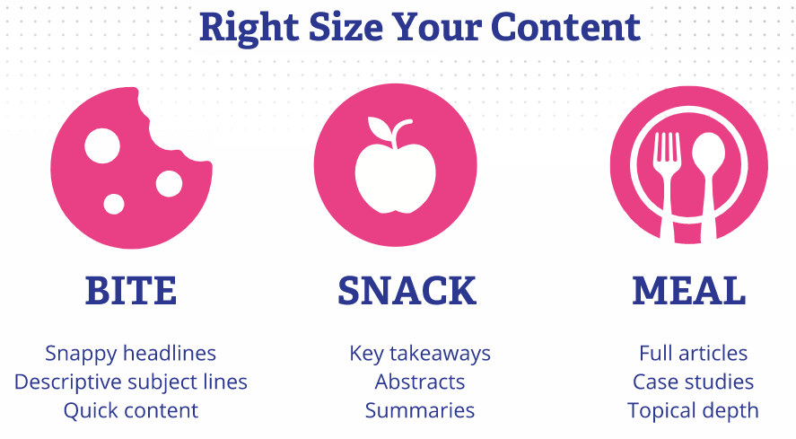
Bite-snack-meal for content design

Slide 16
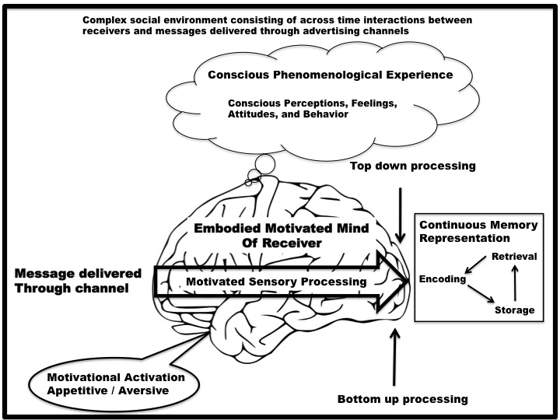
The Human Mind “on” Health Science Content
Pre-existing attitudes
Political/Cultural ID
Risk Assessments
Health Experiences
Limited Cognitive
Capacity
Health Science
Raw Appetitive and Aversive Emotional
Responses

Slide 17
Let’s do Brain Friendly Health Communication…
Effectively engage, educate, and empower audience for wellness and healthy living

Slide 18
Applied Neuromarketing Science Case Study
Di Mu
Doctoral Candidate
Research Associate at Murrow Media Mind Lab

Slide 19

Notes:
Script: "Thank you for watching and learning with us today. Again, we'd like to thank the EXCITE Foundation, through its Interagency Agreement with the USDA National Institute of Food and Agriculture, and the Centers for Disease Control and Prevention, for funding this project. We hope this toolkit is helpful to you and your communities."

