Slide 1



GETTING TO THE HEART AND MIND OF THE MATTER:
A Toolkit to Build Confidence as a
Trusted Messenger of Health Information
Notes:
Hello, my name is Dr. Shawn Domgaard with the Washington State University team working in collaboration with the Extension Collaborative on Immunization Teaching and Engagement, or EXCITE. This is one of 3 Science Media Literacy modules as part of the “Getting to the Heart and Mind of the Matter” toolkit.

Slide 2



Toolkit Workshops & Learning Modules
What is motivational interviewing
Motivational intervewing strategies
Motivational interviewing in group settings
What is science media literacy and why it matters
The science behind science media literacy
Applying the science media literacy infographic to real-world scenarios
Introduction to neuromarketing: A tool for effective health communication
Applied neuromarketing: Understanding the human brain
Applied neuromarketing: Producing brain-friendly health communication
Motivational Interviewing
Science
Media
Literacy
Neuro-
marketing
Notes:
There are many other modules for you to use to help you learn from the toolkit. You can watch any of our other videos about Motivational Interviewing, Science Media Literacy, or Neuromarketing by clicking the link to each of the modules in the description.

Slide 3
Science Media Literacy Workshop – 3 brief Modules

Slide 4
This is part 1 of a 3-part series you can view in any order
Module 1: What is science media literacy and why it matters
Module 2: The science behind science media literacy
Module 3: Applying the science media literacy infographic to real-world scenarios
What is in the Toolkit?
Brief self-guided lessons
Examples for practicing your skills
Handouts to share with others
References and sources for more information
Notes:
I’m presenting about science media literacy, and specifically this module is about what science media literacy is and why it matters. The point of this series is that we have to help people find trusted sources and trustworthy information. We are not trying to tell anybody what to think, but we want to help you find trustworthy sources and information that can help you make decisions that are best for you.

Slide 5
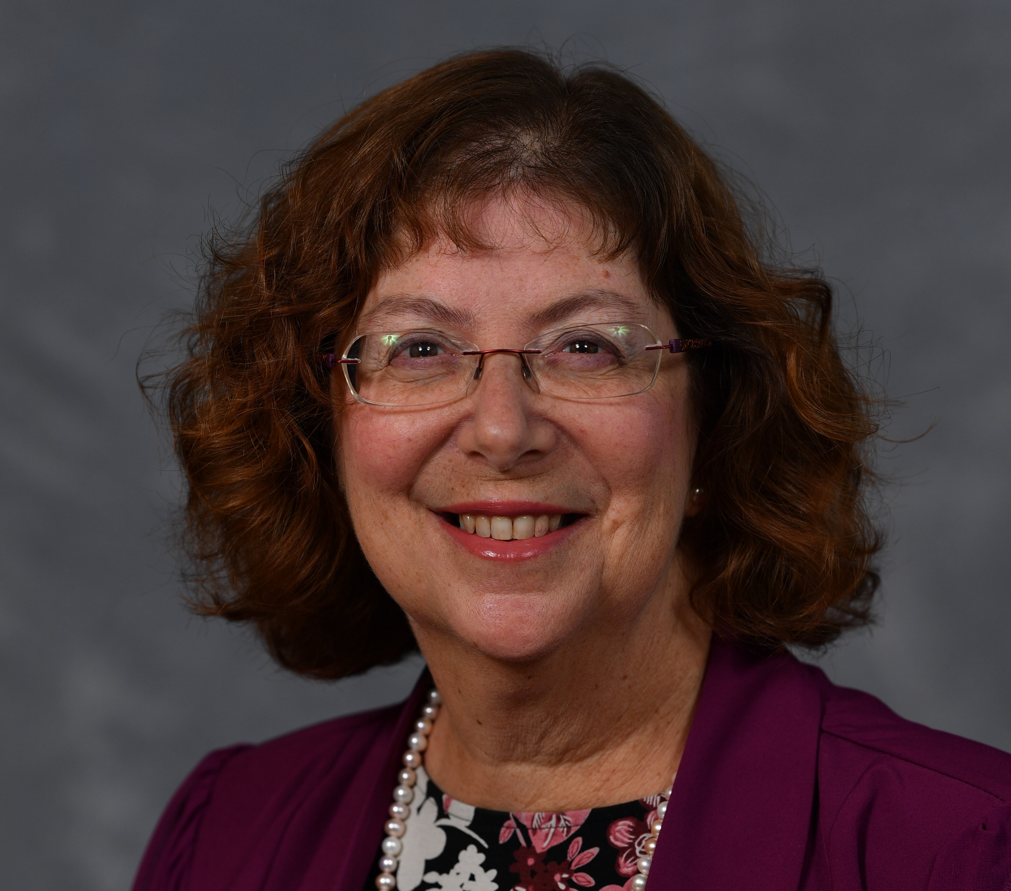

Science media literacy toolkit authors:
Erica Weintraub Austin, PhD
Director of the Edward R. Murrow Center for Media & Health Promotion Research
Shawn Domgaard, PhD
Researcher in:
Media Literacy
Health Communication
Misinformation
Notes:
The science media literacy toolkit authors are myself, Dr. Shawn Domgaard, and Dr. Erica Austin, who presents the second module in this three part series.

Slide 6
This session will help you to:
01.
Describe what science is
02.
Describe what science media literacy is
03.
Explain how science media literacy affects decision-making
04.
Learn science media literacy skills to verify information

Slide 7
What is Science?
a system of acquiring knowledge. This system uses observation and experimentation to describe and explain natural phenomena (Sciencemadesimple.com).
(knowledge from) the careful study of the structure and behavior of the physical world, especially by watching, measuring, and doing experiments, and the development of theories to describe the results of these activities…Cambridge English dictionary
an understanding of basic scientific terms, concepts, and facts; an ability to comprehend how Science & Tech generates and assesses evidence; and a capacity to distinguish science from pseudoscience have become widely used indicators of basic science literacy…National Science Foundation
FOCUSING ONLY ON FACTS AND TERMS PROVIDES A VERY LIMITED VIEW
SCIENCE STRIVES FOR EXPLANATIONS OF HOW AND WHY
Notes:
THE POINT IS THAT THERE ARE MULTIPLE ANSWERS TO THIS QUESTION. CONCENTRATING ON ACQUIRING FACTS AND TERMS PROVIDES A VERY LIIMTED VIEW. BETTER DEFINITIONS FOCUS ON THEORIES AND METHODS FOR ACQUIRING MORE DISCOVERIES THAT CONTINUES TO CHANGE.
(terms and concepts=latest result from NSF is ave get 62% of 9 long-running questions on the test) – it is a process of discovery that continues to evolve and produce updates to knowledge.
https://ncses.nsf.gov/pubs/nsb20207/data data from 2018, N=1175.
Questions used to calculate the NSF average factual knowledge measure
The center of the Earth is very hot. (True) =86
The continents on which we live have been moving their locations for millions of years and will continue to move in the future. (True) = 79
Does the Earth go around the Sun, or does the Sun go around the Earth? (Earth around Sun) = 72
All radioactivity is man-made. (False)= 68
Electrons are smaller than atoms. (True) = 46
Lasers work by focusing sound waves. (False) = 44
The universe began with a huge explosion. (True) = 38
It is the father's gene that decides whether the baby is a boy or a girl. (True) = 59
Antibiotics kill viruses as well as bacteria. (False) = 50
Human beings, as we know them today, developed from earlier species of animals. (True) = 49

Slide 8
Science literacy? Critical thinking?
"Scientific literacy is the knowledge and understanding of scientific concepts and processes required for personal decision making, participation in civic and cultural affairs, and economic productivity.“…The National Science Education Standards
"Scientific literacy means that a person can ask, find, or determine answers to questions derived from curiosity about everyday experiences. It means that a person has the ability to describe, explain, and predict natural phenomena.“… National Academies
Notes:
The key is openness to new information; alternative solutions; curiosity And ability to assess evidence.

Slide 9
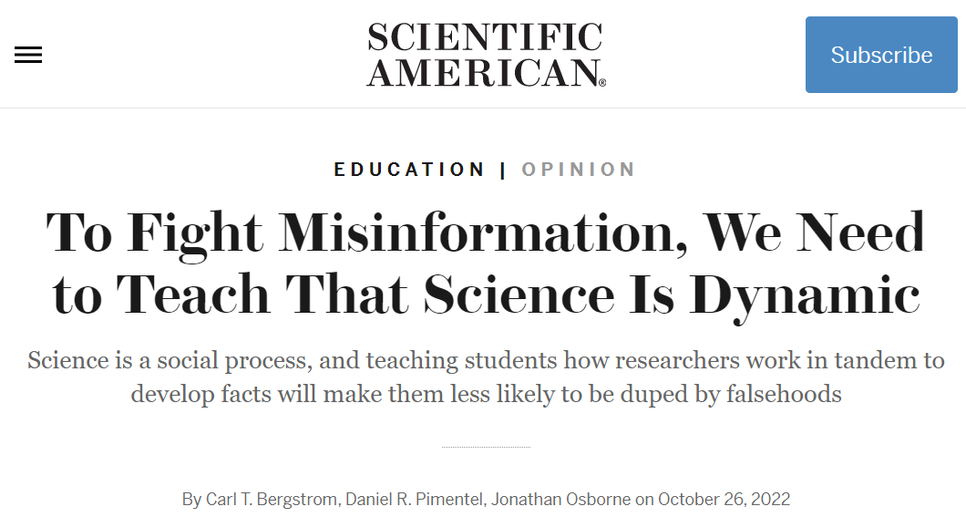
Scientific understanding as a “competent outsider” requires:
Uncertainty: Scientists deal with unsettled questions, and so one set of results from a single study is not seen as a definitive answer, but a step in supporting certain hypothesized answers over others.
Peer Review: Scientists review claims from other experts to determine if they are valid and rigorous enough to enter the ongoing scientific conversation through publication. This makes published answers credible but not definitive.
Expertise: It is important to question how a person became a credible source for their scientific knowledge and whether their employer or sponsor may bias their findings in some way, such as by making the product they are testing.
Consensus: Multiple observations and interpretations of data that have been considered and tested can lead a majority of scientists to agree on a most likely explanation. Total agreement is rare, but scientific claims with broad support from the scientific community are considered a credible way to guide understanding of the world.
Deliberate creation of doubt: It is important to unmask attempts to undermine confidence in scientific findings for political or gain or profit.
Page 57 of the Toolkit

Slide 10
Science is a process.

Slide 11
How is science communicated?
How do we know when we can trust a scientific source?

Slide 12

Science Media Literacy
Science Media Literacy is about applying media literacy to science information. Thus, science media literacy principles can be summarized as follows:
All media messages that contain science information are “constructed” by people and using medium/context-specific techniques.
Media messages that contain science information are produced for particular purposes (have goals).
All media messages that contain science information contain embedded values and points of view.
People construct their own meanings from media messages that contain science information based on their skills and experiences.
Media and media messages about science can influence beliefs, attitudes, values, behaviors, and society.
Page 60 of the Toolkit

Slide 13

Media literacy can help us manage an uncertain and sometimes toxic information environment
So we need healthy skepticism…
Media literacy is the ability to access, analyze, evaluate, create, and act using media in a variety of forms.
News, social media, marketing, books, films, TikTok…
  It’s about asking questions, including about science!
Where?
Why?
When?
Who said?
What else?
How?

Slide 14
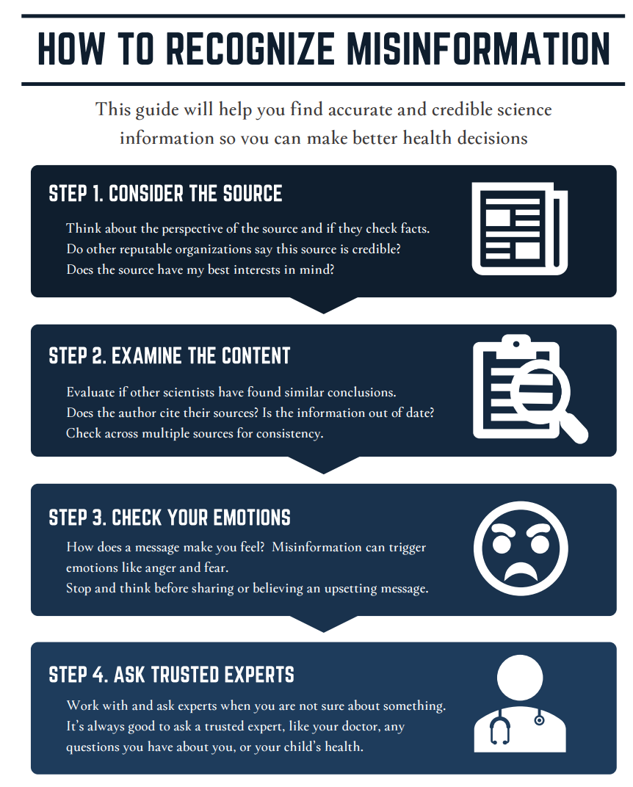
The Science Media Literacy Infographic
https://www.who.int/emergencies/diseases/novel-coronavirus-2019/advice-for-public/myth-busters

Slide 15

Notes:
Script: "Thank you for watching and learning with us today. Again, I’d like to thank the EXCITE Foundation, through its Interagency Agreement with the USDA National Institute of Food and Agriculture, and the Centers for Disease Control and Prevention, for funding this project. We hope this toolkit is helpful to you and your communities. Thank you and take care!"

