Slide 1



GETTING TO THE HEART AND MIND OF THE MATTER:
A Toolkit to Build Confidence as a
Trusted Messenger of Health Information
Notes:
Hello, my name is Dr. Shawn Domgaard with the Washington State University team working in collaboration with the Extension Collaborative on Immunization Teaching and Engagement, or EXCITE. This is one of 3 Science Media Literacy modules as part of the “Getting to the Heart and Mind of the Matter” toolkit.

Slide 2



Toolkit Workshops & Learning Modules
What is motivational interviewing
Motivational intervewing strategies
Motivational interviewing in group settings
What is science media literacy and why it matters
The science behind science media literacy
Applying the science media literacy infographic to real-world scenarios
Introduction to neuromarketing: A tool for effective health communication
Applied neuromarketing: Understanding the human brain
Applied neuromarketing: Producing brain-friendly health communication
Motivational Interviewing
Science
Media
Literacy
Neuro-
marketing
Notes:
There are many other modules for you to use to help you learn from the toolkit. You can watch any of our other videos about Motivational Interviewing, Science Media Literacy, or Neuromarketing by clicking the link to each of the modules in the description.

Slide 3
This is part 1 of a 3-part series you can view in any order
Module 1: What is science media literacy and why it matters
Module 2: The science behind science media literacy
Module 3: Applying the science media literacy infographic to real-world scenarios
What is in the Toolkit?
Brief self-guided lessons
Examples for practicing your skills
Handouts to share with others
References and sources for more information
Notes:
I’m presenting about science media literacy, and specifically this module is about applying the science media literacy infographic to real-world scenarios. The point of this series is that we have to help people find trusted sources and trustworthy information. We are not trying to tell anybody what to think, but we want to help you find trustworthy sources and information that can help you make decisions that are best for you.

Slide 4


Science media literacy toolkit authors:
Erica Weintraub Austin, PhD
Director of the Edward R. Murrow Center for Media & Health Promotion Research
Shawn Domgaard, PhD
Researcher in:
Media Literacy
Health Communication
Misinformation
Notes:
The science media literacy toolkit authors are myself, Dr. Shawn Domgaard, and Dr. Erica Weintraub Austin, who presents the second module in this three part series.

Slide 5
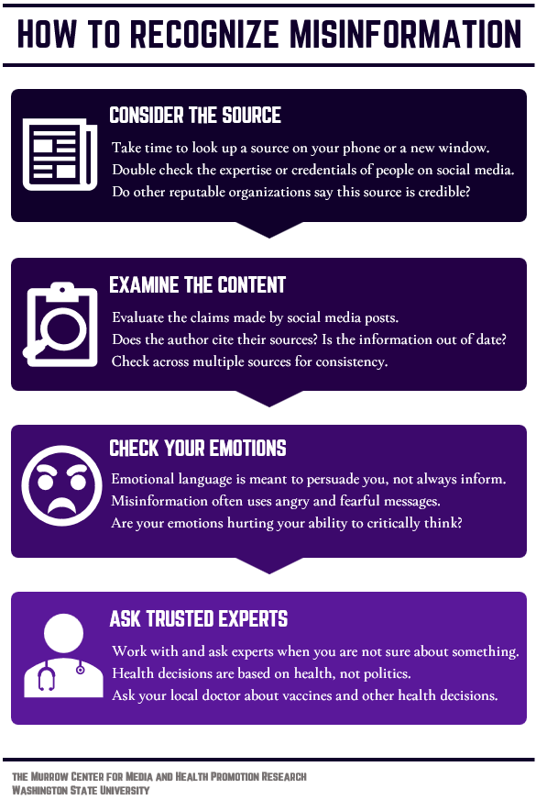
The Science Media Literacy Infographic
https://www.who.int/emergencies/diseases/novel-coronavirus-2019/advice-for-public/myth-busters

Slide 6

Notes:
Script: "Thank you for watching and learning with us today. Again, I’d like to thank the EXCITE Foundation, through its Interagency Agreement with the USDA National Institute of Food and Agriculture, and the Centers for Disease Control and Prevention, for funding this project. We hope this toolkit is helpful to you and your communities. Thank you and take care!"

