Slide 1
Impact and Future of
Stay Strong, Stay Healthy
Flexibility
April 17, 2019
Presented By:
Steve Ball, PhD, Professor, University of Missouri
Kelsey Weitzel, M.S., Associate Extension Professor, University of Missouri

Slide 2
Overview
Introduction
History
Research
Future Directions

Slide 3
History
SSSH-1, established in 2005
SSSH-2, established in 2014
Publications of positive results
Adopting organizations (MO, KS, NV, TN, OK)
SNAP-Ed Toolkit
Over 20,000 participants
Goal: Help more people!
Notes:
ADL’s=activities of daily living
SSSH is based on the results of extensive scientific strengthen training research studies.
33% of those 65 years + will fall annually
Major reason for nursing home admission/in-home care
Are more likely to develop osteoporosis
Affects 55% of those 50 year +
Those enrolled in a fall-prevention exercise program experience fewer falls and improved cognitive function
Dementia is a major reason for nursing home admission/in-home care
Healthy People 2010/2020 report indicates:
only 14% of those 45-64
10% of those 65-74
7% of those 75+
…are involved in exercise that enhances/maintains muscle
strength/endurance

Slide 4
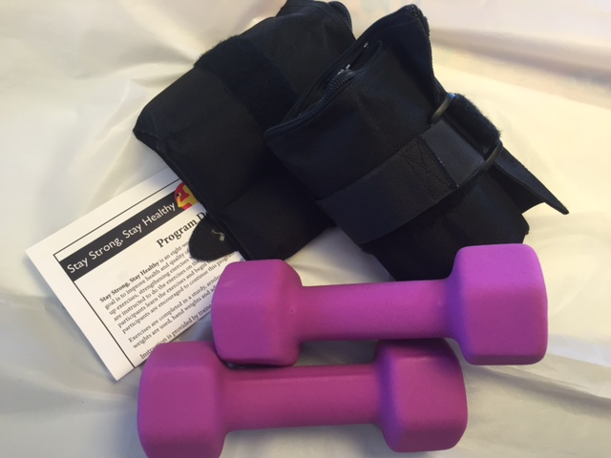
Program Details
8 weeks,16 classes (1 hour) 2x/week
Hand & ankle weights provided
Pre/post fitness assessments & surveys
Led by certified instructor
Affordable and accessible
Notes:
Steve
Stay Strong, Stay Healthy is an evidence based eight-week exercise program for older adults that meets the recommendation for healthy muscle strengthening activities. Over the eight weeks, participants learn the exercises and begin to improve strength and balance. After eight weeks, participants are encouraged to continue this program at home or with a community group.
Signature program that meets the misson of the land grant university

Slide 5
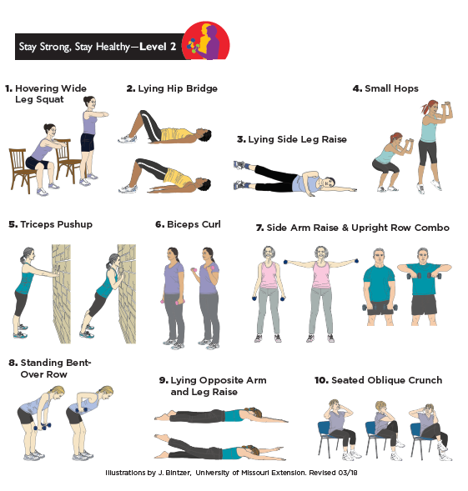
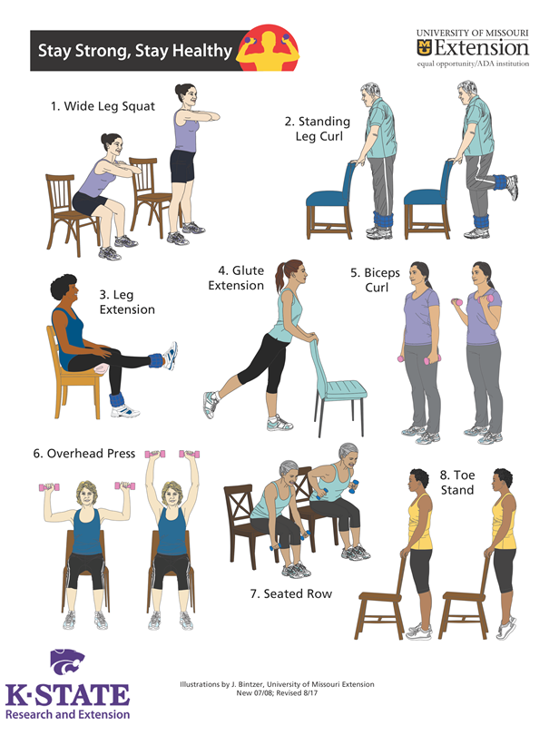
Notes:
Ask someone from audience to lead a cardio warmup?
Those with signed consent forms
Demo Class
Warm Up
Scarves
Chair hamstring stretch
Deltoid Stretch
3 Exercises
Wide leg squat
Glute Extension
Overhead Press
Cool Down
calf stretch
zipper stretch
Breathing

Slide 6
Current Body Evidence
Ball S.D., Miller K., Weitzel K.J., & Baker B.S. (2023) How to Build and Sustain a Transdisciplinary Community-based Exercise Program for Older Adults. Accepted at the Journal of Extension
Spokely N.J., Weitzel K.J., Novaes Oliveira M., Miller K., Ball S.D., and Baker B.S. (2023) Improving Older Adults’ Functional Health Using the Progressive Stay Strong, Stay Healthy Program. Accepted Journal of Applied Gerontology
Royse L.A., Baker B.S., Warne-Griggs M.D., Miller K., Weitzel K.J., Ball S.D., and Duren D.L. (2023) “It’s Not Time for Us to Sit Down Yet”: How Group Exercise Programs Can Motivate Physical Activity and Overcome Barriers in Inactive Older Adults. International Journal of Qualitative Studies on Health and Well-being. 18:1, DOI: 10.1080/17482631.2023.2216034
Miller K., Weitzel K.J., Bliss R.A., Duren D.L., Ball S.D., and Baker, B.S. (2023) Eight weeks of resistance training sparks previously sedentary older adults to adopt long-term positive exercise habits despite COVID-19 restrictions. Journal of Sports Sciences. DOI:10.1080/02640414.2022.2140912
Abreu, E. L., Vance, A., Cheng, A.-L., & Brotto, M. (2022). Musculoskeletal biomarkers response to exercise in older adults. Frontiers in Aging, 3. DOI:10.3389/fragi.2022.867137
Syed-Abdul, M., McClellan, C., Parks, E., Ball, S. (2022). Effects of a resistance training community program in older adults. Ageing & Society, 42(8), 1863-1878. DOI:10.1017/S144686X2001786
Baker, B.S., Syed-Abdul, M.M., Weitzel, K.J., & Ball, S.D. (2021) Acute Resistance Training May Have Lasting Benefit to Middle-Aged Adults. Gerontology and Geriatric Medicine, 7:1-5 DOI: 10.1177/23337214211022592
Baker, B.S., Miller K., Weitzel, K.J., Duren, D.L., and Ball, S.D. (2021) Resistance Training in Older Adults Reduces Age- and Geography-Related Physical Function Discrepancies. Gerontology and Geriatric Medicine, 7:1-9. DOI: 10.1177/2333721421992251
Baker, B.S., Weitzel, K.J., Miller, K, Royse, L.A., Guess, T.M., Ball, S.D., and Duren, D.L. (2021) Efficacy of an Eight-week Resistance Training Program in Older Adults: A Randomized Controlled Trial. Journal of Aging and Physical Activity. 29(1):121-129 DOI:10.1123/japa.2020-0078
Crowe, E. M., & Ball S. D. (2015). Effectiveness of advanced Stay Strong, Stay Healthy in community settings. Gerontology and Geriatric Medicine, 3(1).
Abreu, E. L., Cheng, A.-L., Kelly, P. J., Chertoff, K., Brotto, L., Griffith, E., et al. (2014). Skeletal Muscle Troponin as a Novel Biomarker to Enhance Assessment of the Impact of Strength Training on Fall Prevention in the Older Adults. Nurs. Res. 63(2), 75–82. DOI:10.1097/NNR.0000000000000018
Ball, S. D., Gammon, R., Kelly, P. J., Cheng, A., Chertoff, K., Kaume L., Abreu, E. L., & Brotto, M. (2013) Outcomes of Stay Strong Stay Healthy in Community Settings. Journal of Aging and Health, 25(8), 1388–1397.

Slide 7
Ball S.D., Miller K., Weitzel K.J., & Baker B.S. (2023) How to Build and Sustain a Transdisciplinary Community-based Exercise Program for Older Adults. Accepted at the Journal of Extension
Spokely N.J., Weitzel K.J., Novaes Oliveira M., Miller K., Ball S.D., and Baker B.S. (2023) Improving Older Adults’ Functional Health Using the Progressive Stay Strong, Stay Healthy Program. Accepted Journal of Applied Gerontology
Royse L.A., Baker B.S., Warne-Griggs M.D., Miller K., Weitzel K.J., Ball S.D., and Duren D.L. (2023) “It’s Not Time for Us to Sit Down Yet”: How Group Exercise Programs Can Motivate Physical Activity and Overcome Barriers in Inactive Older Adults. International Journal of Qualitative Studies on Health and Well-being. 18:1, DOI: 10.1080/17482631.2023.2216034
Miller K., Weitzel K.J., Bliss R.A., Duren D.L., Ball S.D., and Baker, B.S. (2023) Eight weeks of resistance training sparks previously sedentary older adults to adopt long-term positive exercise habits despite COVID-19 restrictions. Journal of Sports Sciences. DOI:10.1080/02640414.2022.2140912
Abreu, E. L., Vance, A., Cheng, A.-L., & Brotto, M. (2022). Musculoskeletal biomarkers response to exercise in older adults. Frontiers in Aging, 3. DOI:10.3389/fragi.2022.867137
Syed-Abdul, M., McClellan, C., Parks, E., Ball, S. (2022). Effects of a resistance training community program in older adults. Ageing & Society, 42(8), 1863-1878. DOI:10.1017/S144686X200178
Baker, B.S., Syed-Abdul, M.M., Weitzel, K.J., & Ball, S.D. (2021) Acute Resistance Training May Have Lasting Benefit to Middle-Aged Adults. Gerontology and Geriatric Medicine, 7:1-5 DOI: 10.1177/23337214211022592
Baker, B.S., Miller K., Weitzel, K.J., Duren, D.L., and Ball, S.D. (2021) Resistance Training in Older Adults Reduces Age- and Geography-Related Physical Function Discrepancies. Gerontology and Geriatric Medicine, 7:1-9. DOI: 10.1177/2333721421992251
Baker, B.S., Weitzel, K.J., Miller, K, Royse, L.A., Guess, T.M., Ball, S.D., and Duren, D.L. (2021) Efficacy of an Eight-week Resistance Training Program in Older Adults: A Randomized Controlled Trial. Journal of Aging and Physical Activity. 29(1):121-129 DOI:10.1123/japa.2020-0078
Crowe, E. M., & Ball S. D. (2015). Effectiveness of advanced Stay Strong, Stay Healthy in community settings. Gerontology and Geriatric Medicine, 3(1).
Abreu, E. L., Cheng, A.-L., Kelly, P. J., Chertoff, K., Brotto, L., Griffith, E., et al. (2014). Skeletal Muscle Troponin as a Novel Biomarker to Enhance Assessment of the Impact of Strength Training on Fall Prevention in the Older Adults. Nurs. Res. 63(2), 75–82. DOI:10.1097/NNR.0000000000000018
Ball, S. D., Gammon, R., Kelly, P. J., Cheng, A., Chertoff, K., Kaume L., Abreu, E. L., & Brotto, M. (2013) Outcomes of Stay Strong Stay Healthy in Community Settings. Journal of Aging and Health, 25(8), 1388–1397.

Slide 8
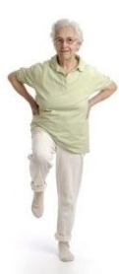
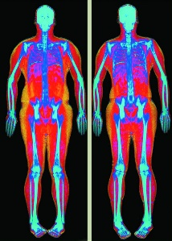
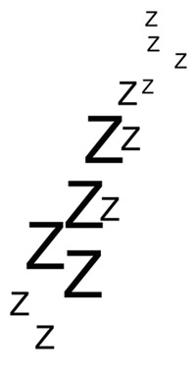
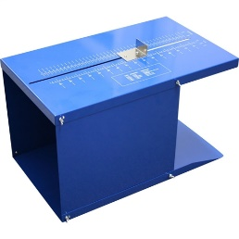
Research Design
Pre-Intervention
Assessments
Post-Intervention
Assessments
SSSH
N=15
8 weeks of
intervention
Total
N=44
Walking N=17
Publish results
Qual
Study
Control N=14
NO CHANGE
Notes:
Kelsey Talk about RCT:
Single Blind
An active control population allows differentiation of the effects of exercise in general versus the effects of a specific exercise intervention such as SSSH.
SSSH
Recruitment strategies:
Did balance assessments at senior living facilities over lunch hours. Made announcements at places where seniors gather. Incentives free DXA, Free SSSH class at the end of the study, and 100 dollars.
After all 60 people had signed consent forms we had an outside individual complete randomization and students helped call and set up appointments
Appointments from 6AM to 12PM, volunteer students to help escort people from parking lot to gwynn to mckee.
The participants were very happy to have a DXA and learn about their results.
Assessments: DXA, Cognition, Sleep, balance, flexibility, and strength

Slide 9
Significant Findings
Overall, twice-weekly participation in eight weeks of the SSSH resistance training program significantly improved:
Lower body strength/coordination
Dynamic balance
Sleep quality
Engagement in auxiliary PA
All improved to a significantly greater extent than an exercise duration matched walking group and control group
Notes:
Measured with 30s STS, TUG, Sit and Reach, Back Scratch, 10 MWT, PSQI
SSSH
Significantly improved
sit to stand performance, upper and lower body flexibility, sleep scores, auxiliary physical activity
Interestingly, dynamic balance and coordination tasks (30STS and TUG) improved while static balances tasks (CDC) did not consistently change in this study
Most falls/trips occur during dynamic movements, CDC sensitivity
Walking
Slight improvement in sit to stand
No improvement
Sleep scores, auxiliary physical activity
Lost upper body flexibility
Control
Sleep scores declined
No improvement or slight decline
physical performance assessments, auxiliary physical activity
No change in body composition: bone muscle or fat, grip strength, cognition

Slide 10
Current Body Evidence
Ball S.D., Miller K., Weitzel K.J., & Baker B.S. (2023) How to Build and Sustain a Transdisciplinary Community-based Exercise Program for Older Adults. Accepted at the Journal of Extension
Spokely N.J., Weitzel K.J., Novaes Oliveira M., Miller K., Ball S.D., and Baker B.S. (2023) Improving Older Adults’ Functional Health Using the Progressive Stay Strong, Stay Healthy Program. Accepted Journal of Applied Gerontology
Royse L.A., Baker B.S., Warne-Griggs M.D., Miller K., Weitzel K.J., Ball S.D., and Duren D.L. (2023) “It’s Not Time for Us to Sit Down Yet”: How Group Exercise Programs Can Motivate Physical Activity and Overcome Barriers in Inactive Older Adults. International Journal of Qualitative Studies on Health and Well-being. 18:1, DOI: 10.1080/17482631.2023.2216034
Miller K., Weitzel K.J., Bliss R.A., Duren D.L., Ball S.D., and Baker, B.S. (2023) Eight weeks of resistance training sparks previously sedentary older adults to adopt long-term positive exercise habits despite COVID-19 restrictions. Journal of Sports Sciences. DOI:10.1080/02640414.2022.2140912
Abreu, E. L., Vance, A., Cheng, A.-L., & Brotto, M. (2022). Musculoskeletal biomarkers response to exercise in older adults. Frontiers in Aging, 3. DOI:10.3389/fragi.2022.867137
Syed-Abdul, M., McClellan, C., Parks, E., Ball, S. (2022). Effects of a resistance training community program in older adults. Ageing & Society, 42(8), 1863-1878. DOI:10.1017/S144686X2001786
Baker, B.S., Syed-Abdul, M.M., Weitzel, K.J., & Ball, S.D. (2021) Acute Resistance Training May Have Lasting Benefit to Middle-Aged Adults. Gerontology and Geriatric Medicine, 7:1-5 DOI: 10.1177/23337214211022592
Baker, B.S., Miller K., Weitzel, K.J., Duren, D.L., and Ball, S.D. (2021) Resistance Training in Older Adults Reduces Age- and Geography-Related Physical Function Discrepancies. Gerontology and Geriatric Medicine, 7:1-9. DOI: 10.1177/2333721421992251
Baker, B.S., Weitzel, K.J., Miller, K, Royse, L.A., Guess, T.M., Ball, S.D., and Duren, D.L. (2021) Efficacy of an Eight-week Resistance Training Program in Older Adults: A Randomized Controlled Trial. Journal of Aging and Physical Activity. 29(1):121-129 DOI:10.1123/japa.2020-0078
Crowe, E. M., & Ball S. D. (2015). Effectiveness of advanced Stay Strong, Stay Healthy in community settings. Gerontology and Geriatric Medicine, 3(1).
Abreu, E. L., Cheng, A.-L., Kelly, P. J., Chertoff, K., Brotto, L., Griffith, E., et al. (2014). Skeletal Muscle Troponin as a Novel Biomarker to Enhance Assessment of the Impact of Strength Training on Fall Prevention in the Older Adults. Nurs. Res. 63(2), 75–82. DOI:10.1097/NNR.0000000000000018
Ball, S. D., Gammon, R., Kelly, P. J., Cheng, A., Chertoff, K., Kaume L., Abreu, E. L., & Brotto, M. (2013) Outcomes of Stay Strong Stay Healthy in Community Settings. Journal of Aging and Health, 25(8), 1388–1397.

Slide 11
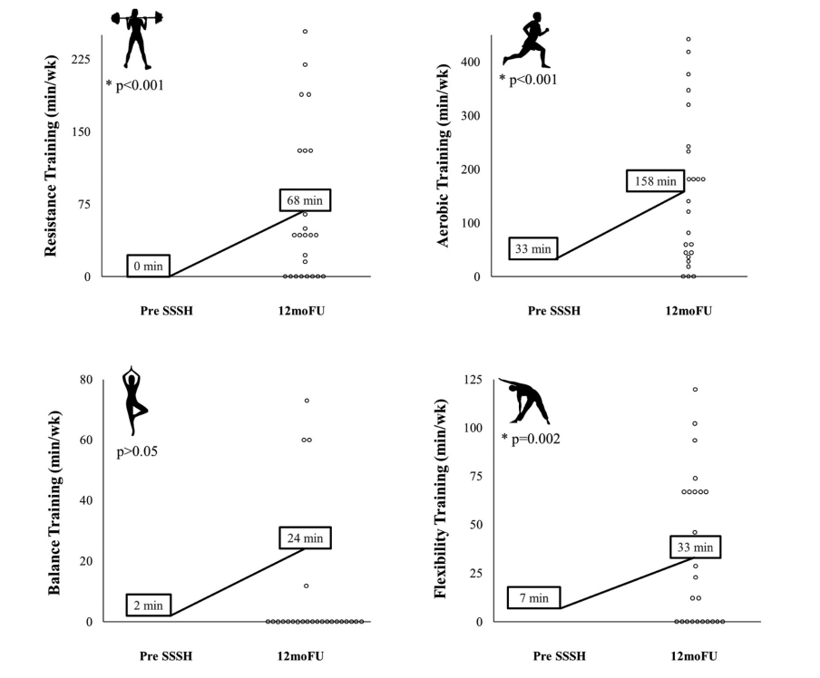
Significant Findings
12 months after SSSH 1 participation, older adults increased their participation in not just resistance training but also aerobic exercise, balance and flexibility training.
Notes:
Miller – poster # 47
We followed the original randomized controlled trial participants and had them fill out 3, 6, 9, and 12 month follow-up surveys about their exercise habits after taking their 1st SSSH class.
24 older adults completed all surveys

Slide 12
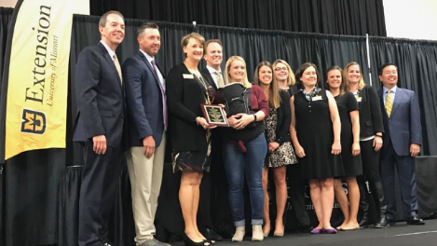
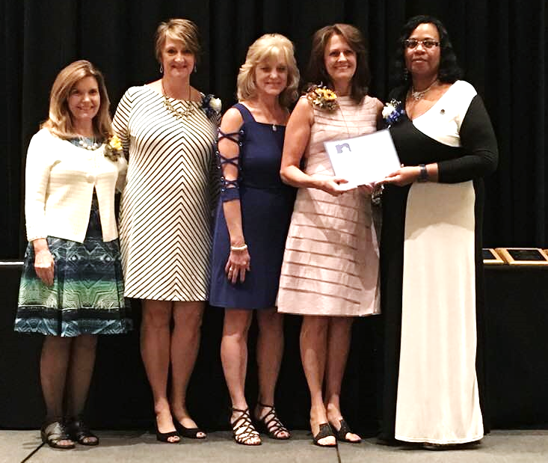
Awards
NEAFCS Multi state Collaboration Award 2018
National Health Outreach Award Priester 2009
MU Team engagement Award 2019
MOCAN Healthcare Pre-professional Student Award “Excellence in Connecting Health to Community”
Daniel Bicklein
Video
Notes:
Daniel video
Kent faddis MU EXT video from beginning.

Slide 13
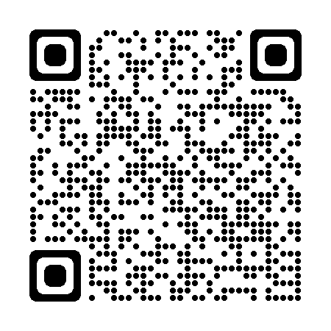
Questions? muextsssh@missouri.edu https://extension.missouri.edu/programs/stay-strong-stay-healthy/ #StayStrong

