Slide 1



MOTIVATIONAL INTERVIEWING
How to communicate confidently with anyone about adult vaccines.
Avoid unpleasant confrontations while maintaining trust and credibility.
SCIENCE MEDIA LITERACY
Skills for yourself and others about how to critically assess emerging science and counter media misinformation to increase trust in adult vaccines.
NEUROMARKETING
Creating “brain friendly” messages to optimize Extension professional confidence in adult vaccines and willingness to engage with education efforts.
Getting to The Heart and Mind of the Matter:
A Toolkit to Build Confidence as a Trusted Messenger of Health Information
Link to 3 workshops:
https://extension.zoom.us/j/87688749241
Session 1:
June 6
1:30-3:00 PM EDT
Session 2:
June 7
1:30-3:00 PM EDT
Session 3:
June 8
1:30-3:00 PM EDT
Toolkit at https://excite.extension.org/excite-resources/programmatic-resources/

Slide 2


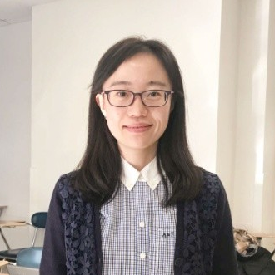
Applied Neuromarketing Science Workshop
Getting to The Heart and Mind of the Matter
Dr. Paul Bolls, Co-PI
Co-Director, Murrow Media Mind Lab
Di Mu
Graduate Research Assistant
June 8, 2023

Slide 3
Agenda for today:
Overview of the workshop (10:30 – 10:35)
Why use Neuromarketing as a “Communication Tool?” (10:35 – 10:45)
Brain truths for Brain friendly communication content (10:45 – 11:00)
  Brief reflection exercise
How can Extension Professionals apply Neuromarketing science (11:00 – 11:20)
Break and reflection (11:20 – 11:25)
Neuromarketing Science: A “Tool” for brain-friendly vaccine science education content (11:25 – 11:45)
  Brief reflection exercise
Pulling it all together: Integrating Motivational Interviewing, Science Media Literacy and Neuromarketing Science for effective vaccine science content (11:45 – 11:50)
Feedback/Evaluation (11:50 – 12:00)

Slide 4
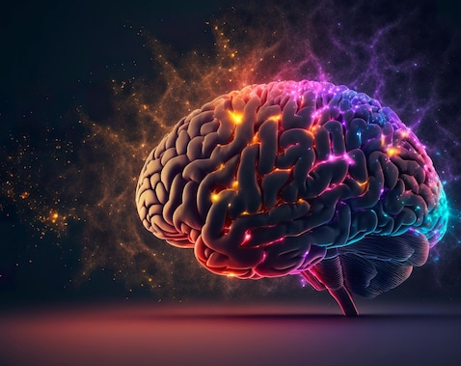
Why use Neuromarketing as a Communication Tool?
Tool Kit pages: 90-97
Neuromarketing is a scientific approach to creating and delivering effective communication content. This approach draws on brain science to gain actionable insights for creating content that resonates and works with the way human brains uniquely process and respond to information.

Slide 5
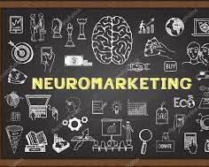
Neuromarketing Science has taken over modern marketing!
Companies are predicted to spend a total of $3.2 billion on Neuromarketing solutions by the year 2032

Slide 6


Neuromarketing is a unique tool that Extension professionals can also use to succeed at achieving communication objectives tied to their community outreach and engagement
  The science underlying Neuromarketing focuses on understanding the human brain and communication involving media content delivered over media technologies.

Slide 7
Neuromarketing science empowers professional communicators, like Extension professionals, to combine brain and communication science with their existing level of creative intuition and expertise to develop, design, and deliver communication content that more effectively and consistently achieves desired objectives

Slide 8
A scientific understanding of how the human brain processes communication requires understanding communication from the perspective of the brain and not communication industries
The human brain defines communication based on the experience that the “sensory” elements of communication content evoke

Slide 9
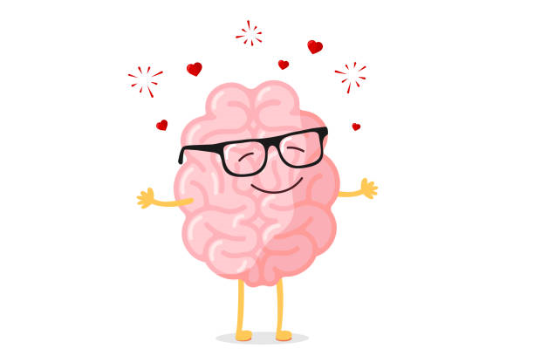
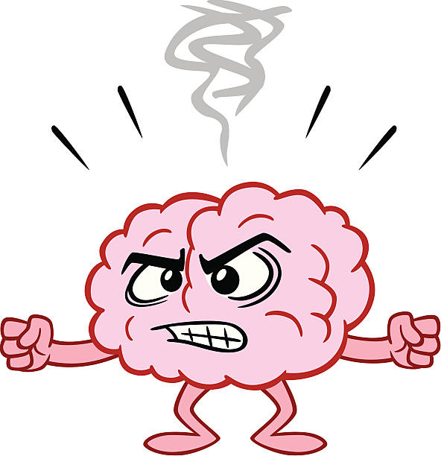
Neuromarketing Science is a “tool” for engaging AND effective communication content
BRAIN FRIENDLY CONTENT
NOT
BRAIN UNFRIENDLY CONTENT

Slide 10
Brain friendly content brings together all the “sensory” elements of communication content in a way that:
Effectively engages the audience by capturing and sustaining attention
Effectively educates the audience by structuring content to enhance memory for key “messages” in the content
Effectively empowers the audience through the presentation of accurate scientific information and an emotional tone that enhances attention and memory for the communication content

Slide 11
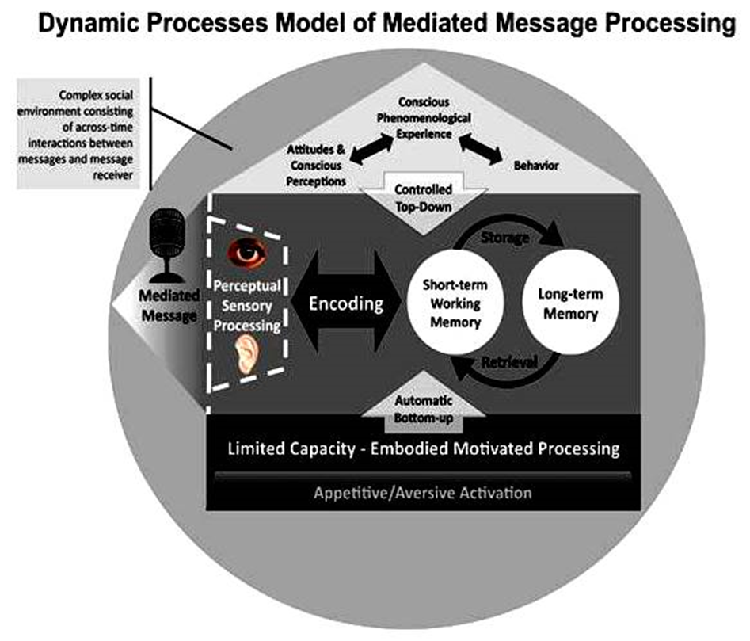

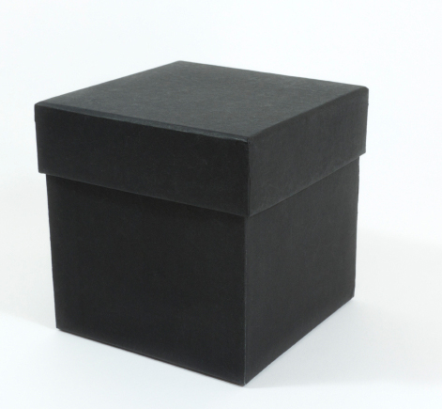
Communication efforts can fail through “ignorance” of how the human mind processes AND responds to content
The human mind does a lot of work processing communication content… most of the work is unconscious/automatic
Brain/mind treated as
black box whose
activity cannot be validly
observed
X
RESPONSE

Slide 12
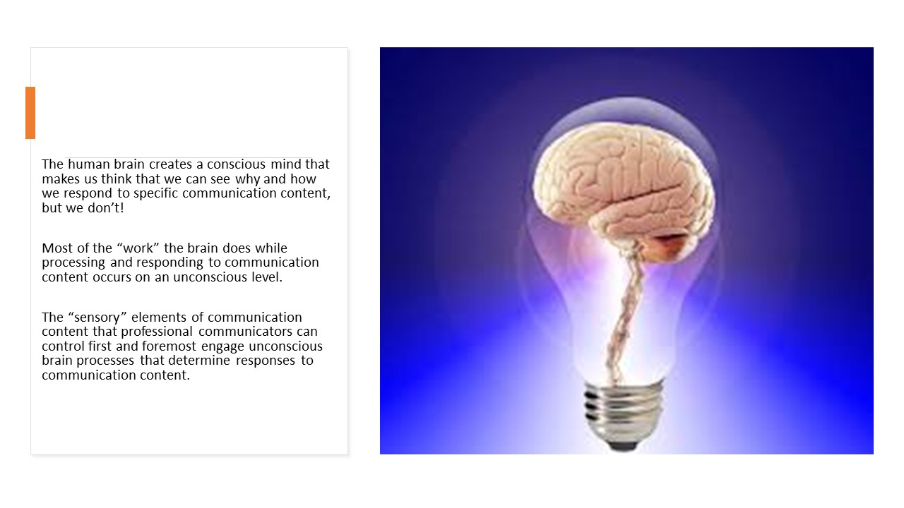

Slide 13
Brain Truths for Brain Friendly Communication Content
Tool Kit pages: 98-100
“Brain Truths” can be used to help guide creative choices concerning communication content as Extension professionals engage in the processes of developing, designing, and delivering content that is central to the mission of educational outreach intended for specific communities. The practical value of these “Brain Truths” comes from the fact that they are fundamental truths about the human brain.

Slide 14
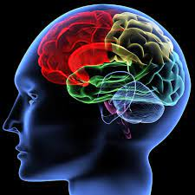
BRAIN TRUTH 1:
The brain is a limited capacity processor
The overall amounts as well as number of distinct “bits” of information in communication content can overload cognitive capacity of the targeted audience causing memory for the content to suffer

Slide 15
The brain is a limited capacity processor
The practical implication of this brain truth is that Extension professionals must focus on:
  Developing content that highlights one central message with a maximum of two or three supporting messages communicated in a clear, uncluttered manner
  Designing content to be delivered in a concise manner with as few “bits” of distinct information as possible
  Delivering content in a way that makes it as easy as possible for audience members to cognitively process (pay attention and learn) the central, most valuable information in the communication content

Slide 16
BRAIN TRUTH 2:
The brain is a contextual/cultural processor
Cultural “cues” in communication content increase the motivational relevance of the content and the context in which content is delivered determines attention and memory

Slide 17
The brain is a contextual/cultural processor
The practical implication of this brain truth is that Extension professionals must focus on:
  Developing content that is informed by expert understanding of the cultural background, emotional triggers, values, and pre-existing attitudes of the intended audience
  Designing content with sensory elements (e.g., visuals, words, colors) that resonate with the cultural background of the intended audience and in a form (layout) that focuses attention on relevant cultural cues
  Delivering content over channels/technology platforms that are culturally relevant to the intended audience and are as uncluttered as possible.

Slide 18
BRAIN TRUTH 3:
The brain is a motivated/emotional processor
Raw motivations related to approach/avoid in combination with emotional responses determine how individuals will process and respond to communication content
  These emotional processes determine how the brain will process and respond to communication content within milliseconds of exposure to the content
  Brain friendly communication content that is intended to educate community members MUST resonate with them at an emotional/motivational level

Slide 19
The brain is a motivated/emotional processor
The practical implication of this brain truth is that Extension professionals must focus on:
  Developing content that strategically includes sensory elements that explicitly connect with current emotional triggers the intended audience feels toward the subject of the content
  Designing content that strikes the best mixture of positive and negative emotional tone based on the emotional context surrounding the topic
  Delivering content over channels/technology platforms that evoke a positive user experience using sources/spokespeople that have strong, positive emotional affiliations with the intended audience

Slide 20
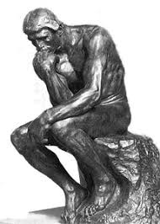
Let’s pause to reflect!
Please take 5 minutes to reflect on the following:
What is one new thing you’ve learned so far about the application of Neuromarketing Science and/or “brain truths” in developing communication content?
Can you think of a recent experience where these brain truths were ignored? How might applying these brain truths have helped develop more effective communication?

Slide 21
How can Extension Professionals apply Neuromarketing Science
Tool Kit pages: 98-100
Neuromarketing Science is a tool for Extension professionals to use to develop, design, and deliver brain friendly communication content which effectively engages, empowers, and educates community members they serve. A fundamental belief in the value of educational outreach is a component of the Extension Agent’s Creed. Brain-friendly communication content is the core of effective educational outreach.

Slide 22
Two ways that Extension Professionals can apply Neuromarketing Science
1. Extension professionals can apply an understanding of how the human brain/mind processes information to develop content that is strategically informed by brain science. This application can encompass the processes of content development, design, and delivery as well as evaluation and refinement of content.

Slide 23
Two ways that Extension Professionals can apply Neuromarketing Science
2. Extension professionals can engage with a partner to conduct applied Neuromarketing Science content testing. This involves the collection of biometric measures (eye tracking, heart rate, facial muscle activity, etc.) that directly test how individuals mentally process specific characteristics of communication content. The results of content testing are translated into actionable insights that can be used to for developing, designing, and delivering content that effectively engages, educates, and empowers community members.

Slide 24
Presenting neuromarketing project in the context of vaccine education
Notes:
No later than 11:20

Slide 25
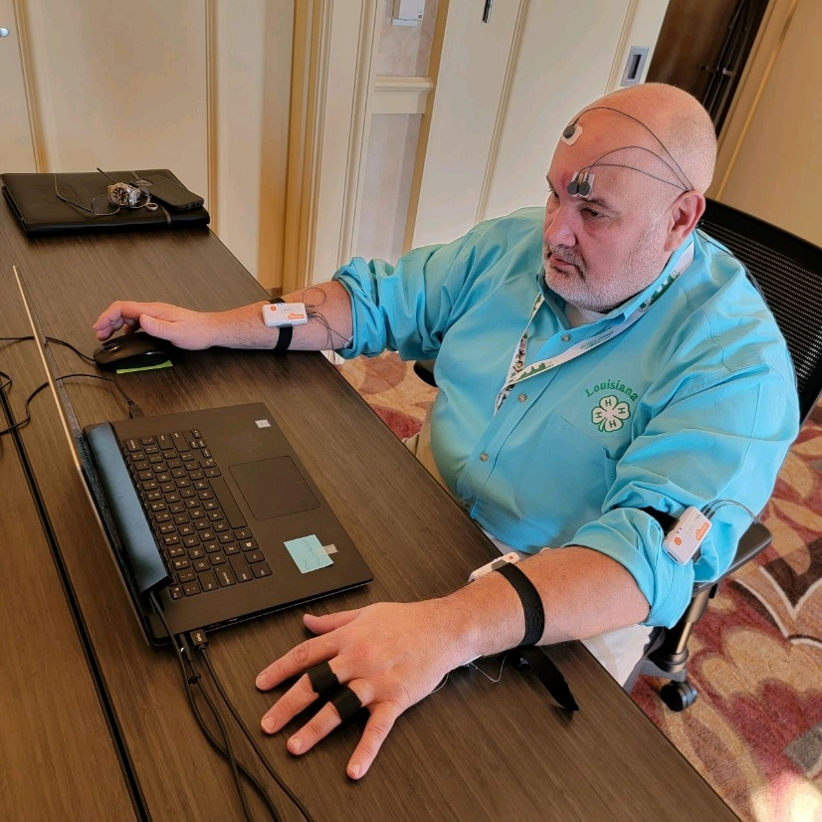


Neuromarketing-based message testing methodology
August 2022
October 2022
AEA 2022
Extension professionals participated in on-site neuromarketing testing of messages in Orlando, FL.
NAE4-HYDP 2022
Extension professionals participated in
additional neuromarketing message testing in Madison, WI.

Slide 26

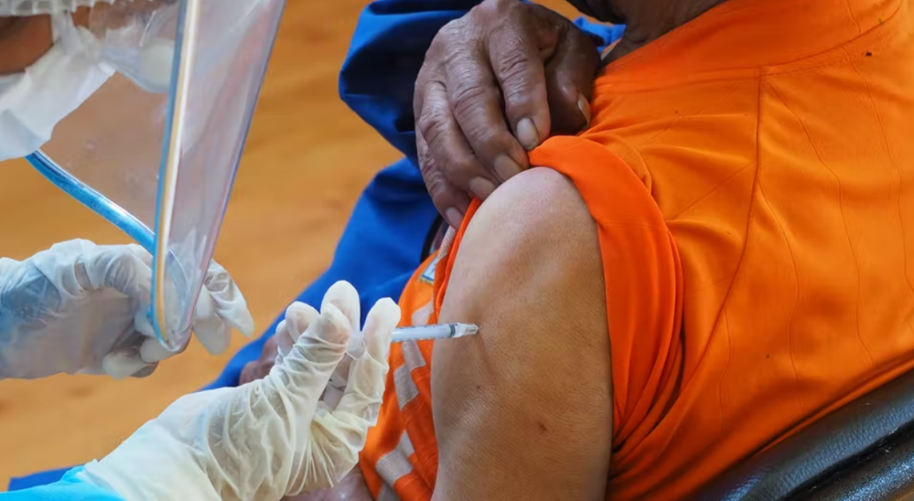
Neuromarketing-based message testing methodology
Objective: Identify visual and text content elements that are likely to effectively engage Extension Professionals in favorably responding to Extension AND Covid-19 Vaccine Messaging
Vaccine Message Content Tested
Photos depicting “vaccination”
Emotional tone (unpleasant) and Dominance of Vaccine Cue
Textual framing that ties Extension to Covid-19 Vaccine education through emotional appeal and Extension values
"Covid-19 Vaccine education fits with the mission of Extension Professionals because we believe in intellectual freedom to search for and present the truth without bias and with courteous tolerance toward the views of others."

Slide 27
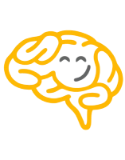
Actionable Insights
Effective vaccine education content begins with “brain friendly” visuals that:
Capture attention and elicit a mixture of positive AND negative emotional responses
Evoke positive attitudes that will enhance mental processing of text
  Positive attitudes
    Favorable
    Desirable
    Likable
    Informative

Slide 28
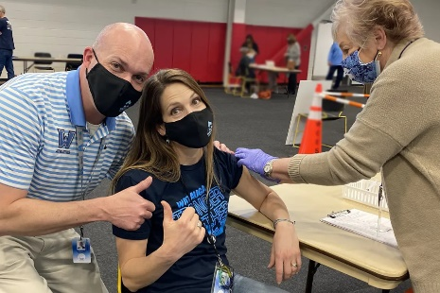
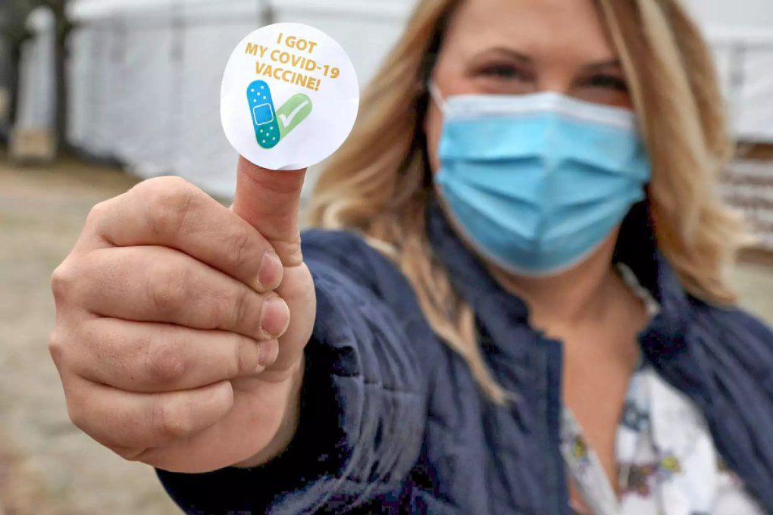
Brain Friendly Visuals
Moderately
Effective
Highly Effective
Low Aversive / Low presence of vaccination “cue”
Low Aversive / High presence of vaccination “cue”

Slide 29
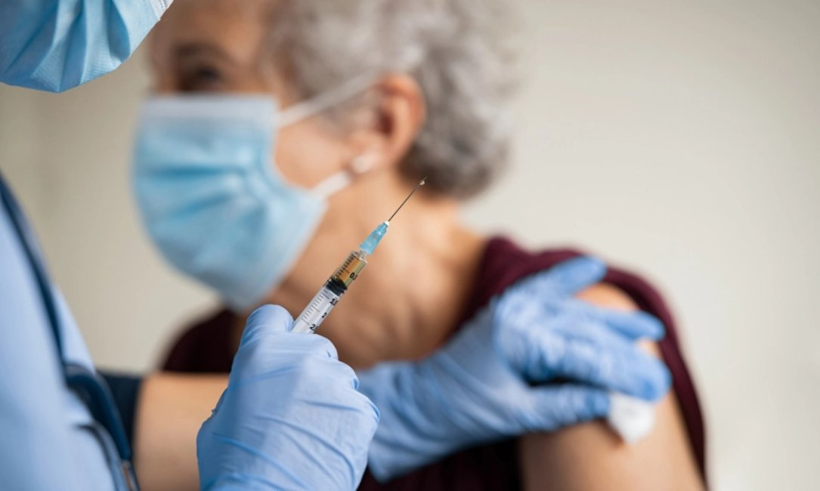
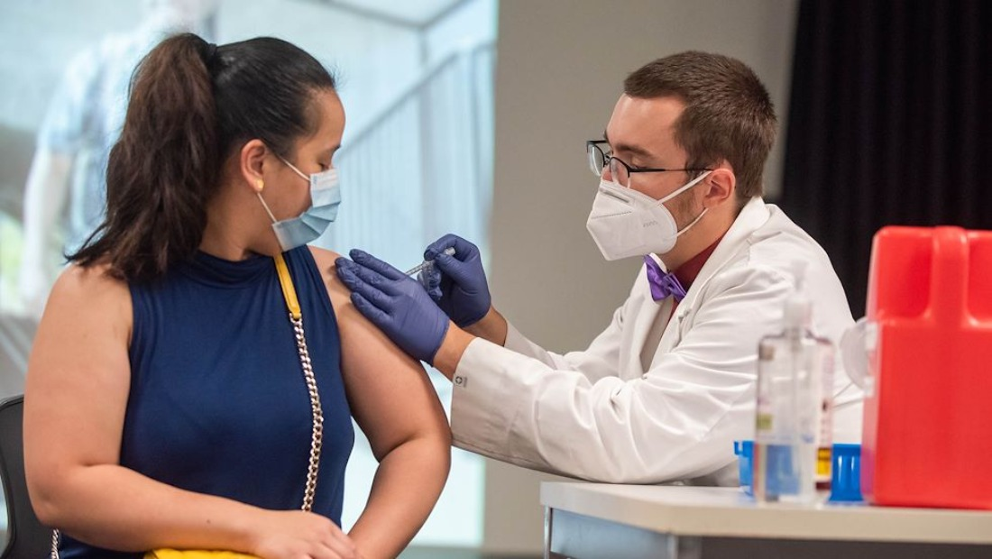
Brain Unfriendly Visuals
Double-edged sword
Avoid high aversive and high presence of vaccination “cue” content

Slide 30
Actionable Insights
What is “brain friendly” textual framing?
  Engaging attention and emotion in a way that enhances memory/learning
  Lowering negative feelings
  Increasing self-efficacy
Two primary “framing” strategies for Extension vaccine education
  Emotional frames (Gratitude; Empathy, Pride)
  Extension Value frames

Slide 31

Brain friendly “Emotional” framing
Empathy for Constituents
    Extension Professionals who are willing to engage in Covid-19 Vaccine education with their clients/constituents have the opportunity to demonstrate empathy for constituents through their work. Extension Professionals can be equipped to deliver vaccine education in ways that treat individuals who are afraid of vaccination or paranoid with respect and does not involve intimidation, humiliation, or even persuasion. Extension should avoid a “savior complex” especially in rural areas. Just share general information about vaccinations, how they work and how they are developed.

Slide 32
Brain friendly “Emotional” framing
Pride in Expertise
    Extension Professionals who are willing to engage in Covid-19 Vaccine education with their clients/constituents have the opportunity to feel pride in their expertise used to educate their community. Extension Professionals have tremendous ability to understand vaccines and the science behind them. Extension has a history of providing vaccine education to Livestock producers, youth and adults. Extension has a history of providing evidence-based education. We can be proud to engage in programs that lead to more thoughtful decision making.

Slide 33
Brain friendly “Extension Value” framing
Link between people and scientists
    Covid-19 Vaccine education fits with the mission of Extension Professionals because we believe that Extension is a link between the people and the ever-changing discoveries produced by expert scientists.

Slide 34
Brain friendly “Extension Value” framing
Believe in intellectual freedom
    Covid-19 Vaccine education fits with the mission of Extension Professionals because we believe in intellectual freedom to search for and present the truth without bias and with courteous tolerance toward the views of others.

Slide 35
Brain unfriendly framing
Covid-19 Vaccine education fits with the mission of Extension Professionals
… because education is basic in stimulating individual initiative and self-determination.
… because we believe in our own work and in the opportunity we have to make our lives and the work we do as Extension Professionals useful to humanity.

Slide 36

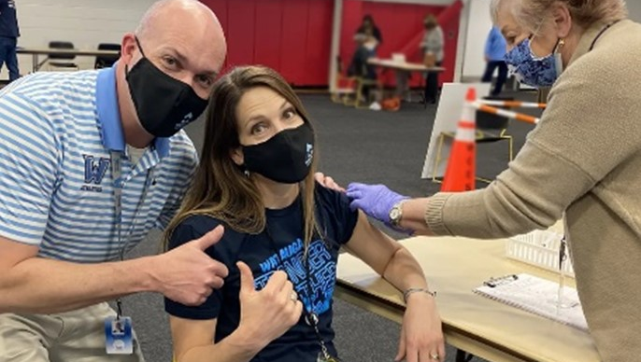
Sample Message Template Script (Creative Brief)
Communities served by Extension have a critical need for respectful science-based vaccine education. Many community members have significant concern and confusion about the benefits and risks of vaccines. Extension professionals uniquely identify with the community members we serve. We can be a critical bridge between our communities and vaccine science. We can take pride in using our expertise to understand vaccines and the science behind them to produce programs that foster thoughtful decision making and empower ourselves with scientific knowledge.
Here's some human vaccine science highlights:
(drop in three brief vaccine science information highlights)
Extension professionals are dedicated to treating individuals who are concerned about the risks of vaccination with respect, without intimidation, humiliation, or even persuasion about human vaccines. Extension vaccine education is Extension expertise and empathy, bridging science and our communities.

Slide 37
Let’s pause to break & reflect!
Please take 5 minutes to break and reflect on the following:
How might you think about applying Neuromarketing Science in your work developing communication content for community outreach and engagement?

Slide 38
Neuromarketing Science: A tool for brain friendly vaccine science education content
Tool Kit pages: 98-100
Effective” “brain friendly” vaccine science content will engage, educate, and empower individuals to make evidence-based health decisions!

Slide 39
Neuromarketing Science & Vaccine Science Content
Neuromarketing Science has a valuable role to play in producing and delivering effective vaccine science content by:
  Guiding production of “brain friendly” content
  Providing new “data based” actionable insights

Slide 40
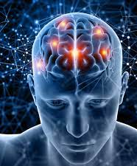

Extension professionals MUST remember that human brain characteristics ALWAYS impact how community members mentally process and attitudinally and behaviorally respond to all information.
The highly politicized and potentially emotionally explosive communication context that can still surround Covid-19, and vaccine science in general, makes processes described by the “Brain Truths” even more influential in shaping community responses to related communication content.

Slide 41
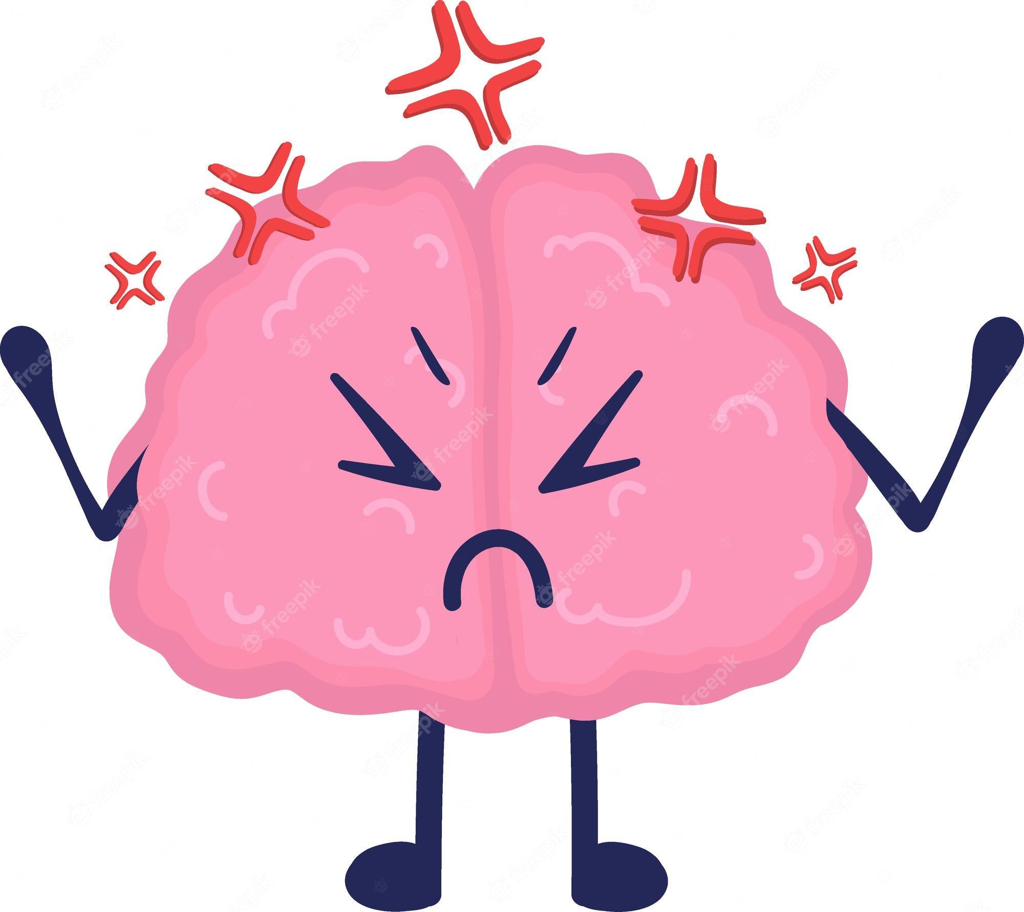
“Three brain truths” in “overdrive”
The Brain is a Motivational Emotional processor
  Vaccine Science information/misinformation is extremely emotional/political, priming “aversive/defensive” responses
The Brain is a Limited Capacity processor
  Vaccine Science information contains a lot of “bits” of changing information tied to the evolving science
The Brain is a Cultural/Contextual processor
  Cultural background and experiences creating disparities and distrust shape the communication context and filter how Vaccine Science is interpreted and responded to

Slide 42
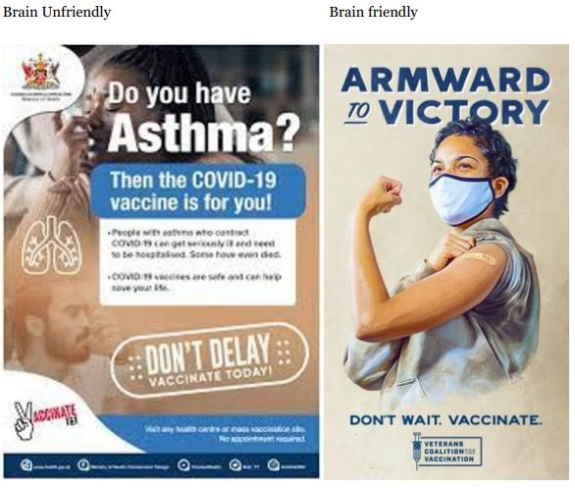
The Solution: Respect the “Three brain truths”
The Brain is a Motivational Emotional processor

Slide 43
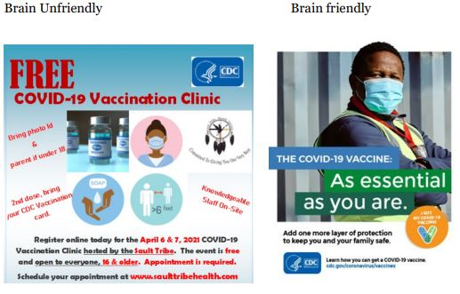
The Solution: Respect the “Three brain truths”
The Brain is a Limited Capacity processor

Slide 44
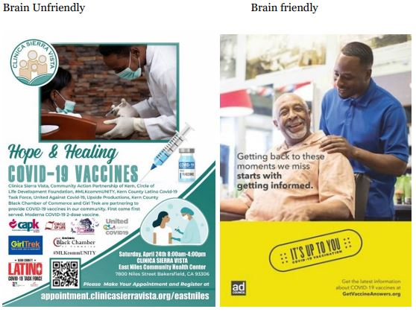
The Solution: Respect the “Three brain truths”
The Brain is a Cultural/Contextual processor

Slide 45
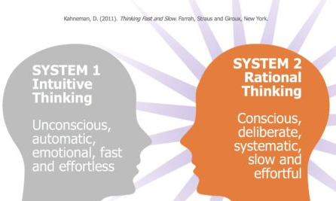
Developing “Brain Friendly” Vaccine Science Content
Brain Friendly vaccine education content will include content that engages BOTH “Intuitive” AND “Rational” thinking
Use production features to engage System 1
  Camera angle and shot length
  Color Schemes
  Font size
  Production pacing and “effects”
Use copy/content to engage System 2
  Write copy/content to highlight key points
  Write copy/content to empower
  Write copy/content to evoke feelings

Slide 46
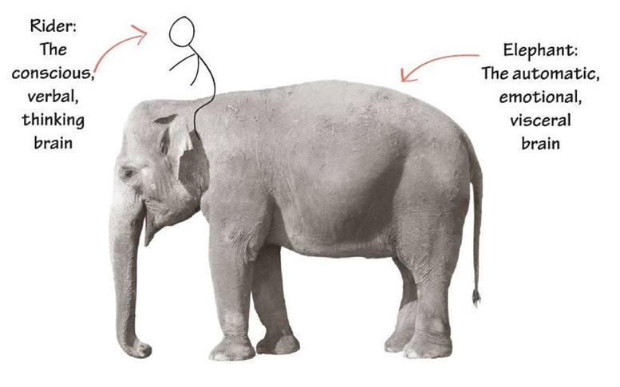
Developing “Brain Friendly” Vaccine Science Content
Brain Friendly vaccine education content for “vaccine hesitant” communities MUST reduce defensiveness and emotionally resonate to motivate individuals to consider and act on information
Brain Friendly vaccine science content
needs to “tame the Elephant”
Feature “relatable” real humans
Feature positive emotional content (hope)
Acknowledge risks (negative affect)
Use calming color schemes
Use inclusive language “we”
Avoid highlighting “vaccine” cues
Avoid unintended politicized cues
Avoid “red” or similar color schemes
Avoid “directive” or “loss-frame” content

Slide 47
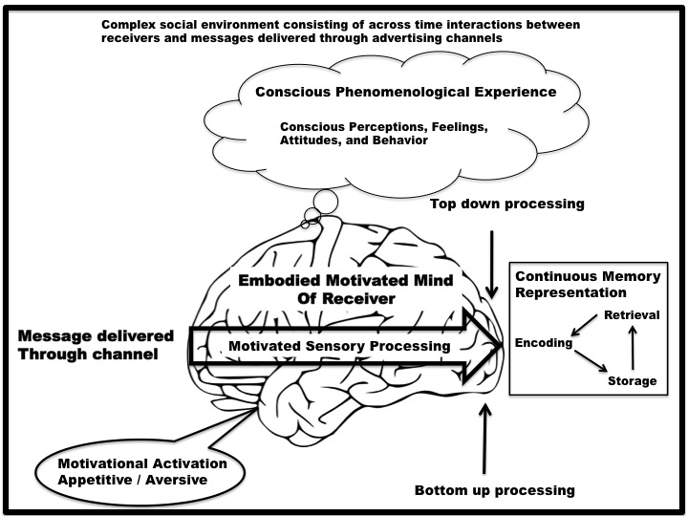
The Human Mind “on” Vaccine Science Content
Pre-existing attitudes
Political/Cultural ID
Risk Assessments
Health Experiences
Limited Cognitive
Capacity
Vaccine Science
Raw Appetitive and Aversive Emotional
Responses

Slide 48
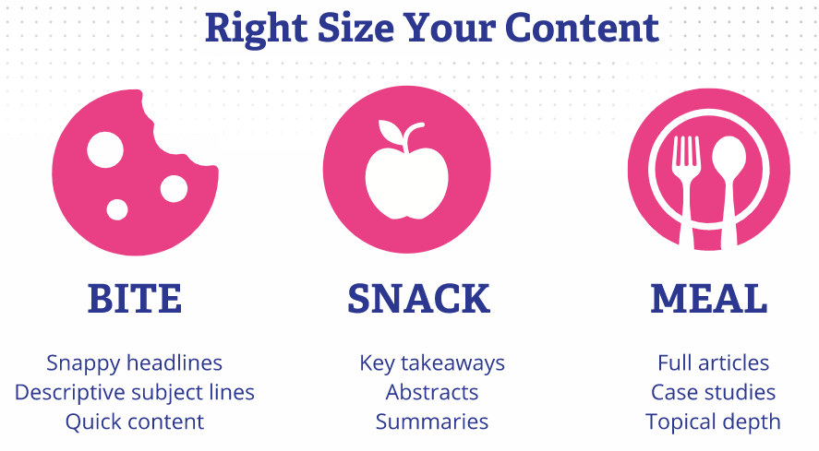
Bite-snack-meal for content design

Slide 49
Let’s pause to reflect!
Vaccine Science Communication Video
Please take 5 minutes to reflect on the following:
What appears to make this video example brain friendly?
What might make this video example brain unfriendly?
https://www.youtube.com/watch?v=4RNBeBYGU4U

Slide 50
Pulling it all together: Integrating Motivational Interviewing, Science Media Literacy, and Neuromarketing Science
Tool Kit page: 125
Neuromarketing Science, Motivational Interviewing, and Science Media Literacy provide insight into distinct but related processes in how individuals mentally process and respond to vaccine science content. These three tools can be used by Extension Professionals to develop communication content that effectively engages, educates, and empowers community members.

Slide 51
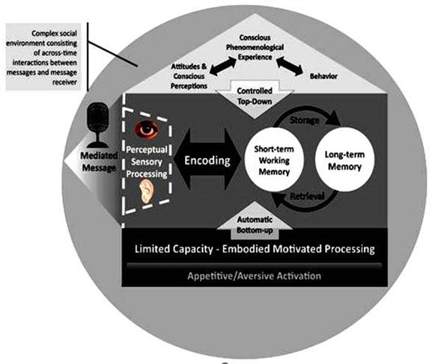
INTEGRATING NEUROMARKETING SCIENCE, MOTIVATIONAL INTERVIEWING AND SCIENCE MEDIA LITERACY
IN MENTAL PROCESSING OF VACCINE SCIENCE CONTENT
Motivational Interviewing
Science Media Literacy
Neuromarketing Science

Slide 52
Feedback/Evaluation
WSU
Thank you for coming today.
This is a reminder to fill out the evaluation of the workshops at the end of the workshop. We value your feedback!
Neuromarketing evaluation
https://wsu.co1.qualtrics.com/jfe/form/SV_a2ySFuu0Xrj1JFs
Science Media Literacy evaluation
https://wsu.co1.qualtrics.com/jfe/form/SV_5biBIH5f99JlyJg
Motivational Interviewing evaluation
https://wsu.co1.qualtrics.com/jfe/form/SV_3yHJW6TfuJmL046

