Slide 1
MOTIVATIONAL INTERVIEWING
How to communicate confidently with anyone about adult vaccines.
Avoid unpleasant confrontations while maintaining trust and credibility.
SCIENCE MEDIA LITERACY
Skills for yourself and others about how to critically assess emerging science and counter media misinformation to increase trust in adult vaccines.
NEUROMARKETING
Creating “brain friendly” messages to optimize Extension professional confidence in adult vaccines and willingness to engage with education efforts.
Getting to The Heart and Mind of the Matter:
A Toolkit to Build Confidence as a Trusted Messenger of Health Information
Link to 3 workshops:
https://extension.zoom.us/j/87688749241
Session 1:
June 6
1:30-3:30 PM EST
Session 2:
June 7
1:30-3:30 PM EST
Session 3:
June 8
1:30-3:30 PM EST
Notes:
Erica will introduce

Slide 2
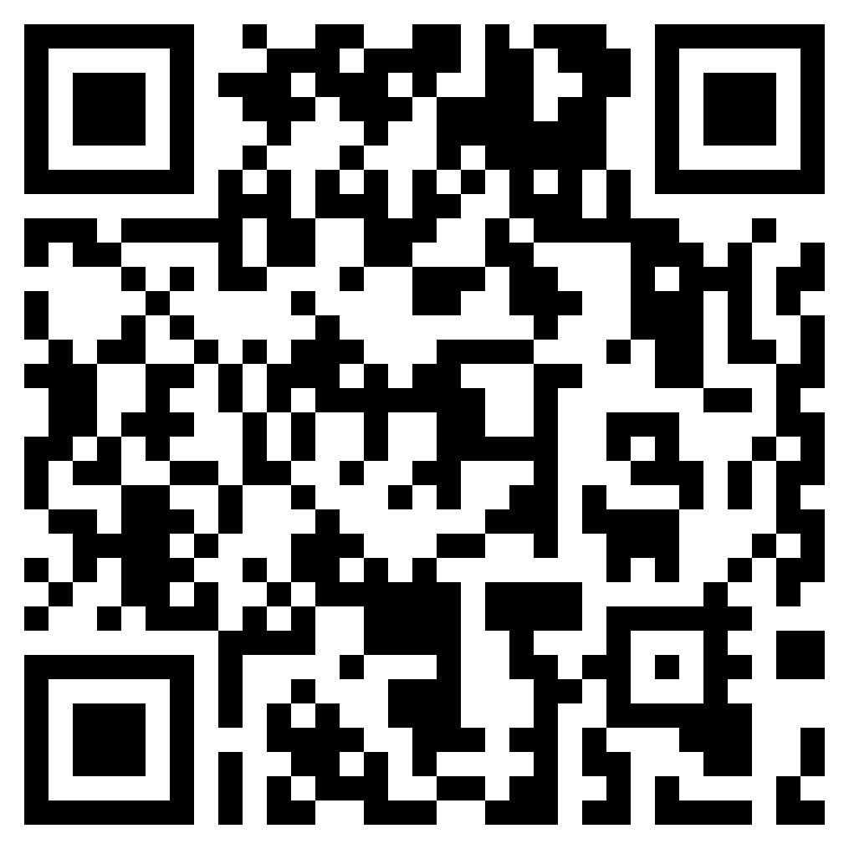
Workshop Evaluation
This is a reminder to fill out the evaluation of the workshop at the end of the workshop. We value your feedback!
https://wsu.co1.qualtrics.com/jfe/form/SV_3yHJW6TfuJmL046
Notes:
@ 80 minutes

Slide 3
Session 1: Motivational Interviewing Dr. Anya Sheftel Washington State University
How to communicate confidently with anyone about adult vaccines
Avoid unpleasant confrontations while maintaining trust & credibility

Slide 4
Agenda
A Taste of MI
What is Motivational Interviewing?
MI and Vaccine Hesitancy
Spirit of MI
Change Talk
MI Technical Skills
Strategies
Breakout practice
MI in Group Settings
Survey

Slide 5
Goal of Motivational Interviewing:
Engage a person in a conversation that evokes and reinforces their own reasons for change
(Miller & Rollnick, 2013)

Slide 6
A Taste of MI
You will observe two interactions between me and one of the facilitators
Please, note what is effective about each interaction and what is less effective.
Notes:
Need help from a facilitators
5 mins

Slide 7
A Taste of MI – Option 1
Think about a behavior change that you are ambivalent about.
For how long have you thought about this change?
Experts say that this change is important for your quality of life. What is stopping you?
Do you want to schedule an appointment with an expert to discuss this further?
Notes:
Need help from a facilitators
5 mins

Slide 8
A Taste of MI – Option 2
Think about the same behavior change.
If you were to make this change, what would your life look like in 1 year? 5 years?
How could this change support your other goals? Your values?
If you were to make this change, what could be one small step towards it?
Notes:
Need help from a facilitators
5 mins

Slide 9
A Taste of MI: Debrief
Share out in chat or by speaking:
What was the difference between the two interactions?
What worked or was effective in helping [facilitator] consider making this change?
Notes:
Need to be @ 20 minutes

Slide 10
Goal of Motivational Interviewing:
Engage a person in a guiding conversation that evokes and reinforces their own reasons for change
(Miller & Rollnick, 2013)

Slide 11
MI and Vaccine Education (p. 18)
MI has been widely in healthcare settings (Rollnick et al., 2023)
Recently, it has showed promise in decreasing vaccine hesitancy (Gagneur, 2020)

Slide 12
Partnership
Compassion
MI Spirit
(p. 20)
Acceptance
Evocation
Miller & Rollnick, 2013
Notes:
Page 20 of the Tooklike

Slide 13
Change Talk (p. 23)
Desire: I want to change
Ability: I can change
Reasons: These are my reasons for changing
Need: I need to change
Commitment: I will start engaging in a new behavior
Activation: I am considering change
Taking Steps: I will/have started to take steps towards change
Miller & Rollnick, 2013

Slide 14
Processes of MI (p. 22)
Engaging:
Get to know the person
Planning:
If appropriate, develop a plan
Focusing: Identify a collaborative focus for the conversation
Evoking:
Evoke and reinforce statements about change
Miller & Rollnick, 2013

Slide 15
MI Technical Skills (p. 25-33)
Avoid the Righting Reflex
Dance, don’t wrestle
Reflections
Reflect what the person said to you in a form of a statement
Simple reflection = simple restatement
Complex reflection = additional content (reflect meaning or feeling)
Open-ended questions
Show curiosity
Affirmations
Affirm strengths, values, goals
Miller & Rollnick, 2013
Notes:
Need to be @ 30 minutes

Slide 16
MI Strategies
Ask – Offer –Ask
(p. 34)
Assessing Readiness
(p. 37)
Miller & Rollnick, 2013

Slide 17
Ask-Offer-Ask (p. 34)
Ask the person what they already know about the topic
Reflect/affirm
Ask for permission to share more information
If yes, offer 1 piece of information
Ask how what the person thinks about this information
Demonstration and Debrief:
Keep track of effective questions and reflections. You can use page 1 of your handout.
What change talk did you hear?
How did Anya respond to the change talk?
Notes:
Need to be at 40 minutes
With Pamela

Slide 18
Assessing Vaccine Readiness (p. 36)
Ask the person on a scale 1-10 (1=not ready; 10=ready), how ready they are [insert your topic of conversation)
Ask the person why they are as high as this number and not lower
Ask the person what would help them to become a little more ready
Summarize and highlight change talk

Slide 19
Vaccine Readiness – break out groups
Complete the handout labeled Vaccine Readiness Conversation Practice
You will have 15 minutes
Debrief
Notes:
@ 65 minutes

Slide 20
MI in Group Settings (p. 44)
Have a plan
Focus on the positive
Stay in the moment
Explore perspectives
Look towards the future
Reflect and explore change talk
End the group on a positive note
Support self-efficacy
Reduce interpersonal discord
Wagner & Ingersoll, 2012
Notes:
@ 75 minutes

Slide 21
Questions?
Tip: Use the Toolkit
Notes:
5 minutes

Slide 22
Workshop Evaluation
This is a reminder to fill out the evaluation of the workshop at the end of the workshop. We value your feedback!
https://wsu.co1.qualtrics.com/jfe/form/SV_3yHJW6TfuJmL046
Notes:
@ 80 minutes

